Slide 1
Shopping is Easy in UNT System Marketplace!
Creating a Requisition from a Shopping Cart ​

Slide 2
What is the Requestor’s Role in UNT System Marketplace?
Requestors can shop for items and add them to carts.
Requestors can also submit carts that have been assigned to them by Shoppers.
Requestors are users who have knowledge of UNT System Marketplace accounting codes and Chartfields. They input those codes when submitting the requisition.
Responsibilities of a requestor include following Procurement Guidelines, bid thresholds, validating accuracy of Accounting Chartfields, Ship To information, and Business Purpose.

Slide 3
Creating a Requisition from a Shopping Cart
As a Requestor, in addition to shopping, you may also be assigned carts from individuals in your department who have the Shopper role. Shoppers cannot place orders. Shoppers can add items to a cart, and then assign the cart to a Requestor for review.

Slide 4
Creating a Requisition from a Shopping Cart
The Requestor reviews the cart and can Return the Cart to the Shopper if changes are needed. If everything is correct, the Requestor clicks Proceed to Checkout.

Slide 5
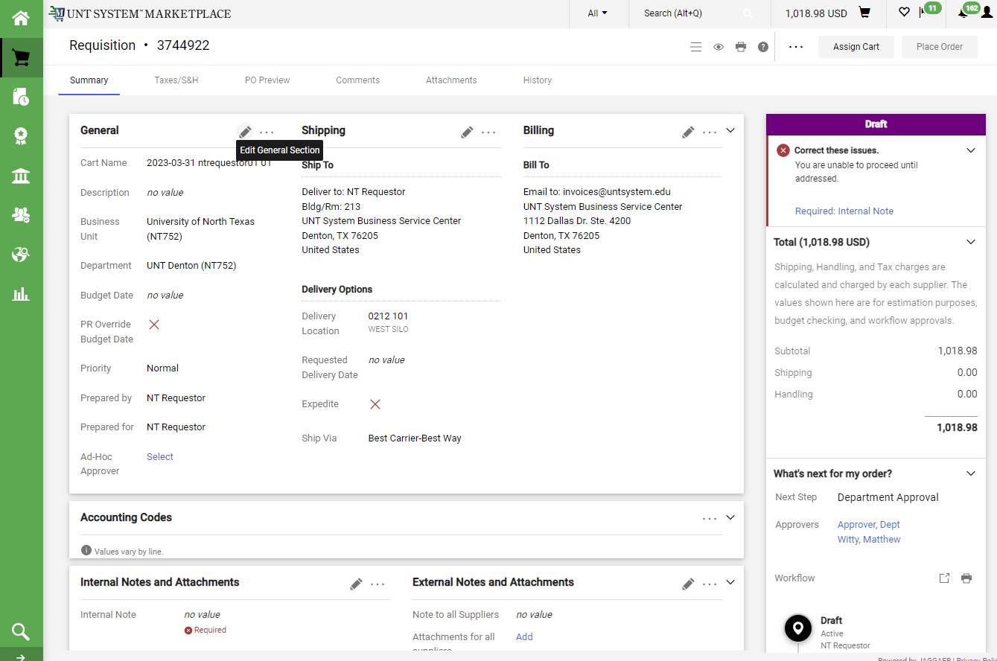
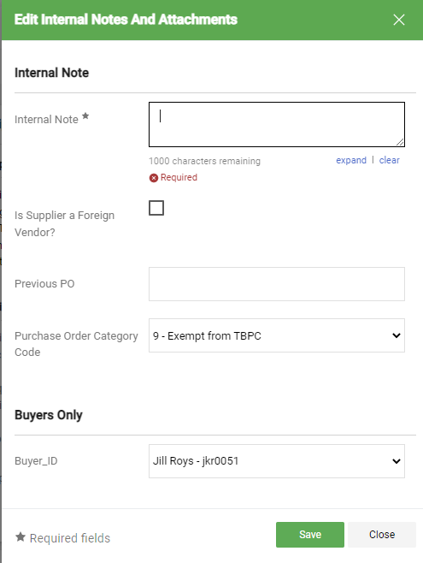
Creating a Requisition from a Shopping Cart
The Draft section on the right will guide you through completing any required information. Click on the blue links for help.
You will need to carefully review items on the requisition. If you need to make edits in a section, simply click the Pencil icon for that section to enable editing.

Slide 6
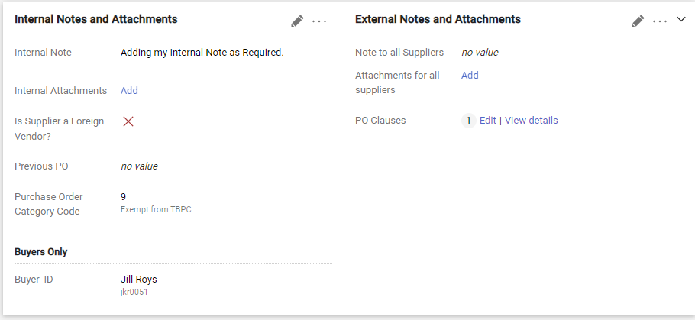
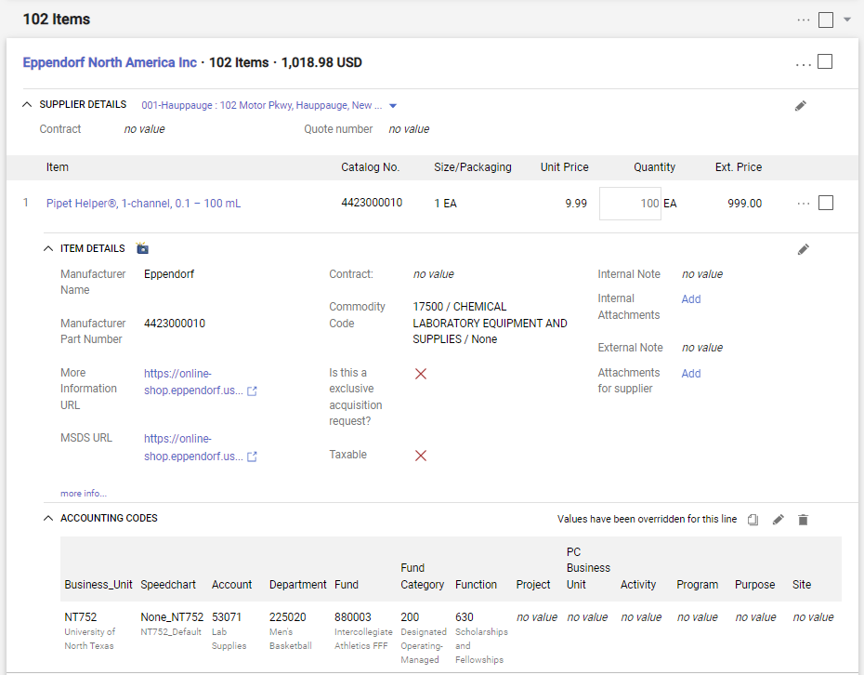
Creating a Requisition from a Shopping Cart
You can add Internal Notes (the internal note is required) or External Notes and attachments to your requisition. Non-catalog suppliers will receive External notes and attachments. Important to Note: External notes will be available to punchout and hosted suppliers (suppliers may or may not access them).
Update as needed using the Pencil icon. Each line item on your requisition will have accounting codes that you will need to review.
The next screen will guide you through adding attachments.

Slide 7
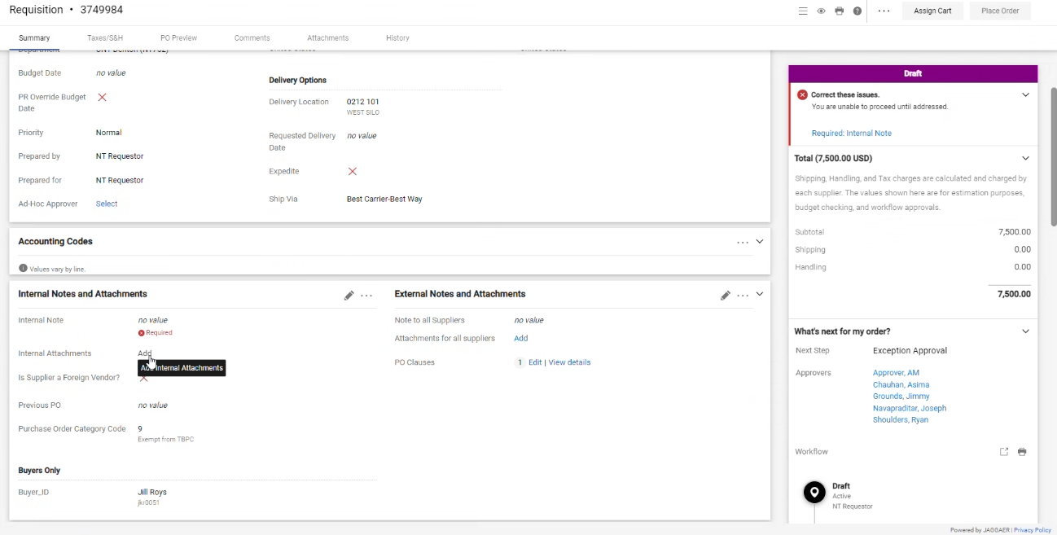
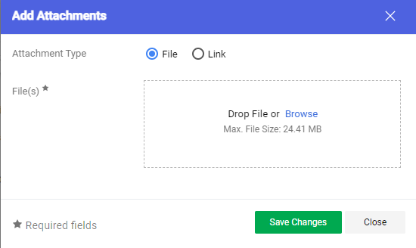
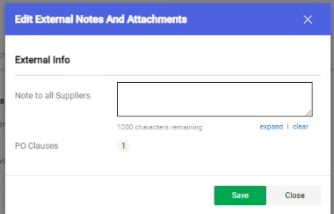
Creating a Requisition from a Shopping Cart
​
Internal and External attachments can be added by clicking the Add links in the Internal Notes and Attachments section and External Notes and Attachment section.
Note that External attachments are visible to non-catalog suppliers. Attachments are not sent to punchout and hosted suppliers.

Slide 8
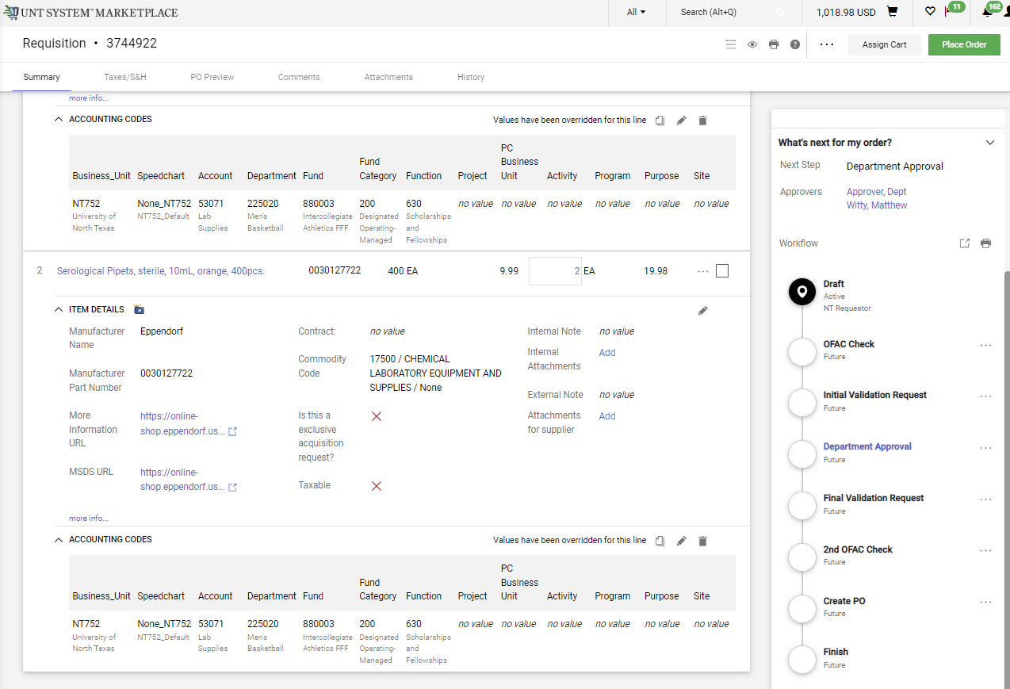
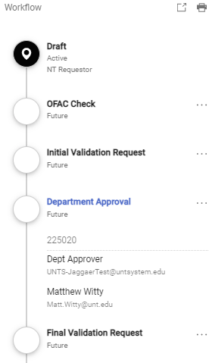
Creating a Requisition from a Shopping Cart
The Workflow section will provide you helpful information about where the requisition is in the workflow process.
The blue links can be clicked to tell you who the approvers are for the requisition.
Once you have reviewed the requisition, click the Place Order button in the top right corner of the screen.

Slide 9
Creating a Requisition from a Shopping Cart
Instructions to adding the Speed-chart:
If the Project is a Sponsored Project and/or Grant funded, the speed-chart is the Project ID.
For all other funding sources, the speed-chart will follow the format (NONE_BusinessUnit)
Enter Project ID for Sponsored Projects/Grants
For all other Funding sources, type NONE_BU

Slide 10
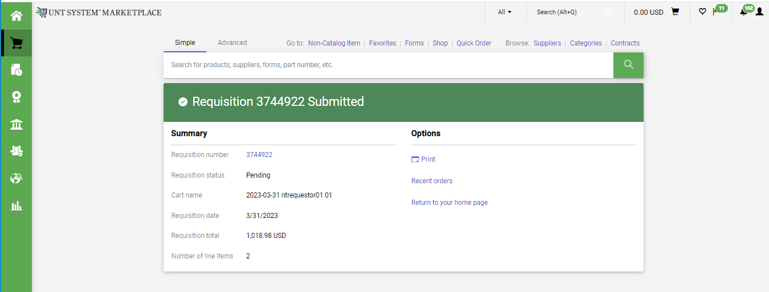
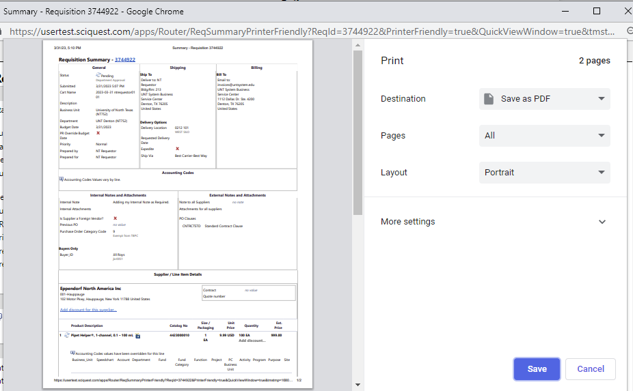
Creating a Requisition from a Shopping Cart
Your requisition is created and on its way through the workflow.
You can click the Requisition Number link to view the requisition. You also have the option to print a copy of the requisition.

Slide 11
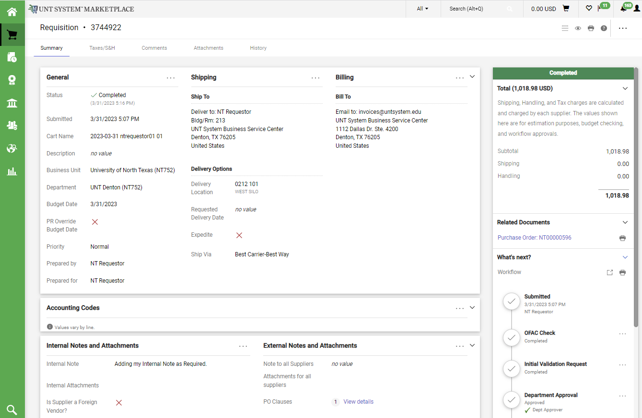
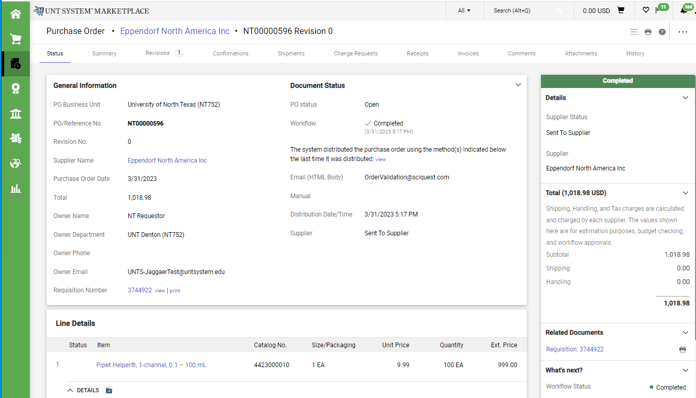
Creating a Requisition from a Shopping Cart
Once your requisition passes OFAC checking and Initial Validation, it routes through approvals.
Once approved, the requisition goes through final validation and a second OFAC check.
Then your PO will be created and sent to the supplier!

