Slide 1
Shopping is Easy in UNT System Marketplace!
Hosted Catalog Shopping
Quick Guide​

Slide 2
Creating a Cart with a Hosted Catalog
UNT System Marketplace Shoppers and Requestors:
Both Shoppers and Requestors can shop for items and add them to carts.
Requestors have additional permissions:
Requestors can submit carts that have been assigned to them by Shoppers.
Requestors are users who have knowledge of UNT System Marketplace accounting codes and Chartfields. The requestor may need to update the requisition with these codes before placing an order.
Responsibilities of a Requestor include following Procurement Guidelines, bid thresholds, validating accuracy of Accounting Chartfields, Ship To information, and Business Purpose.

Slide 3
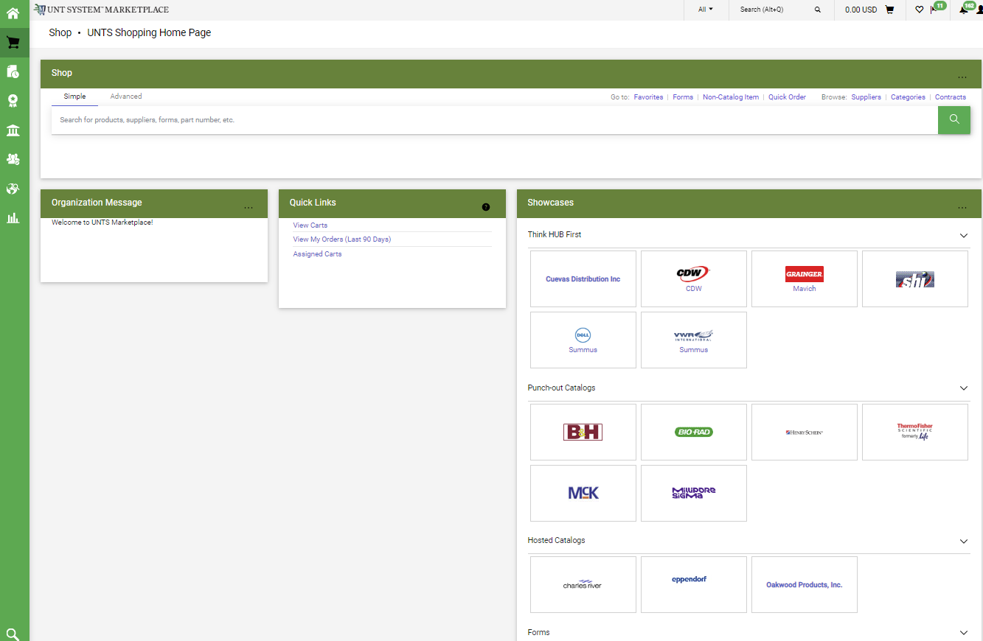
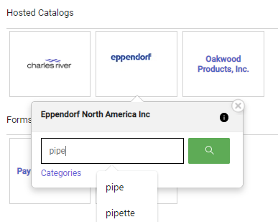
Creating a Cart with a Hosted Catalog Supplier
The Showcases section on your Home page contains links to make shopping easier, allowing you to create many types of requisitions and payment requests.
Hosted Catalog shopping is a great new feature of UNT System Marketplace.
To access items in a Hosted Catalog, you can click the tile for the Hosted Catalog supplier, or you can type information about the item you would like to purchase in the Search bar at the top of the page. You can search by product name, supplier, part number, etc.

Slide 4
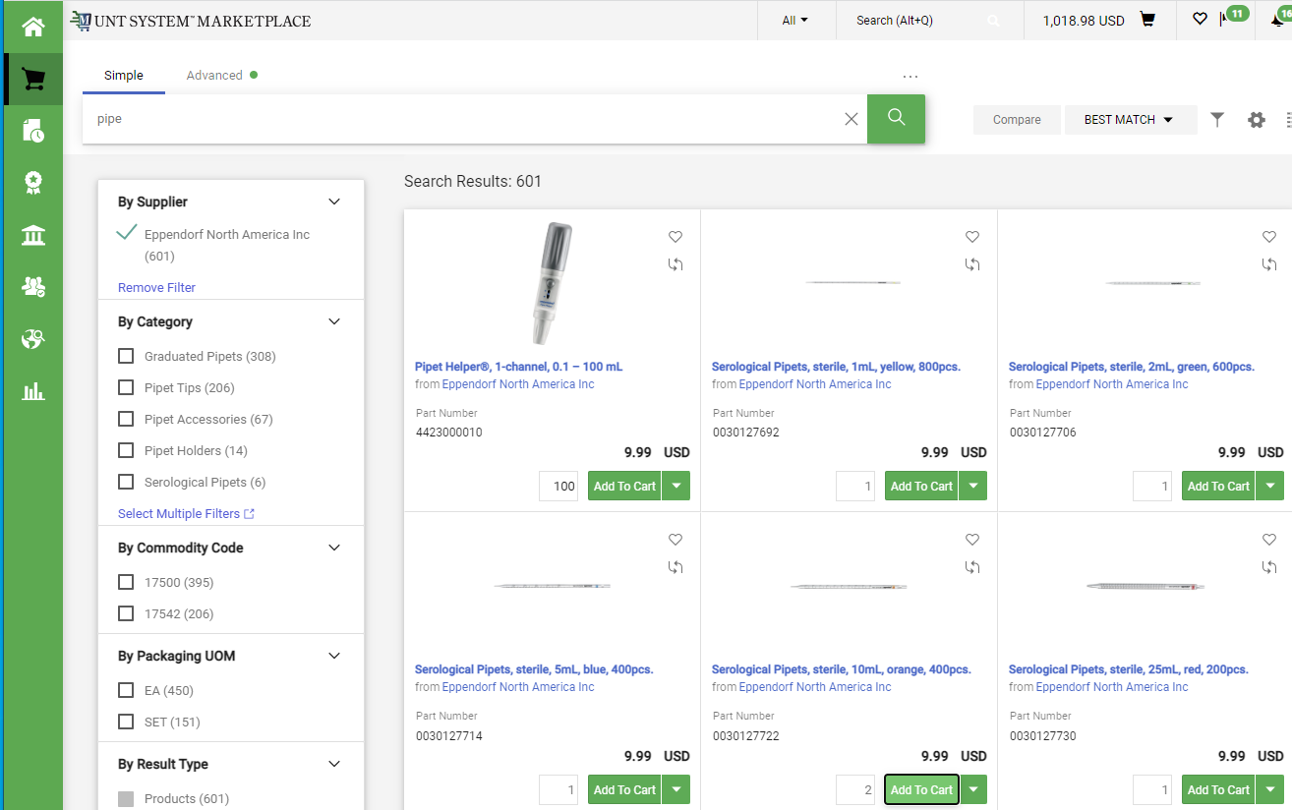
Creating a Cart with a Hosted Catalog Supplier
After you enter your search criteria, the catalog will display, and you will be able to select the quantity and the items you wish to add to your shopping cart.
When you are finished shopping, click on the link to view your cart (the shopping cart in the top right corner of your screen).

Slide 5
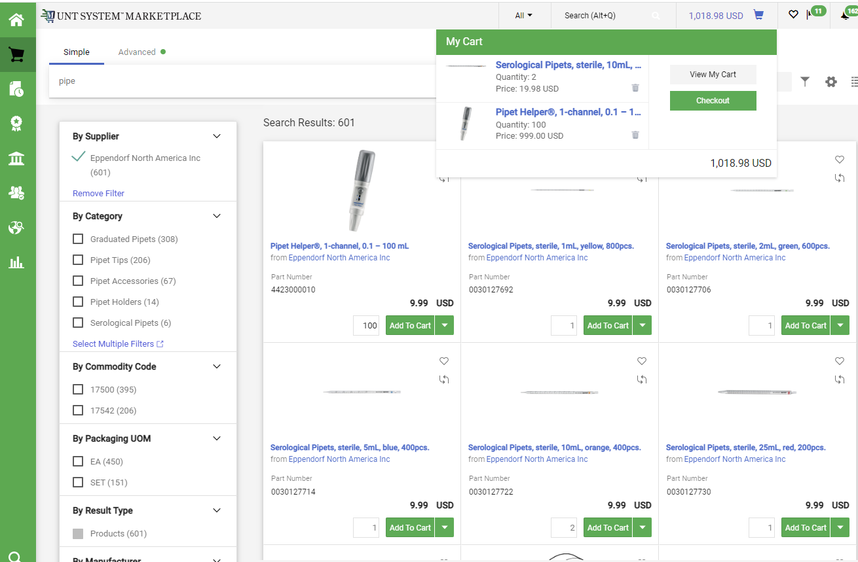
Creating a Cart with a Hosted Catalog Supplier
When you click the Cart icon or the link displaying the amount of your cart, a popup displaying items in your cart will appear.
You have the option to View My Cart or Checkout. When you choose to checkout, a requisition will be created.

Slide 6
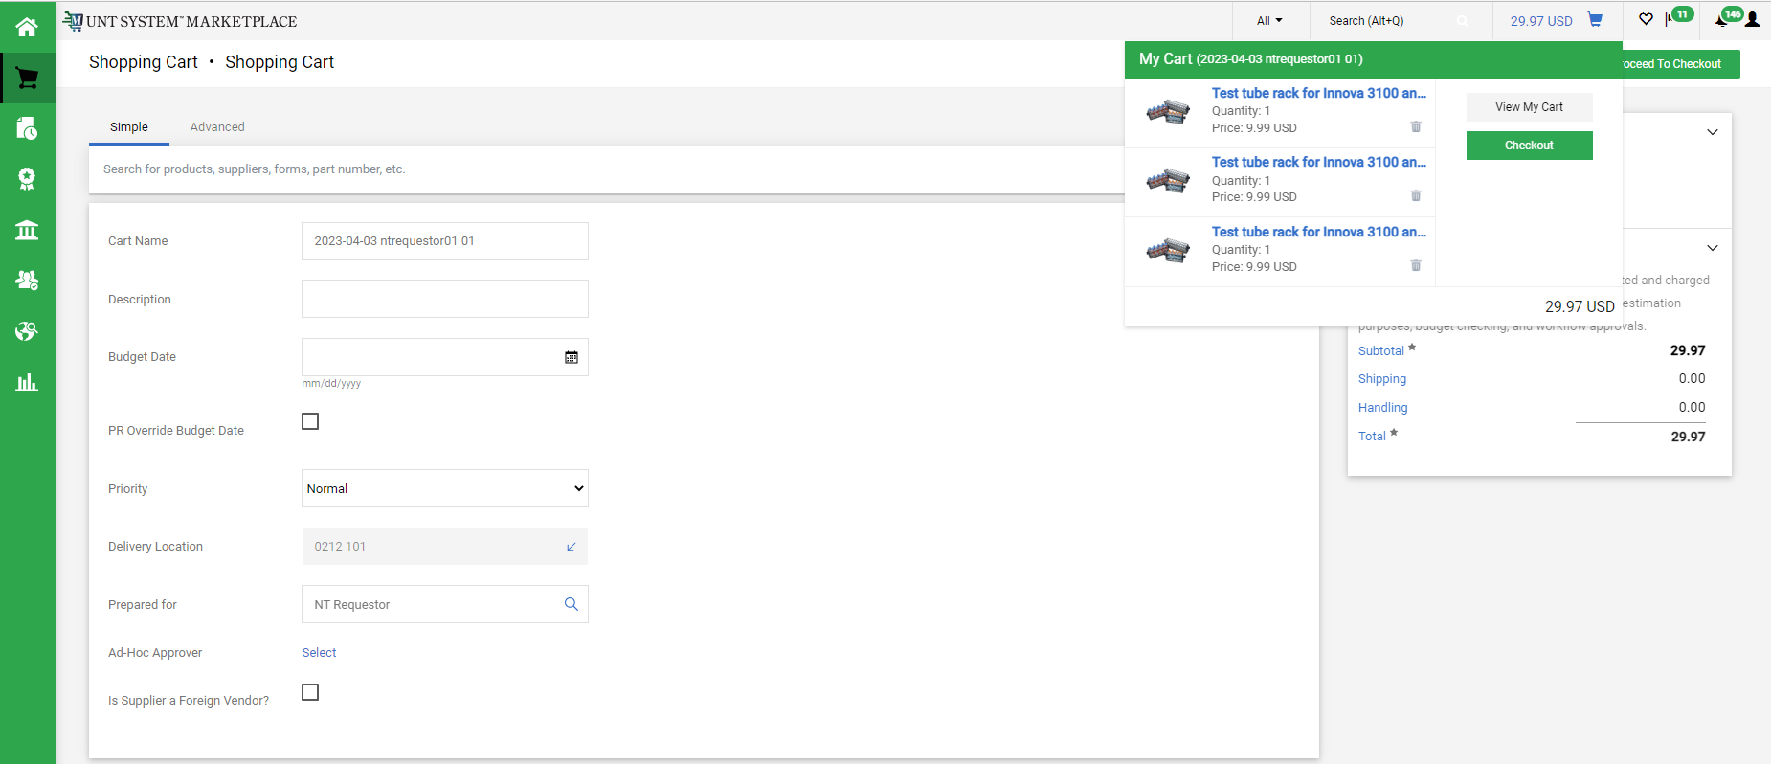
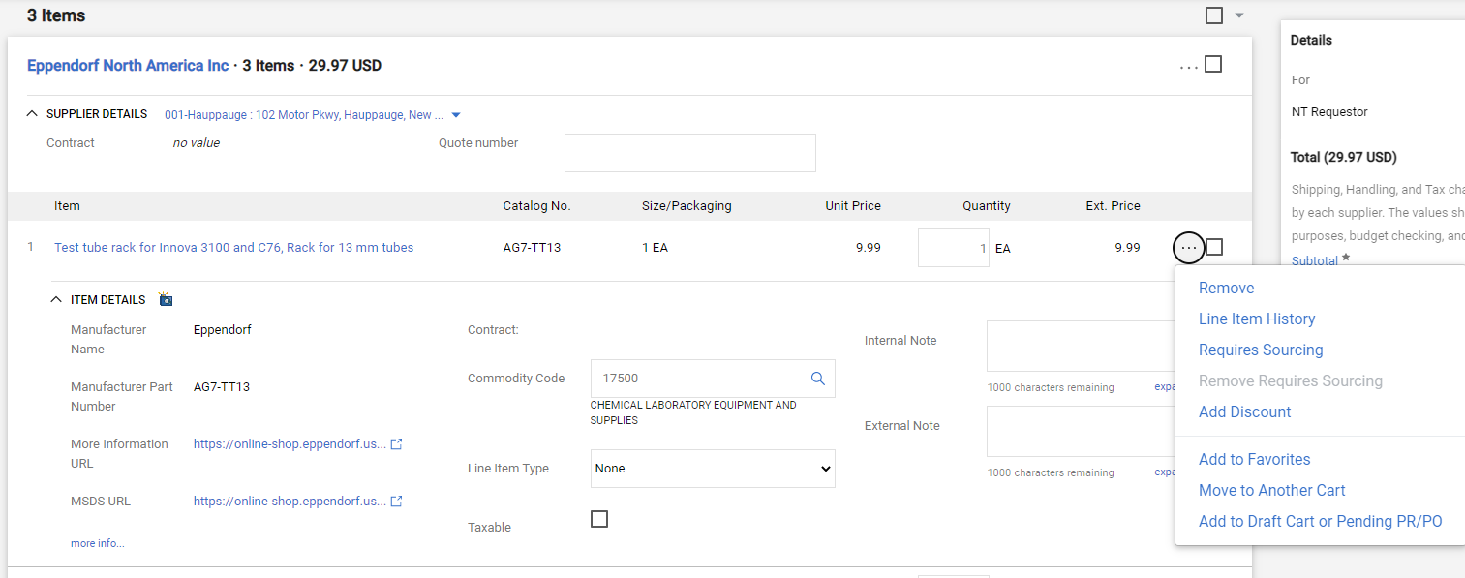
Creating a Cart with a Hosted Catalog Supplier
If you choose to view your cart, you can review items in the cart, update the Cart Name, choose a Delivery Location, and make other adjustments as needed.
You can add or remove items, but you should not attempt to add items from another supplier to your cart. To remove items, click the Ellipses (…) and select the Remove link.

Slide 7
Creating a Cart with a Hosted Catalog Supplier
When you are ready to Checkout and create your Requisition in Marketplace, click the Proceed to Checkout button.

Slide 8
Creating a Cart with a Hosted Catalog Supplier
​
For SHOPPERS, the next step is to Assign Cart to a requestor to place the order. See page 9 for details.
For REQUESTORS, the next step is to proceed directly to Place Order.​
To continue creating your requisition or to submit requisitions assigned to you by Shoppers, please follow the instructions on the Requisition from a Shopping Cart document in the Requestor section.​​ ​​

Slide 9
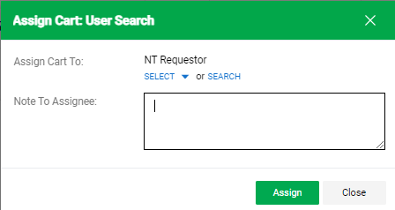
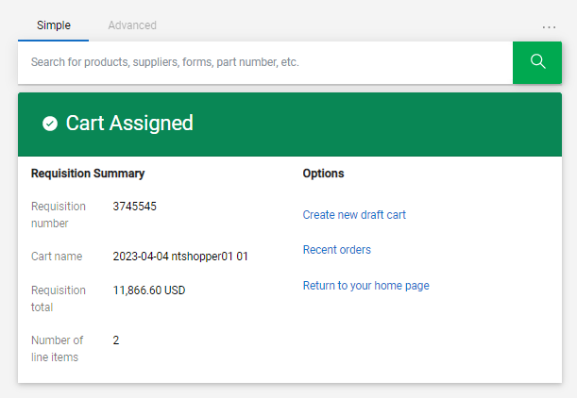
Creating a Cart with a Hosted Catalog Supplier
If you are a Shopper, you will be prompted to select a Requestor to review and submit your cart after you click the Assign Cart button. Once your assigned Requestor places the order, the requisition will begin the Marketplace approval process.

Slide 10
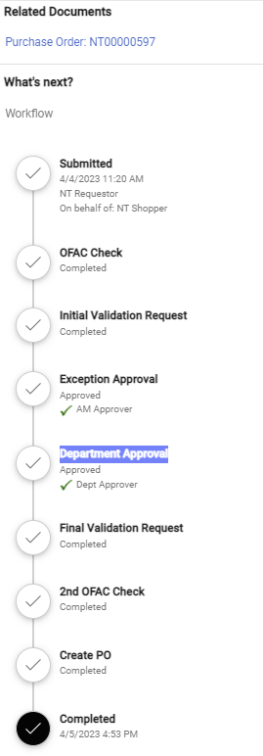
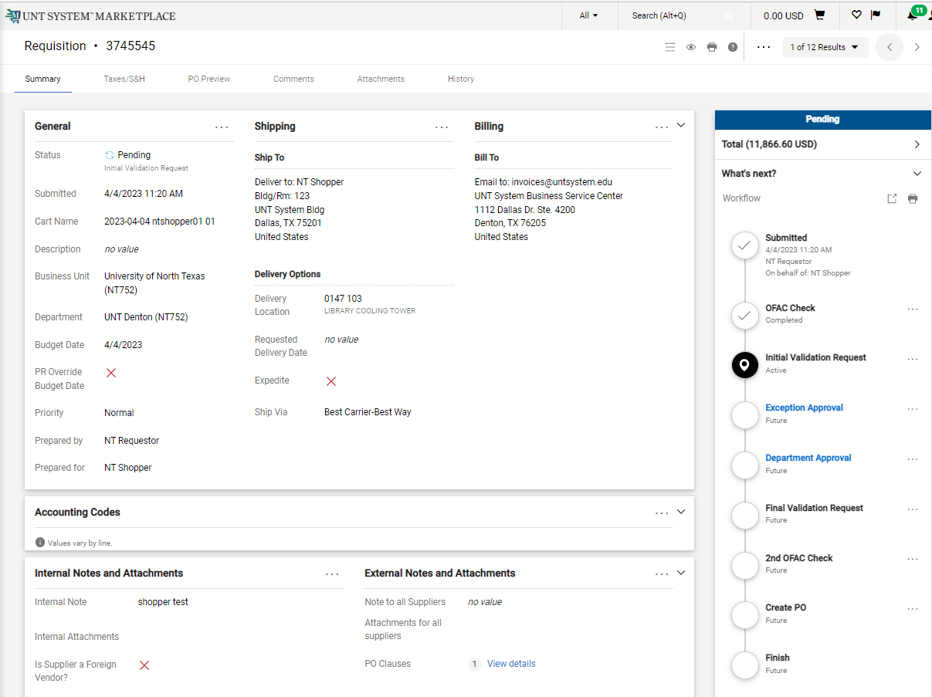
Creating a Cart with a Hosted Catalog Supplier
When the Requestor places the order, the workflow status can be viewed in the What’s Next section of the requisition. Once it moves all the way through the workflow, a Purchase Order will be issued and a link to the PO becomes available.

