Slide 1
Shopping is Easy in UNT System Marketplace!
Requisition for Services
or Blanket Orders
A Requestor's​ Quick Guide​

Slide 2
Blanket Orders are NOT to be used for assets or controlled items. All assets and controlled items MUST be ordered via Catalog or Non-Catalog requisitions.
Disclaimer:​

Slide 3
Creating a Service Request / Blanket Order
From the Shopping Home Page, navigate to the Forms section under the Showcases menu. Click ‘Service Request / Blanket Order’ to begin.

Slide 4
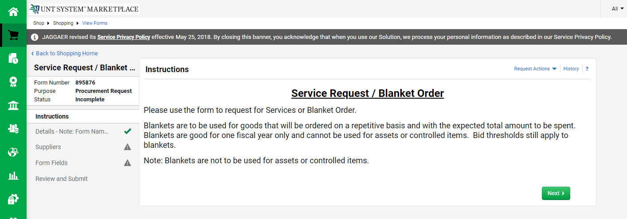
Creating a Service Request / Blanket Order
The Instructions page is displayed. Take a moment to familiarize yourself and click ‘Next’ to proceed.

Slide 5
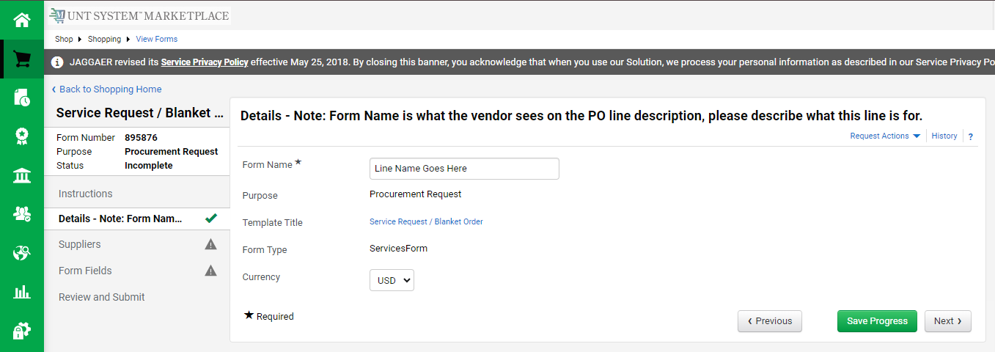
Creating a Service Request / Blanket Order
The Details page is displayed. The Form Name will be the name of the corresponding line on the PO, so update it accordingly. Click ‘Next’.

Slide 6
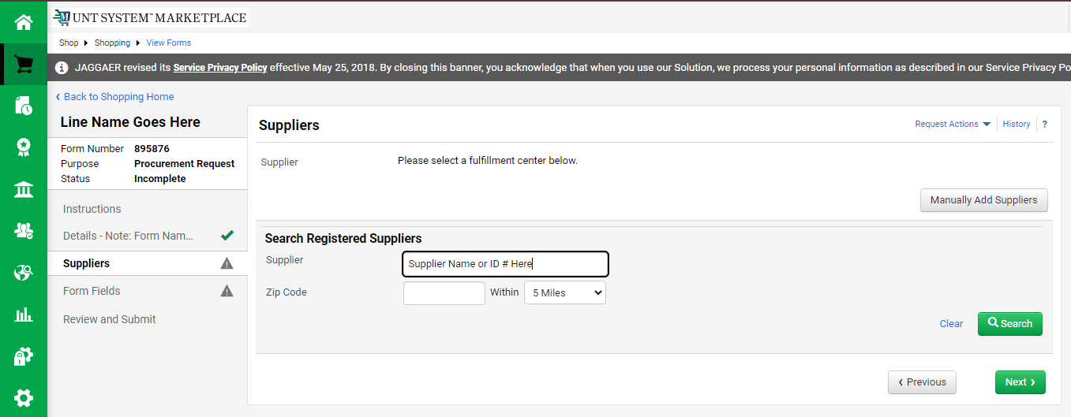
Creating a Service Request / Blanket Order
Enter the supplier's name or ID number and click ‘Search’.

Slide 7
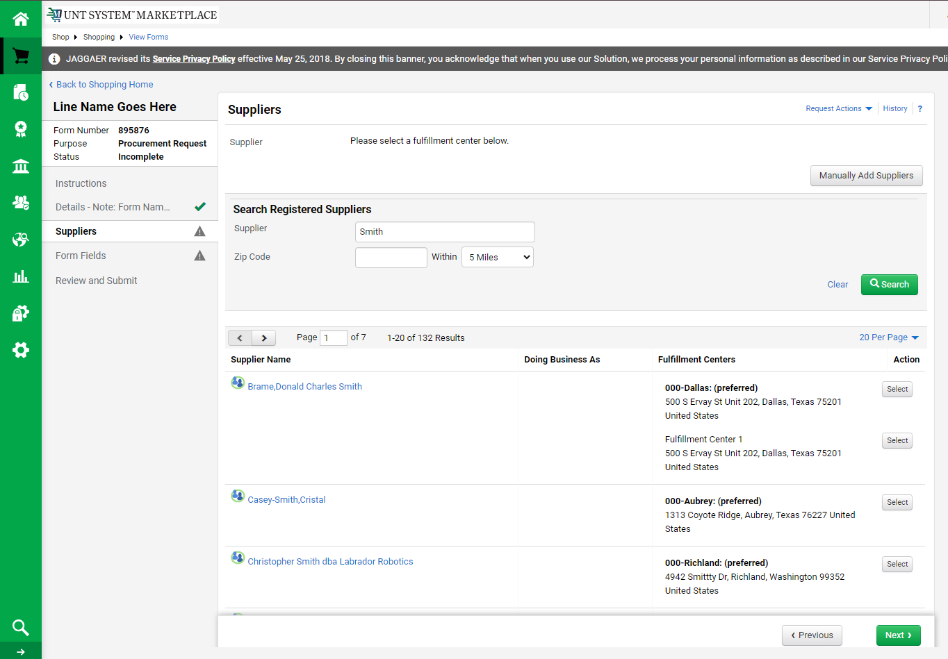
Creating a Service Request / Blanket Order
From the search results, click ‘Select’ for the intended supplier, then click ‘Next’. Do not select the Fulfillment Center 1 option if available.

Slide 8
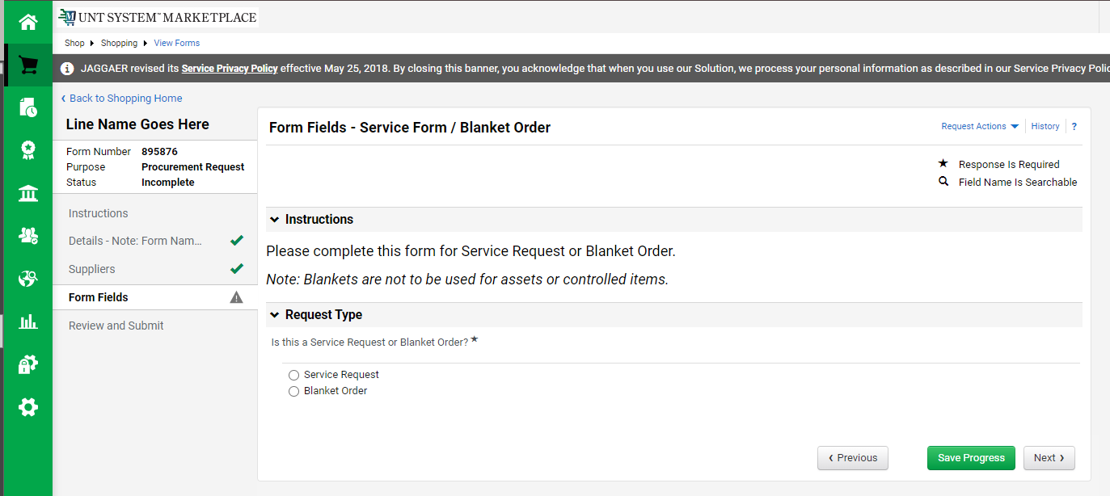
Creating a Service Request / Blanket Order
The Form Fields page is displayed. Select ‘Service Request’ or ‘Blanket Order’, then click ‘Next’.
Reminder: Blanket Orders are NOT to be used for assets or controlled items. All assets and controlled items MUST be ordered via Catalog or Non-Catalog requisitions.

Slide 9
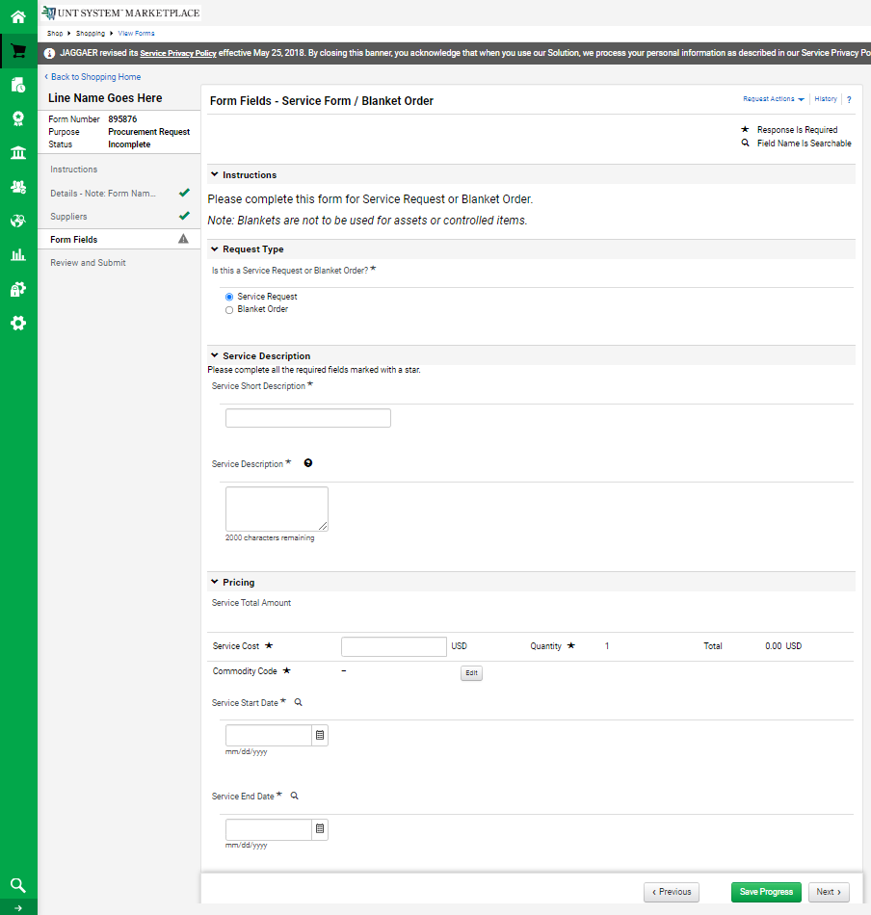
Creating a Service Request
The rest of the Form Fields page is displayed. Enter the necessary information and select the appropriate Commodity Code. Click ‘Next’.
For Blanket Orders, see the next slide.
Help Text is available anywhere the question mark is displayed.

Slide 10
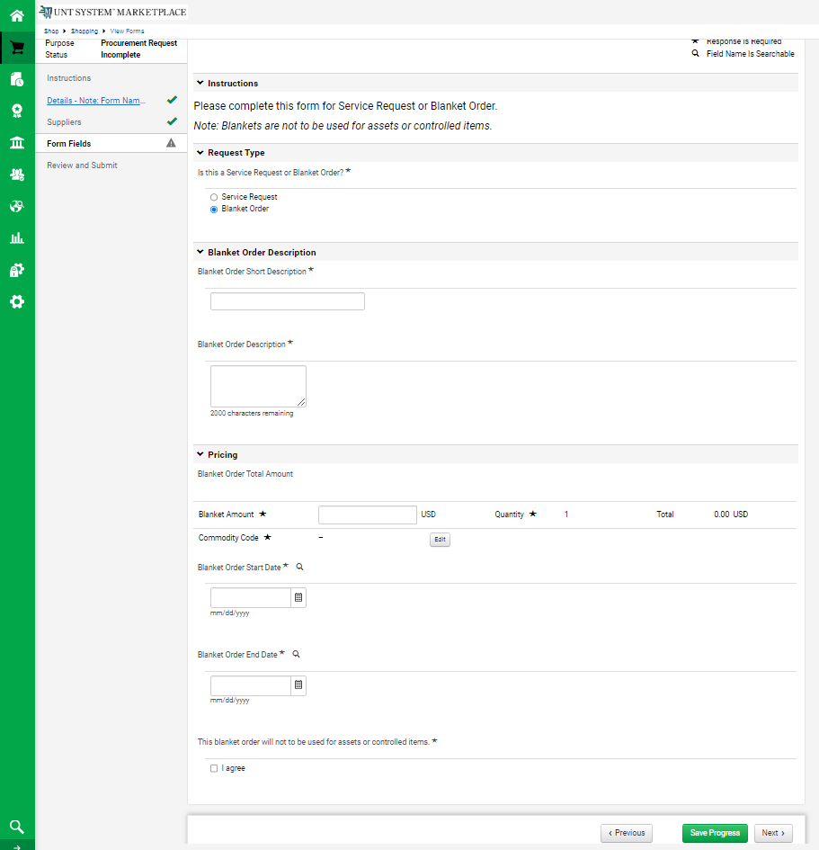
Creating a Blanket Order
The rest of the Form Fields page is displayed. Enter the necessary information, select the appropriate Commodity Code, and select ‘I agree’ to confirm that you will not use the Blanket Order for assets or controlled items. Click ‘Next'.

Slide 11
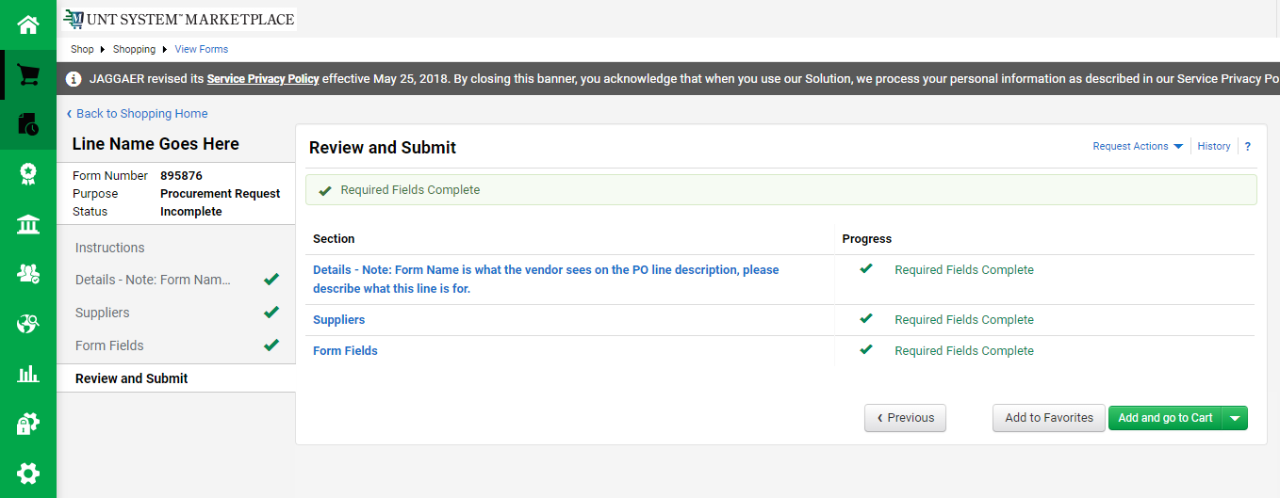
Creating a Service Request / Blanket Order
If all pages are complete, and no more lines are needed, click ‘Add and go to Cart’.
If additional lines are needed, proceed to the next page. Otherwise, skip to slide 18.

Slide 12
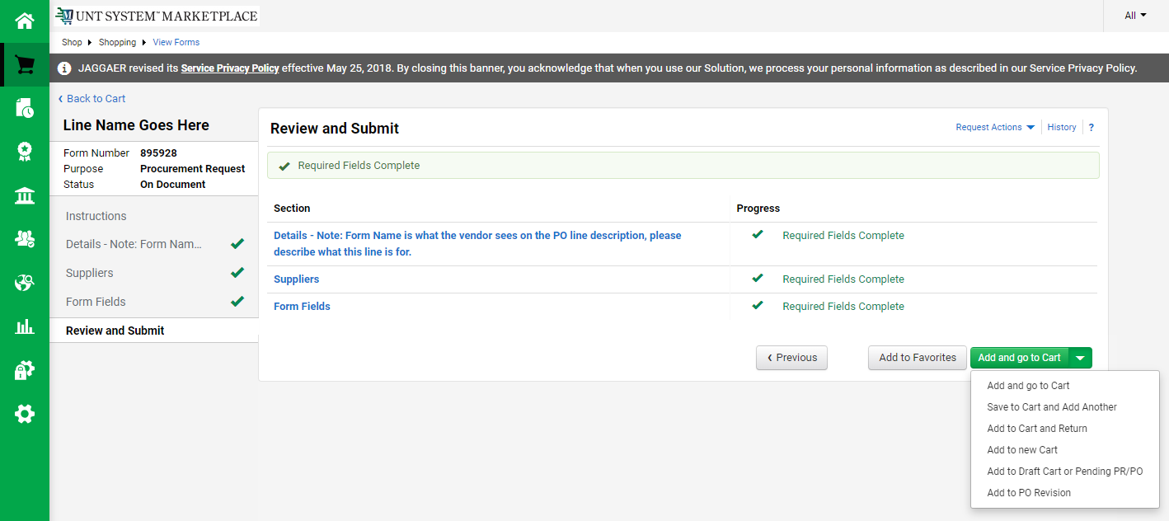
Creating a Service Request / Blanket Order
To add an additional line, click the downward arrow, then click ‘Save to Cart and Add Another’.

Slide 13
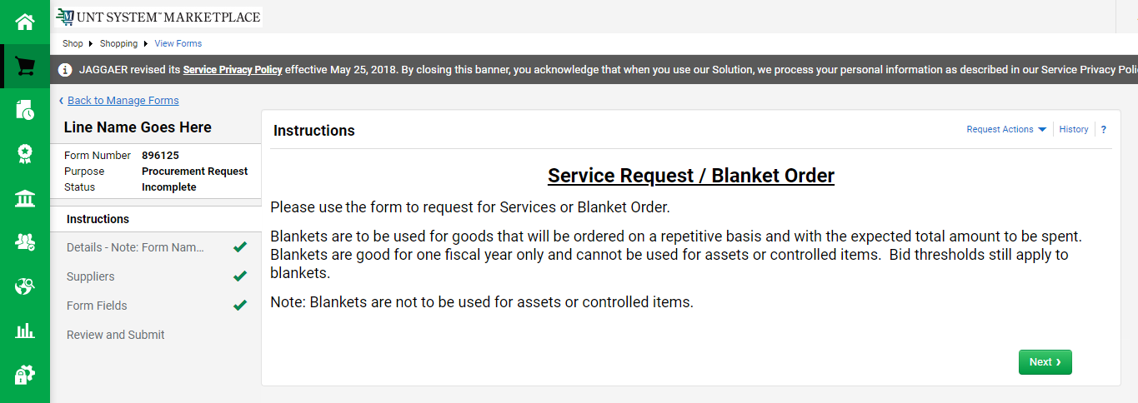
Creating a Service Request / Blanket Order
The Instructions page appears again. Click ‘Next’.

Slide 14
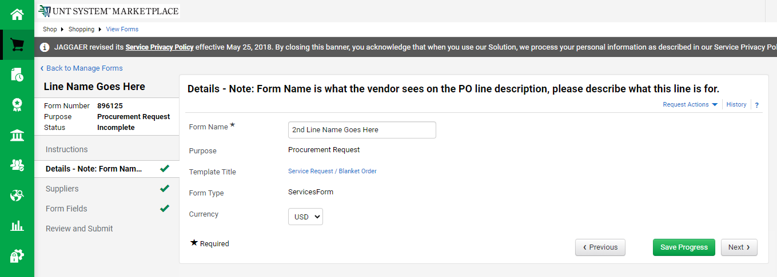
Creating a Service Request / Blanket Order
The Details page appears again. The Form Name will be the name of the corresponding line on the PO, so update it accordingly. Click ‘Next’.
NOTE: This form/line name MUST be distinct from all other line names for this order.

Slide 15
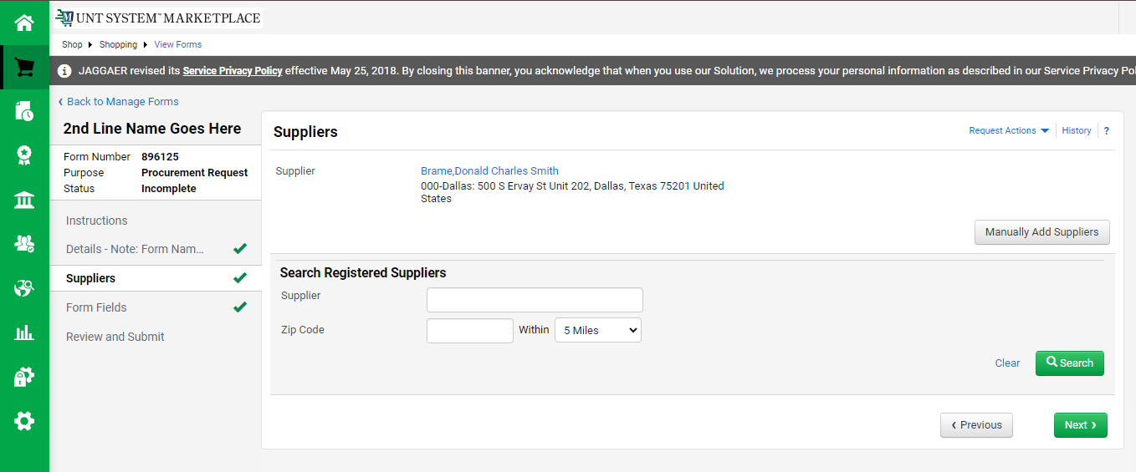
Creating a Service Request / Blanket Order
The Suppliers page appears again. You can not submit requisitions for multiple suppliers at once, so click ‘Next’.

Slide 16
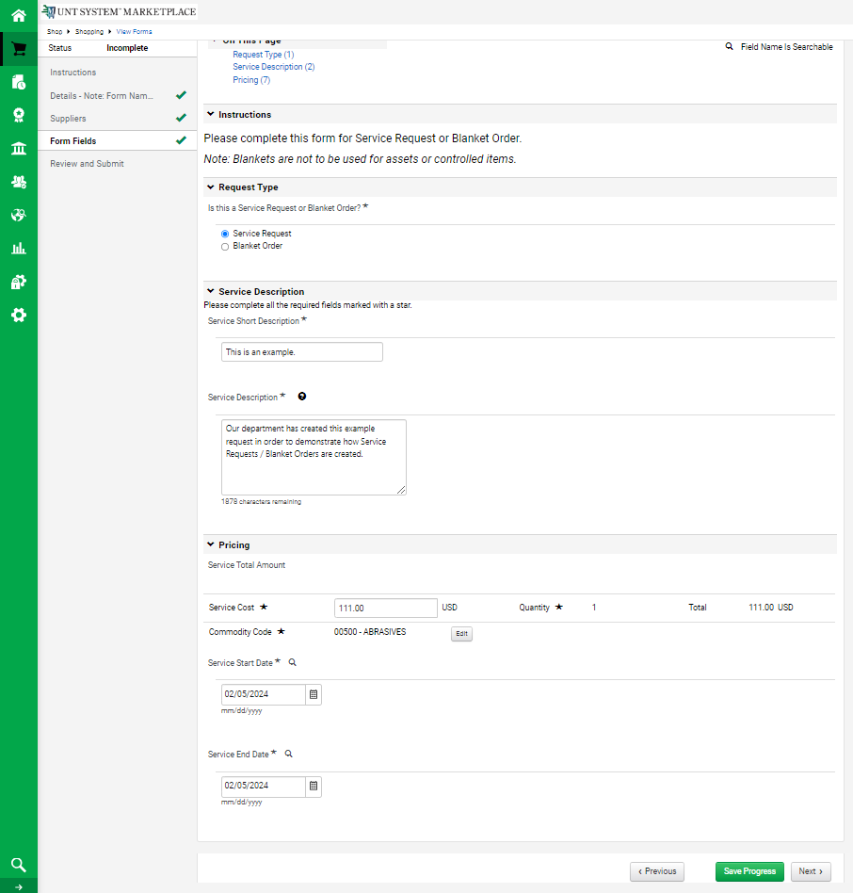
Creating a Service Request / Blanket Order
The Form Fields page appears again. Notice that all the information input for the first line appears here as well. None of these sections are required to be unique, but you may change them as needed. When all fields reflect the intended information for the additional line, click ‘Next’.
NOTE: Different form types can not be mixed on a single requisition. Do not attempt to change the second line to a Blanket Order or Vice Versa.

Slide 17
Creating a Service Request / Blanket Order
If all pages are complete, and no more lines are needed, click ‘Add and go to Cart’.
If additional lines are needed, repeat from slide 12.

Slide 18
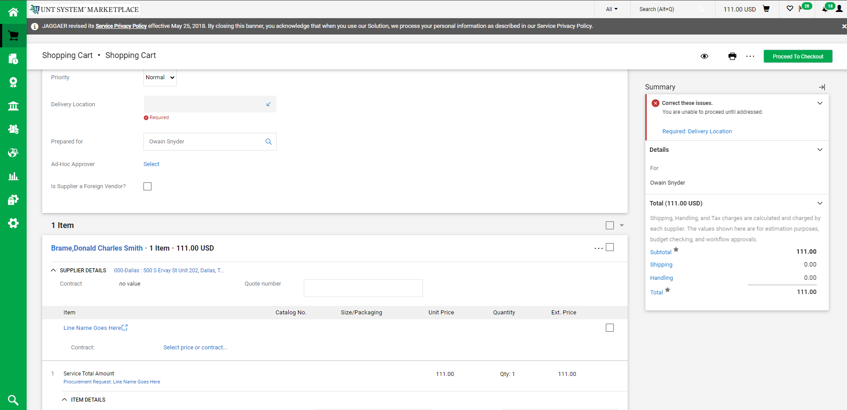
Creating a Service Request / Blanket Order
The form is now a line item in your active cart. Address any issues before clicking ‘Proceed to Checkout’.
NOTE: If you’ve gotten to this step and additional lines are still needed, click the Home Icon and repeat from slide 3. This is NOT starting over- it will add the resulting 2nd line to your active cart.

Slide 19
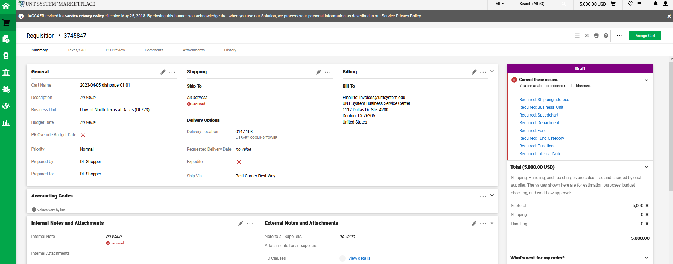
Creating a Service Request / Blanket Order
Users with the Shopper role will click Assign Cart to route the form to an individual with the Requestor role. The Requestor will review and place the order. NOTE: Approvers’ names MUST NOT appear in the ‘Prepared by’ or ‘Prepared for’ fields.

Slide 20
Creating a Service Request / Blanket Order
The Requestor logs in to view the Cart. Click the flag icon and the ‘Carts Assigned to Me’ link.
The Requestor can activate the cart to begin reviewing.

Slide 21
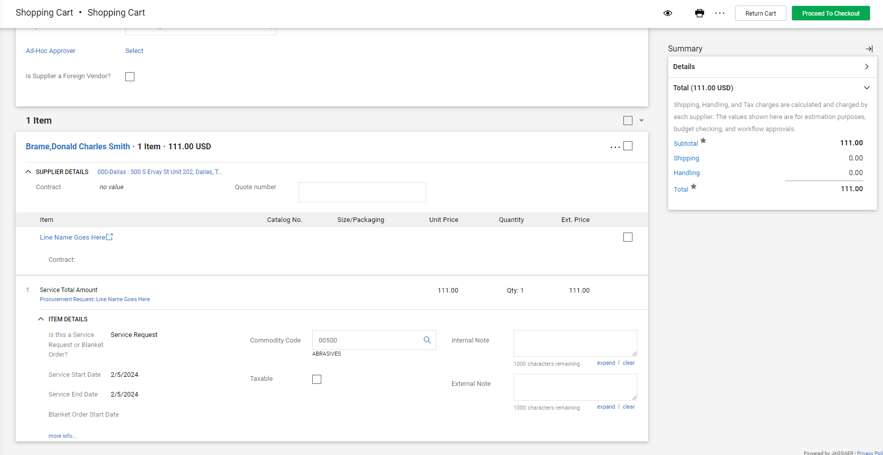
Creating a Service Request / Blanket Order
The Requestor reviews the cart, and can either return the cart for revisions, or proceed to checkout. A hyperlink to the Service Request / Blanket Order is available.
The

Slide 22
Creating a Service Request / Blanket Order
Before the order can be placed, all required fields must be completed. Each section can be edited with the corresponding pencil icon.
The

Slide 23
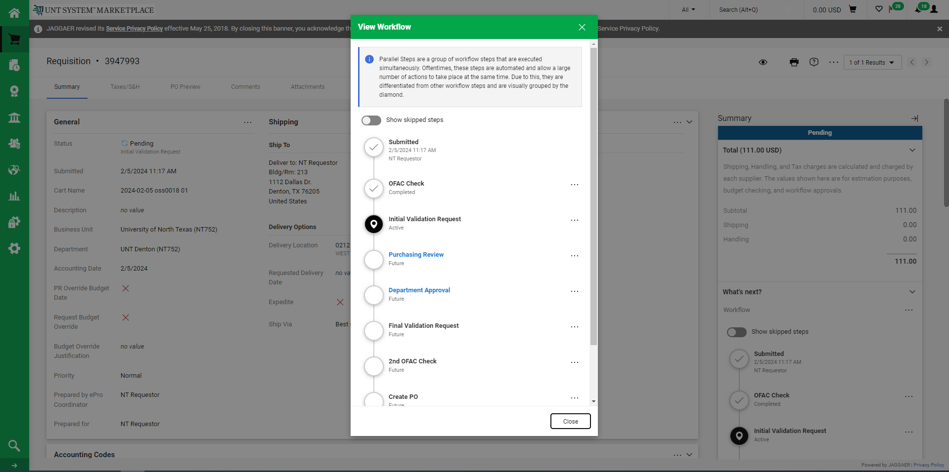
Creating a Service Request / Blanket Order
When the Requestor places the order, the workflow status can be viewed in the ‘What’s Next’ section of the requisition. Once it moves all the way through the workflow, a Purchase Order will be issued. Click the box with the arrow to view the workflow steps.
.
The

