Slide 1
Shopping is Easy in UNT System Marketplace!
Profile Management​

Slide 2
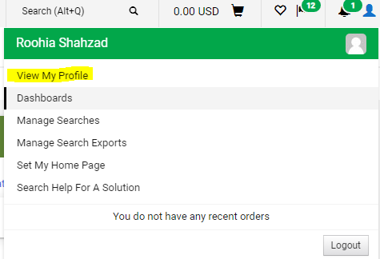
Once you are logged in, you can go to view/manage your profile settings by clicking on the person icon on the top right of your screen.
Click on “View my Profile”

Slide 3
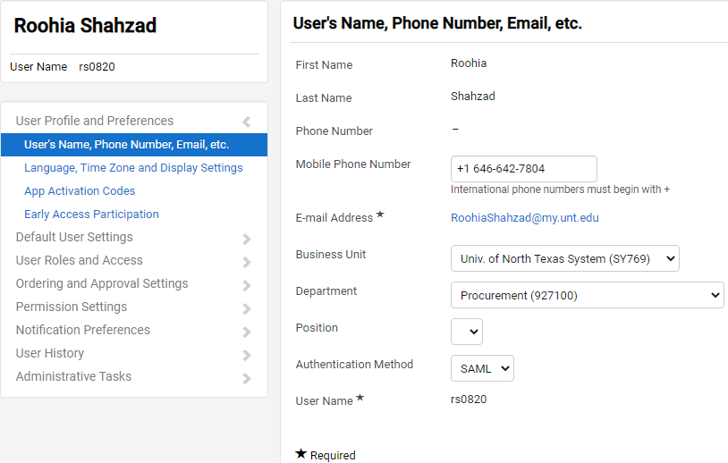
You can view your user profile settings including your name, contact information and department associated with you.

Slide 4
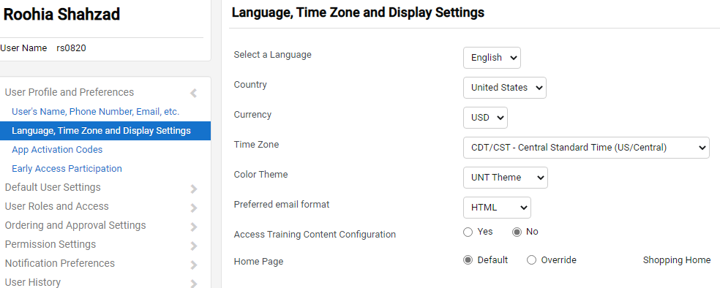
You can configure display settings in the “Language, Time Zone and Display Settings”

Slide 5
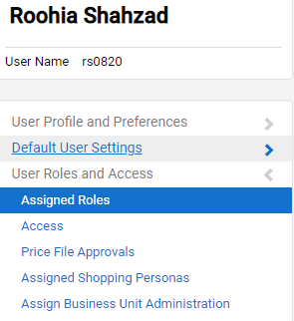
You can view your user roles under the “User Roles and Access” tab in “Assigned Roles”.
Refer to the detailed internal documentation to see how to setup your default Ship To/ Bill To Addresses and how to setup Chart-field values.

Slide 6
To Configure Email and Notification Delivery Options:
1. Click on the “View My Profile” from the top right corner of your UNTS Marketplace portal dropdown.
2. Click “Notification Preferences”
3. Click on the document type or category you wish to change
4. Click the “Edit Section” link in the upper right corner of the screen.
5. Select Override next to the notification you wish to change.
6. Click on the drop down
7. Select the way you want wish to be notified
8. Click “Save Changes”

Slide 7
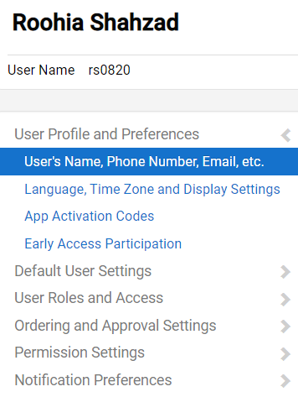
To Configure Email and Notification Delivery Options:

Slide 8
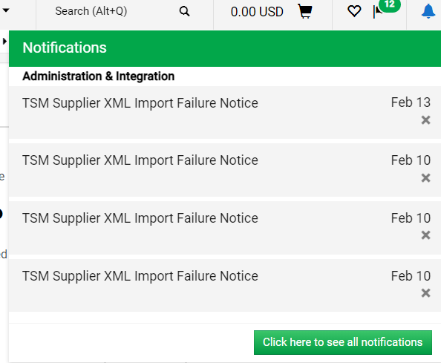
To view and delete Notifications:
Click on the bell icon on the top right to view your notifications. Click on the ‘x’ to delete the notification.

