Slide 1
Shopping is Easy in UNT System Marketplace!
Creating a Change Request
How Do I Change a Hosted Catalog Purchase?

Slide 2
Creating a Change Request for Hosted Catalog Quick Guide
UNT System Marketplace Requestors:
Requestors have permissions for creating change requests:
UNT System Marketplace makes it easy to order additional items as needed! There is no need to create a change request - Simply follow the process to shop and order from the hosted supplier. See Shoppers and Requestors - Guide for Hosted Catalog Shopping for a quick guide to shopping with a hosted catalog supplier.
Requestors can submit change requests. On hosted catalog change requests, Requestors can update accounting Chartfields, commodity codes, external notes, and internal notes and attachments.
CHANGE ORDERS CANNOT BE USED FOR PRICE OR QUANTITY CHANGE OR TO ADD A NEW LINE FOR CATALOG PURCHASES
The Requestor can submit change requests on behalf of Shoppers, who do not have permission to submit change requests.
Requestors are users who have knowledge of UNT System Marketplace accounting codes and Chartfields. The requestor may need to update the Change Request with these codes before placing an order.
Responsibilities of a Requestor include following Procurement Guidelines, bid thresholds, validating accuracy of Accounting Chartfields, Ship To information, and Business Purpose.

Slide 3
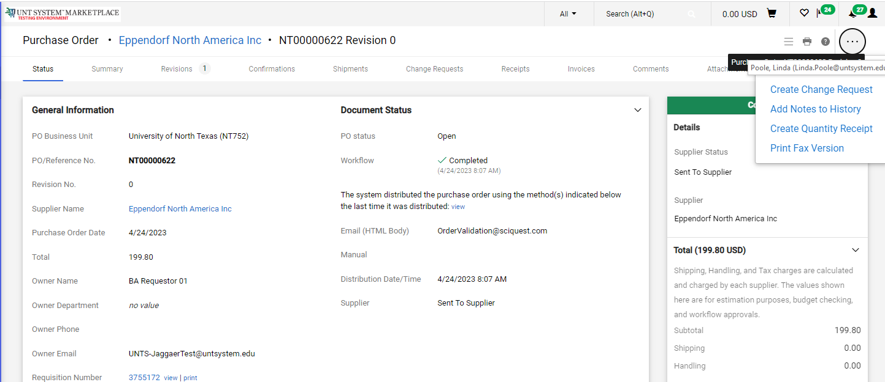
How Do I Change a Hosted Catalog Order? Quick Guide
You can create change requests for hosted catalog suppliers by opening your purchase order. Click the ellipses (…) in the top right corner, then click the link to Create Change Request in the drop-down list.

Slide 4
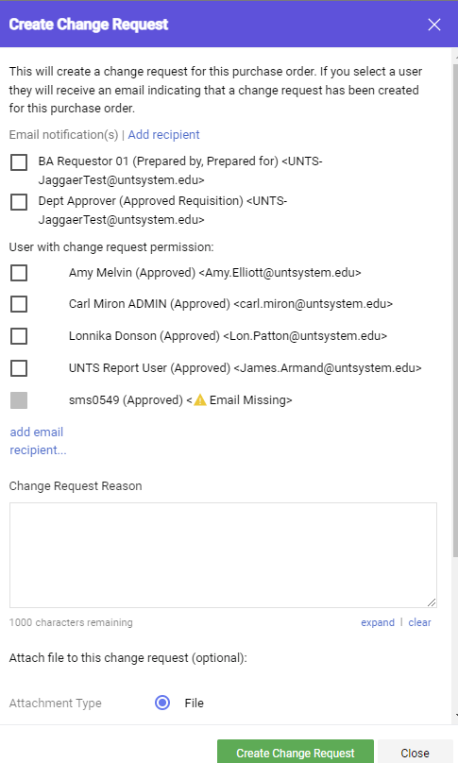
Creating a Change Request Quick Guide
Optional for this form:
You can send an email notification by clicking the checkbox to the recipient(s) you wish to include.
You can add attachments to the change request.
Required for this form:
In the Create Change Request window, enter a Change Request Reason (for instance: changing a ChartField).
Click the Create Change Request button.

Slide 5
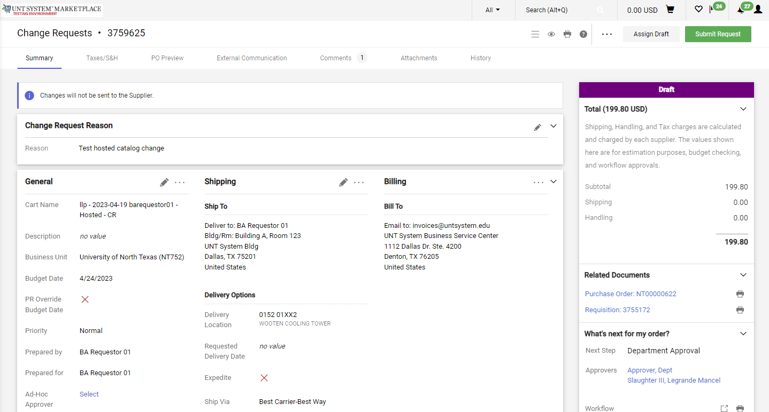
Creating a Change Request Quick Guide
The Change Request is created and ready for additional updates by you.

Slide 6
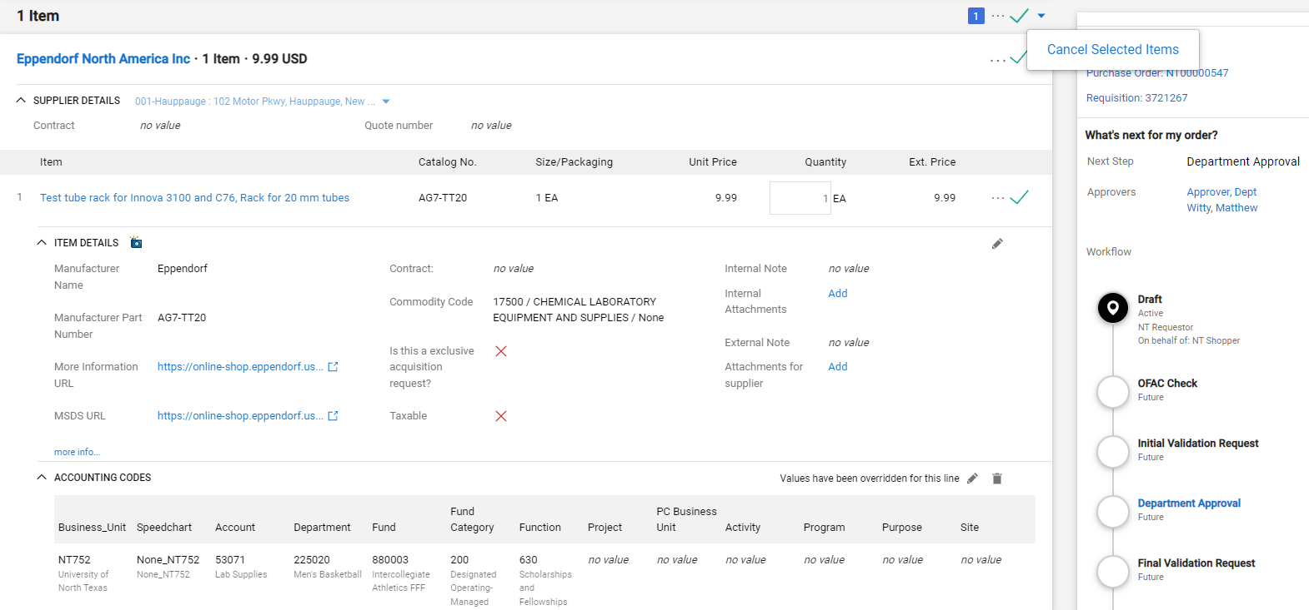
How Do I Change a Hosted Catalog Order? Quick Guide
You can change internal fields for hosted suppliers by clicking the pencil icon in the section where you need to make a change.
If you need to change the quantity ordered or remove item lines after a purchase order has been sent to a hosted catalog supplier, please contact the supplier for assistance. This will allow you to coordinate adjustments to the existing purchase order with the supplier and will help avoid confusion with the order.

Slide 7
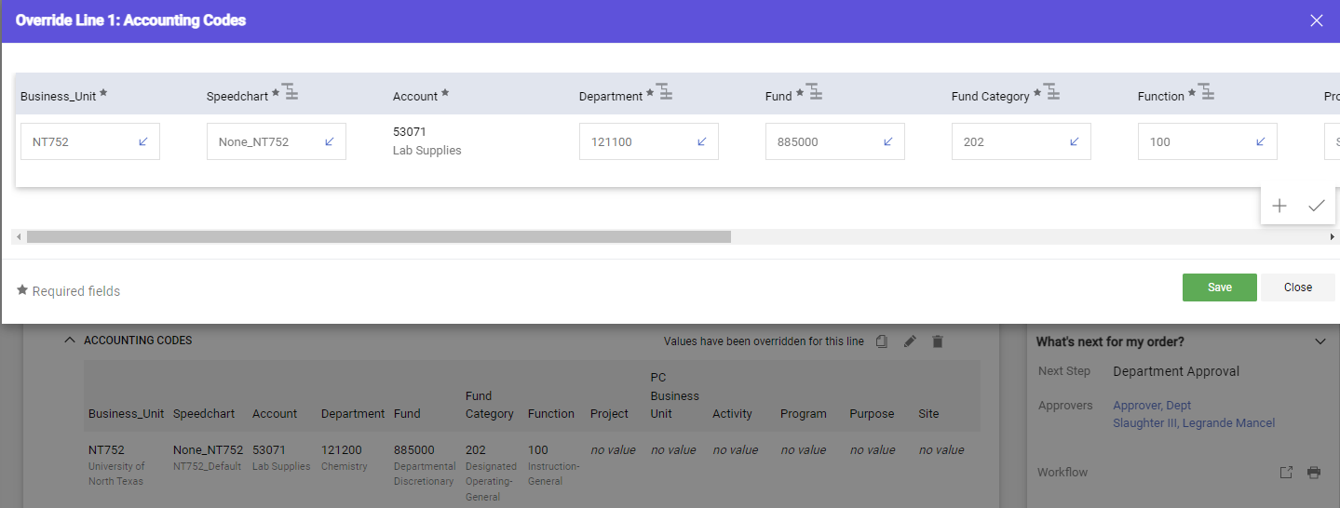
How Do I Change a Hosted Catalog Order? Quick Guide
Changing internal information, like ChartField values, Commodity Codes, adding internal notes and attachments, and external notes can be accomplished with the pencil icon. For ChartField changes, clicking the pencil icon opens a popup for your changes. You can verify that the ChartString is valid by clicking the checkmark (√) icon.
After you complete the changes, click the Save button.

Slide 8
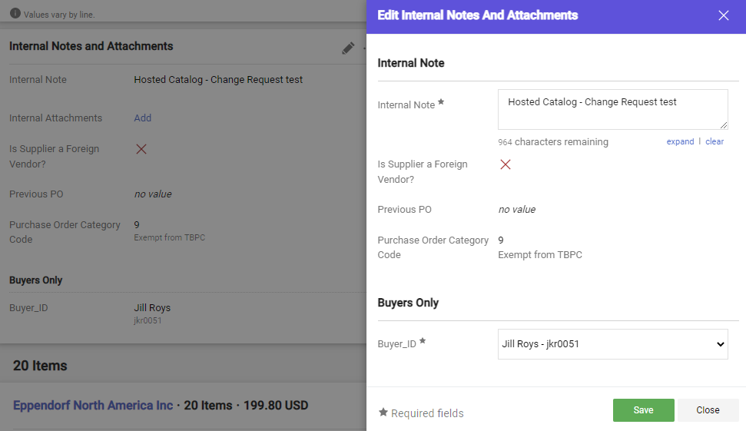
How Do I Change a Hosted Catalog Order? Quick Guide
To add Internal Notes, click the pencil icon. A popup will display to allow you to add notes and any additional information. Click Save when your edits are complete.

Slide 9
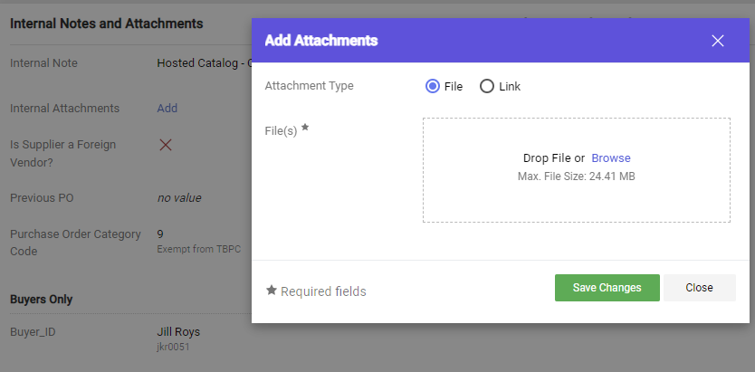
How Do I Change a Hosted Catalog Order? Quick Guide
To add attachments, click the Add link. A popup will display to allow you to add your file or link. Click Save Changes when your edits are complete.

Slide 10
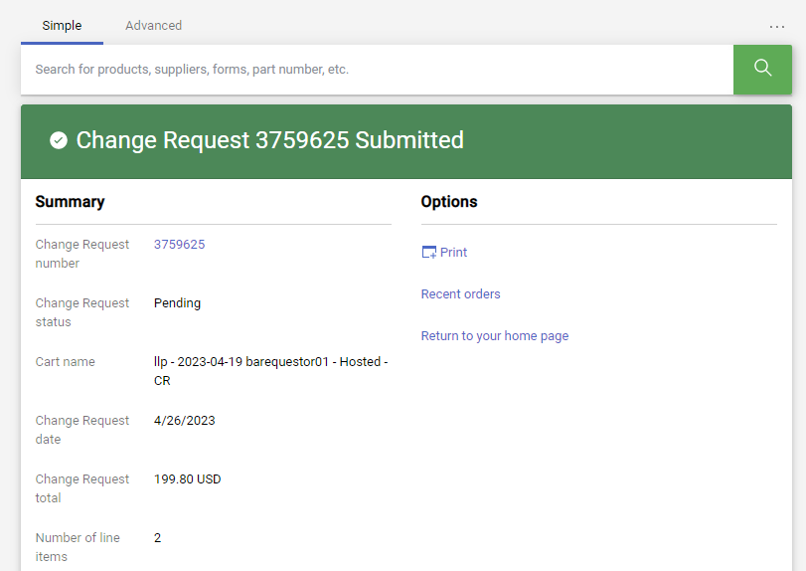
How Do I Change a Hosted Catalog Order? Quick Guide
When your change request is complete, click the Submit Request button in the top right corner of the screen to submit the change.
A confirmation will be displayed with links to view or print your change request.

Slide 11
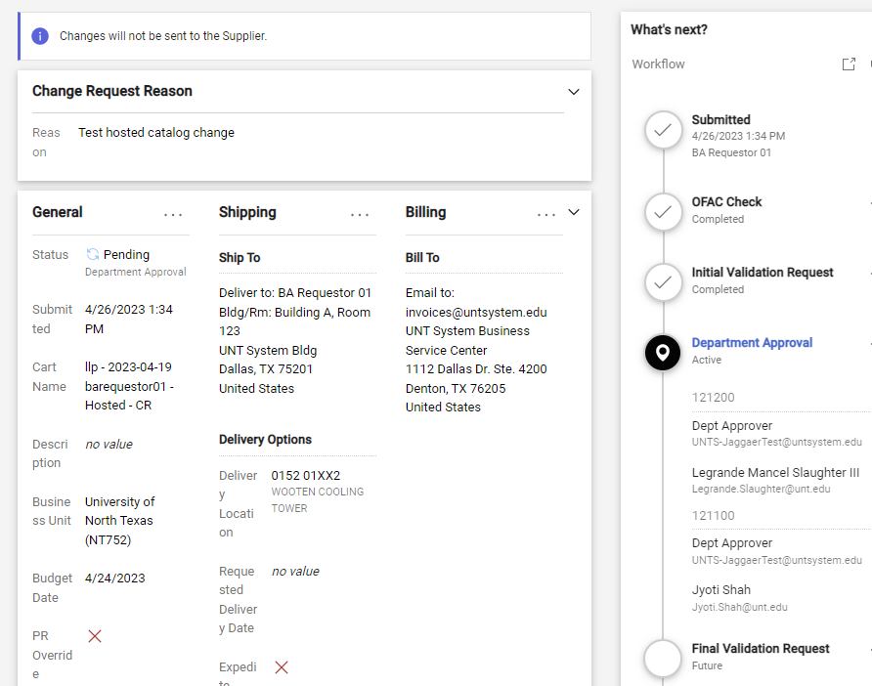
How Do I Change a Hosted Catalog Order? Quick Guide
Marketplace provides useful information about the status for your change request. The Location icon notifies you of the current workflow step. Clicking blue links in the What’s Next section will expand the workflow for you to view approvers.

