Slide 1
Shopping is Easy in UNT System Marketplace!
Marketplace Budget Exceptions

Slide 2
Marketplace Budget Exceptions
Workflow in the Marketplace was setup to perform budget checking at the beginning and at the end of the workflow process. The steps are labeled Initial Validation Request (step 2) and Final Validation Request (before PO is created). The reason for the two steps is due to not knowing the length of time a document will take to go through all the approvals. Therefore, funds may be available during the initial validation request, but not be available during the final validation requests.
A budget exception can be generated by the Marketplace after a Requisition, Change Request or a Service Form Request is submitted for approval.
The second step in the workflow is Initial Validation Request. On this step, the system performs various validations including validating the chartstring and performing budget checking for available funds. If an issue is found during this validation, the system will return the document to the requestor and a message will be included in the History tab as to why the document is being returned.
If the issue is related to budget checking, the system will display a budget exception message that provides detail information for the exception.

Slide 3
Marketplace Budget Exceptions
Below is an example of a message returned for a UNT System requisition. The message includes the ledger group and the current available balance for the chartstring. Users should confirm the current available balance by going to EIS, Cognos or for HSC users - Axiom (Reminder: Cognos & Axiom have a one-day lag).
Line: 0, Split: 0 - Budget Check Exception for Ledger Group: SY769 / EX_PAR : Department = 900120, Fund = 830029, Fund Category = 200, Function = , PC BU = , Project = , Activity = , Account = B5060, Program = , Purpose = , Site = , Budget Period = 2023 Available funds exceeded. Current Available Balance = $7,400.00 and Requisition amount for this Budget is: $10,000.00
If a document passes budget checking during the Initial Validation Request but fails budget checking during the Final Validation Request, the same information as above will be displayed in the History tab.

Slide 4
Marketplace Budget Exceptions
When a Requisition, Change Request or a Service Form Request is returned to a Requestor due to a budget exception for available funds exceeded, best practice is to “Move the money” and to resubmit.
An alternative method is to work with your budget office to get an override. This is done on a case-by-case basis and should not be the normal manner of doing business.
Move Funds Process:
UNT Denton - Automated Budget Authorization (ABA)
https://budget.unt.edu/sites/default/files/aba_ppt-_pdf_updated_9.23.2020.pdf
UNT Dallas - Automated Budget Authorization (ABA)
https://www.untdallas.edu/sites/default/files/aba_training_guide.pdf
untd-aba-process-10.4.21.pptx (live.com)
HSC:
Contact Budget Office
UNT System:
Contact Budget Office

Slide 5
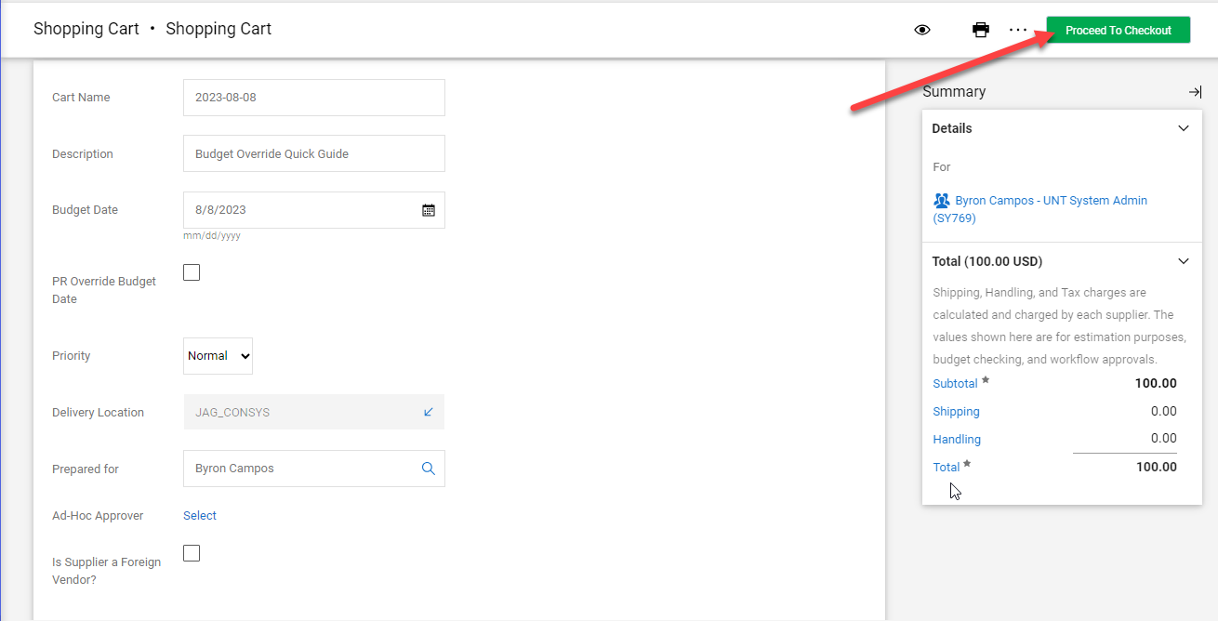
Marketplace Budget Exceptions
Processing a request for a Budget Override in the Marketplace:
Note: For System Administration departments, please email system_admin_budget@untsystem.edu in lieu of overriding in UNT Marketplace.
Before you can a request a budget override, you need to complete the initial required information in the Shopping Cart and then click on Proceed to Checkout button.

Slide 6
Marketplace Budget Exceptions
Processing a request for a Budget Override in the Marketplace:
After proceeding to checkout: Go to Summary tab, click on Edit General Section and complete the Request Budget Override and Budget Override Justification. (See next slide)
Note: The Budget Override Justification is required once the Request Budget Override box is checked. If left blank, the document will be returned to the requestor with the following message: “Budget Override Justification cannot be blank when Request for Budget Override is set to Yes”

Slide 7
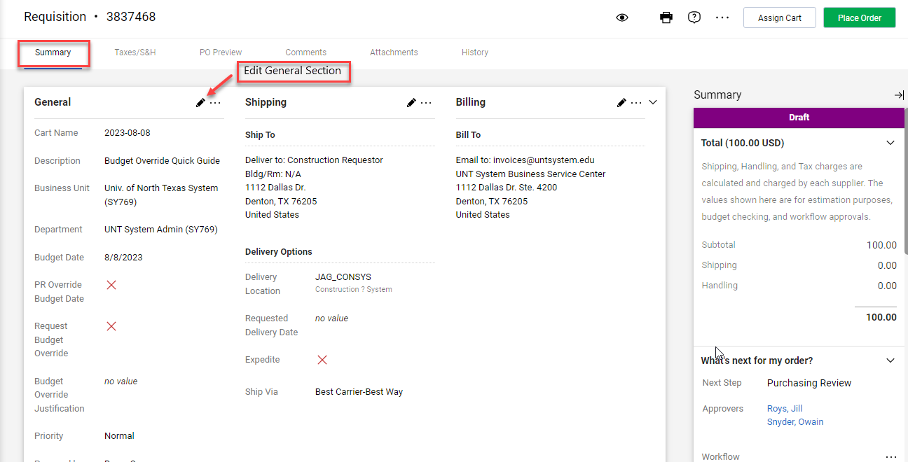
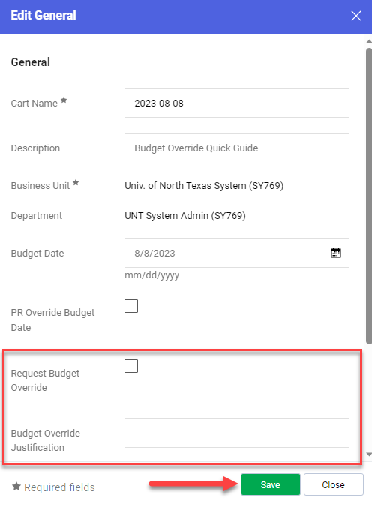
Marketplace Budget Exceptions
Processing a request for a Budget Override in the Marketplace:

Slide 8
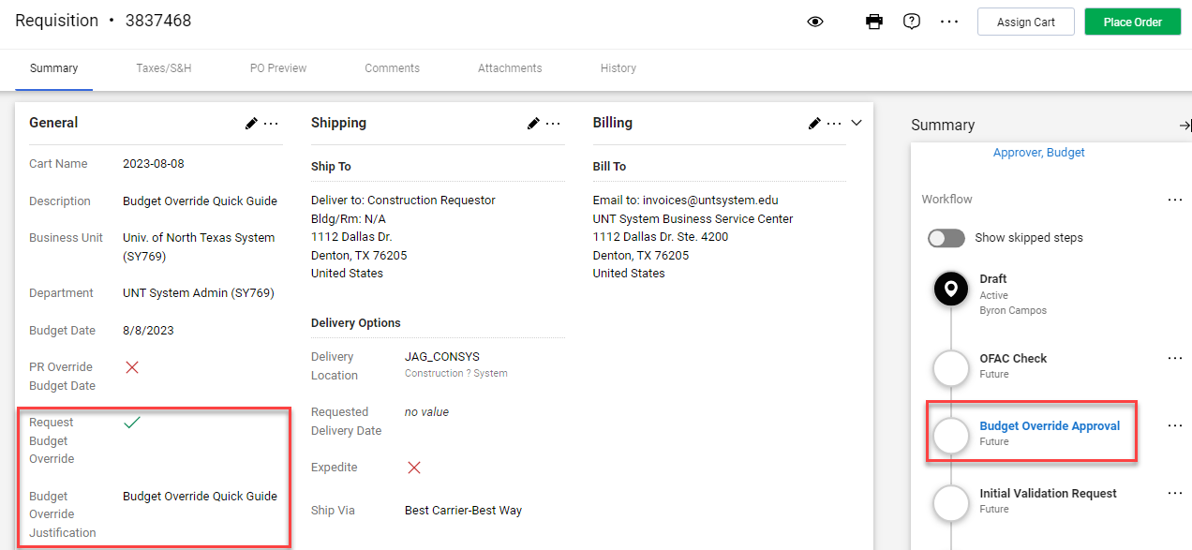
Marketplace Budget Exceptions
Processing a request for a Budget Override in the Marketplace:
Prior to clicking on “Place Order”, confirm the request for a budget override by verifying below:

Slide 9
Marketplace Budget Exceptions
Processing a request for a Budget Override in the Marketplace:
Note 1:
The process for requesting a budget override is the same for Requisitions, Change Requests or a Service Form Request
Note 2:
A Change Request (CR) is created from a PO and therefore, all the information including the budget override information is transferred to the CR. So, if you’re not increasing the amount of the PO when submitting the CR, the Request Budget Override box needs to be unchecked and the justification blanked out. Otherwise, the CR will route to the Budget Office for budget override approval.

Slide 10
Marketplace Budget Exceptions
Processing a request for a Budget Override in the Marketplace:
Invoices:
Budget Override requests are also available for Non-PO Invoices. However, only the AP team can request a budget override on an invoice.
For a Payment Request, the budget override request can be included before submitting the request for approval.
Note: PO invoices do not need override due to an existing encumbrance.

Slide 11
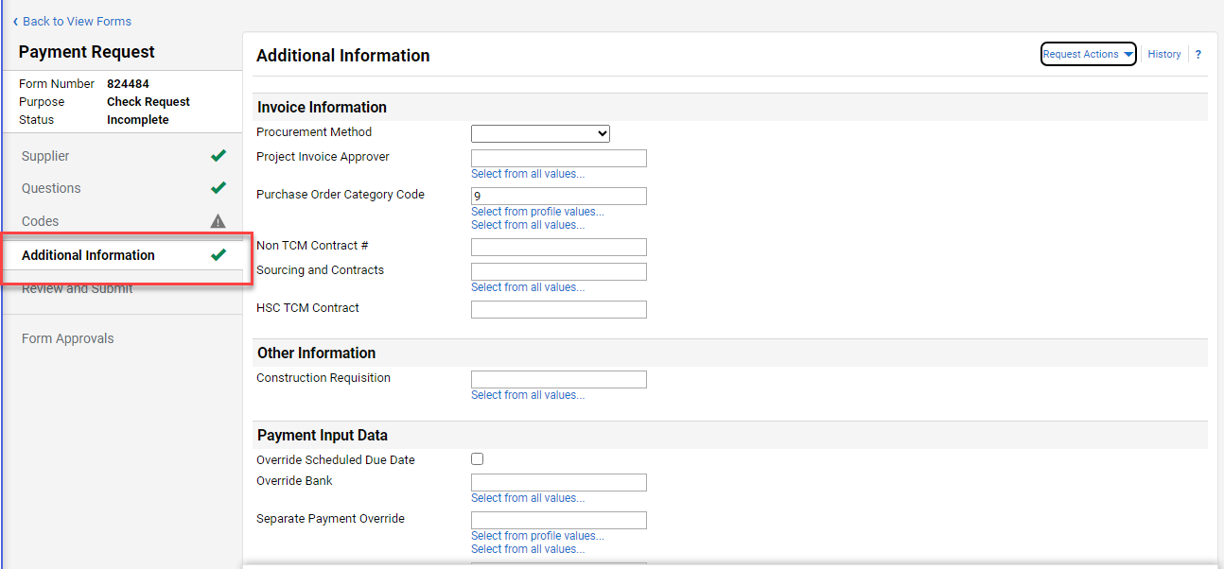
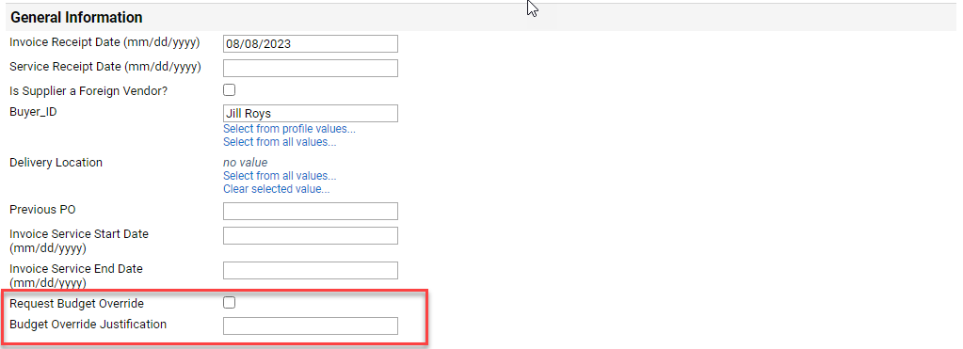
Marketplace Budget Exceptions
Completing the Budget Override request on a Payment Request:
Go to Additional Information and scroll down to General Information

