Slide 1
Viewing the status of Contracts
Total Contract Manager (TCM)

Slide 2
What is Total Contract Manager (TCM)
Total Contract Manager (TCM) is a web-based tool to assist with contract administration and is designed to enable organizations to manage the complete lifecycle of contracts from authoring to approval.
The Office of Contract Administration can assist with questions and negotiations but only officially begins working a contract when received via a Contract Request in TCM.

Slide 3
Access to Records in TCM
Access to contract records in TCM is granted by roles and permissions. You may have limited access to certain sections of Contract Records depending on your role. If you don’t find a contract or information you would like access to, contact the Office of Contract Administration for assistance.

Slide 4
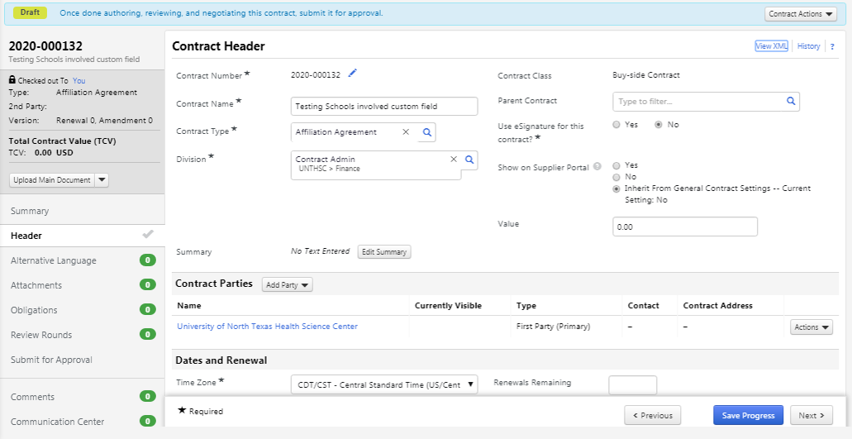
Finding Information on the Contract RECORD
Status = Draft, Internal Review, External Review
When the status is in draft status, OCA will leave notes, status updates, questions, and/or instructions in the Comments Section or the Communication Center.

Slide 5
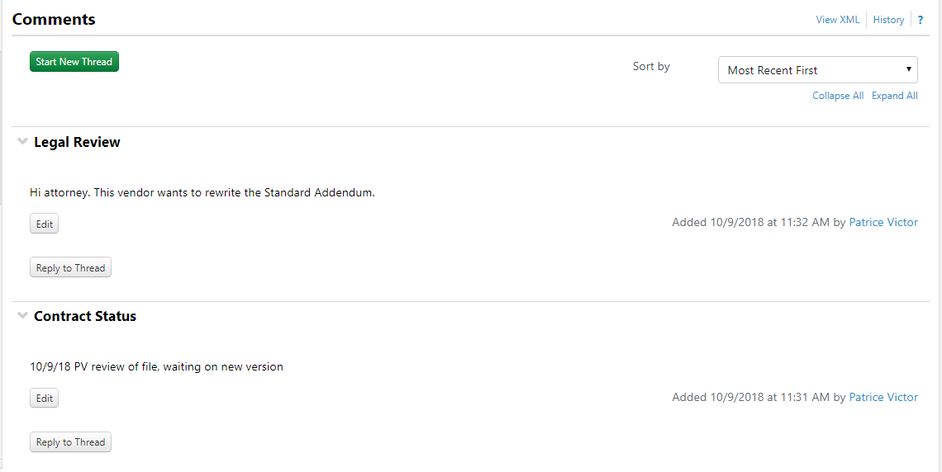
Comments
The Header in bold will highlight the topic of all of the messages in the thread.
The messages (notes, status updates, questions, and/or instructions) will be under the header.
The messages will be time stamped, listed in chronological order, and list the person that posted the message.

Slide 6
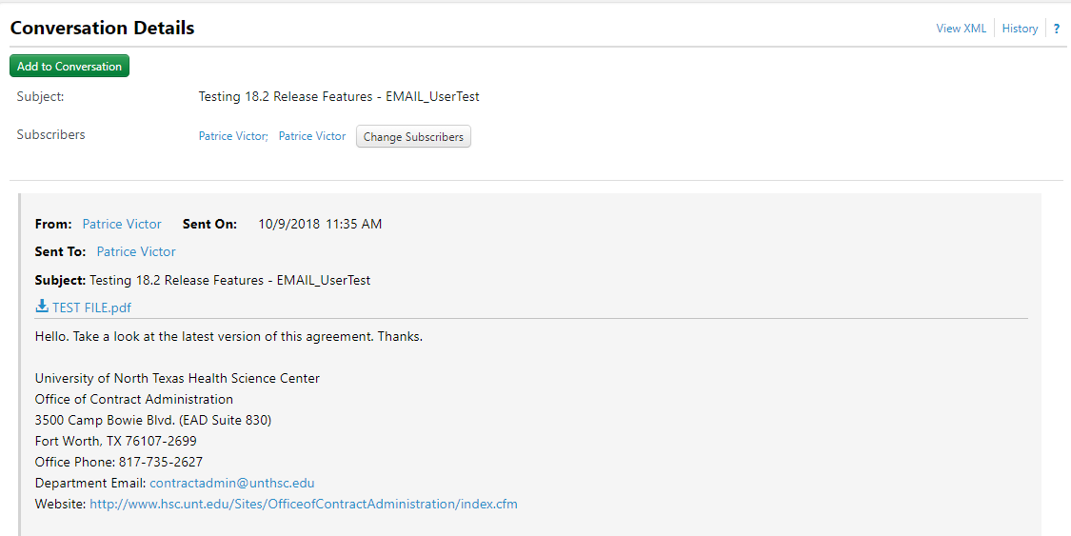
Communication Center
The Communication Center will contain emails OCA sends from the Contract Record.
Here is an example of an email.

Slide 7
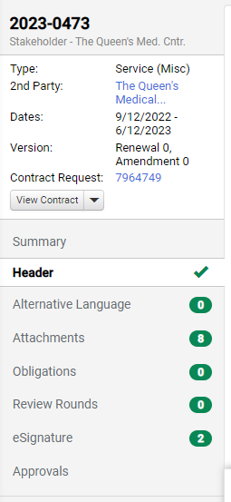
Finding Information on the Contract RECORD
Status = Out for Signature
When the contract status is “Out for Signature”, OCA has launched the contract for signature via DocuSign. You can view the recipients of the contract, if they have viewed the contract and if they have signed.
To open the section, select the “eSignature” link.

Slide 8
Finding Information on the Contract RECORD
Status = Out for Signature
Here you can see the signers, the order that the signers will sign, the information icon will show if the signer has viewed and/or signed the contract.

Slide 9
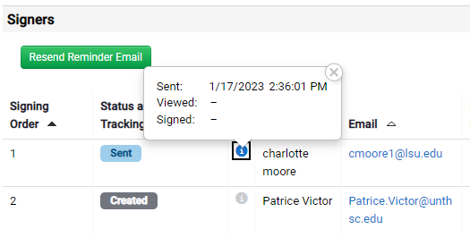
Finding Information on the Contract RECORD
Status = Out for Signature
Here is the view after you select the information icon.

Slide 10
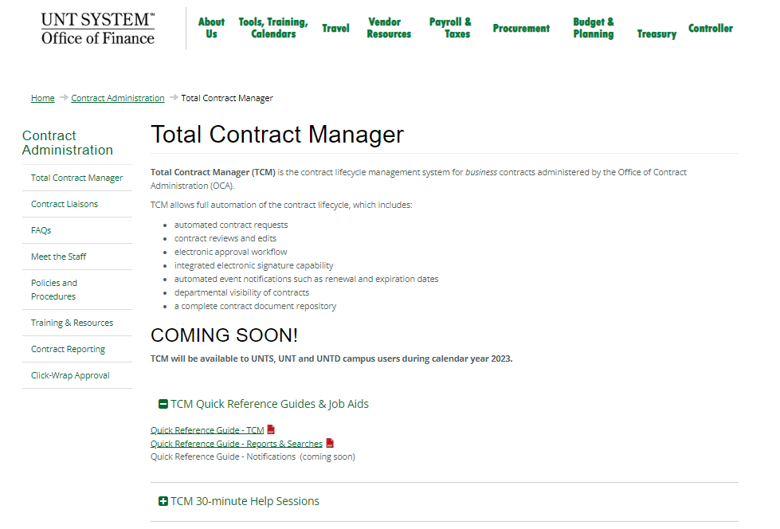
TCM Guides and Job Aids
Use the HSC TCM. DO NOT Submit Contract Requests here.

Slide 11
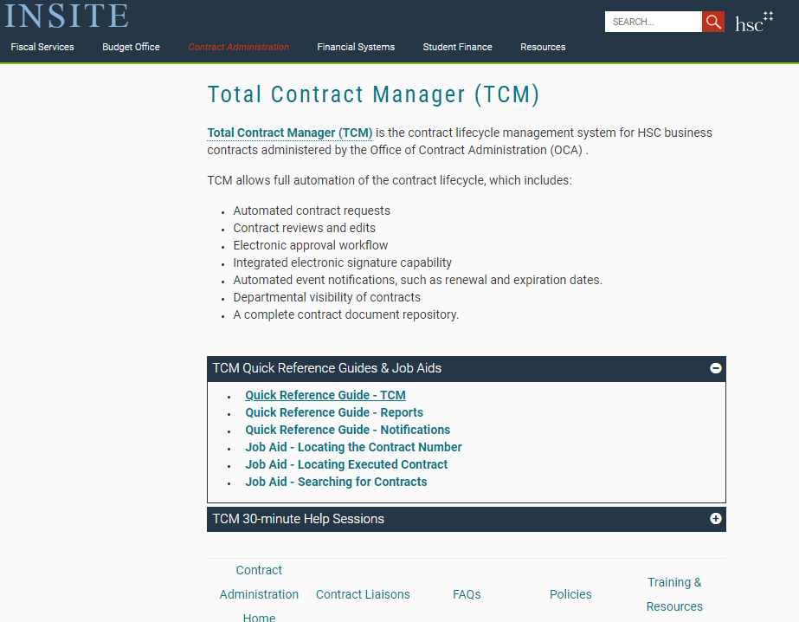
TCM Guides and Job Aids

