Slide 1
Searching for Contracts
Total Contract Manager (TCM)

Slide 2
What is Total Contract Manager (TCM)
Total Contract Manager (TCM) is a web-based tool to assist with contract administration and is designed to enable organizations to manage the complete lifecycle of contracts from authoring to approval.
The Office of Contract Administration can assist with questions and negotiations but only officially begins working a contract when received via a Contract Request in TCM.

Slide 3
Access to Records in TCM
Access to contract records in TCM is granted by roles and permissions. You may have limited access to certain sections of Contract Records depending on your role. If you don’t find a contract or information you would like access to, contact the Office of Contract Administration for assistance.

Slide 4
Contracts Modules
The functionality is the same for both TCM contract modules. Searching may be different because of varying field options. Otherwise, the steps shown in this presentation are the same. All users can search for contracts, but results and access will vary depending on your user permissions and system licenses. If you often search for the same things, you can save your search settings in a saved search to use again.

Slide 5
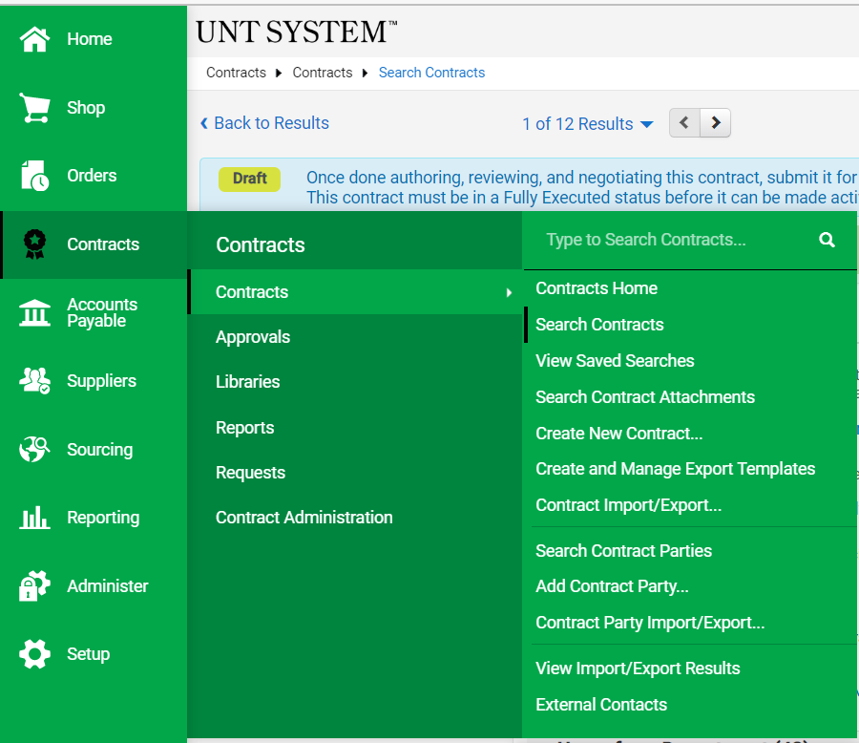

Slide 6
Types of Searches
There are two ways to search, and which type to use depends on what you're looking for:
Use Simple Search when you may not have all the information you need and want to search based on partial information. The system will search all contract fields for each keyword entered, providing you with a broad results set.

Slide 7
Types of Searches
There are two ways to search, and which type to use depends on what you're looking for:
Use Advanced Search when you have exact data or a complex set of values that you want to search for, e.g., you have a contract number, or want to apply multiple search filters to limit the number of search results. The system only returns results that are an exact match to the values entered.

Slide 8
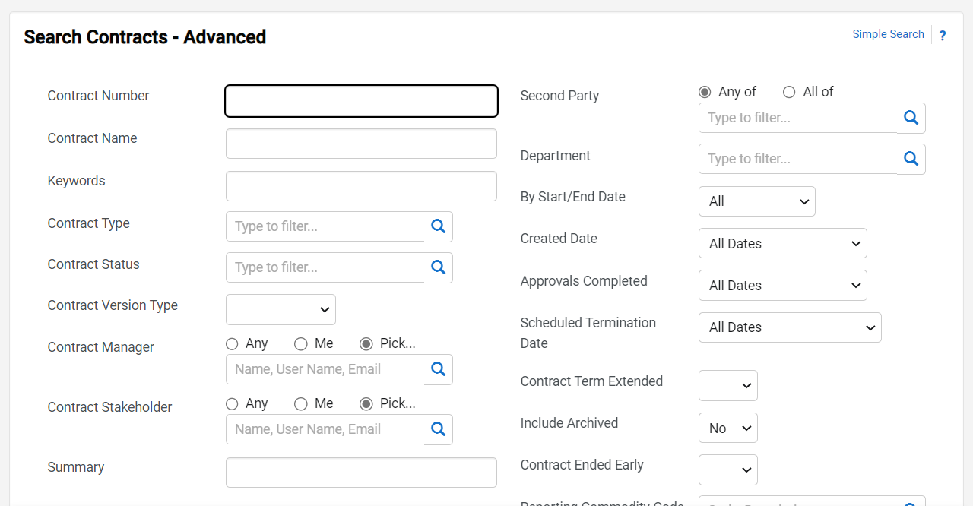
Toggle between “Simple Search” and “Advanced Search” with this link.

Slide 9
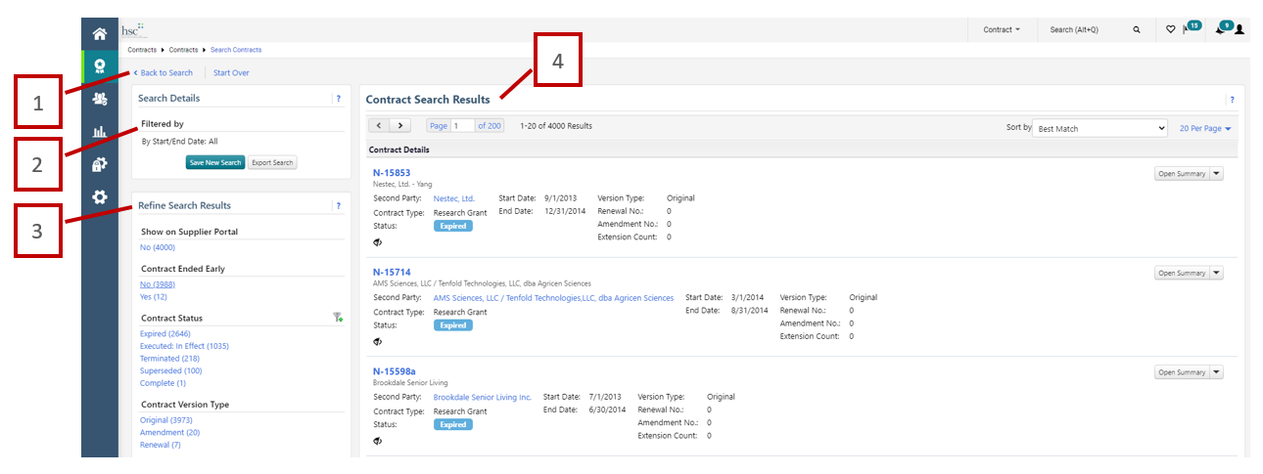
Understanding search results

Slide 10
Understanding search results
1. Back to Search/Start Over
Selecting Back to Search will return you to the search page with all of our previous search criteria intact. Selecting Start Over takes you to a brand new search with no criteria entered.
2. Filtered by
This section displays the filters/values by which your search results are filtered. Initially, any search criteria you entered will be displayed. As you add filters, the Filtered by section will update to reflect the new filters. From this section, you can also remove a single filter by de-selecting the associated checkbox are click the remove all link to remove all the filters. The Export Search button allows you to export the search results.
3. Refine Search Results
Search results can be refined by using the post-search filters. Below each filter, the available values display. The number of contracts associated with that value displays beside the value. Click on a value to filter the search results. Note: The filters and values displayed will vary based on your organization's set up and your individual permissions.
4. Contract Search Results
The search results display in a list and include the following information:
Contract No. - The contract number. Click on the number to view the Contract Record
Contract Name - The contract name.
Second Party Name - The second party or on the contract, i.e., who the contract is with.
Contract Type - The contract type.
Status - Indicates where the contract is in the contract workflow.
Start Date/End Date - The start and end date of the contract.

Slide 11
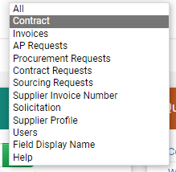
Searching for Contracts
This search is a “global” search of the TCM system that is recommended when you are not sure where in the system you might find the information for which we are looking. Be sure to filter - see example dropdown menu on the left.
Top Navigation Bar

Slide 12
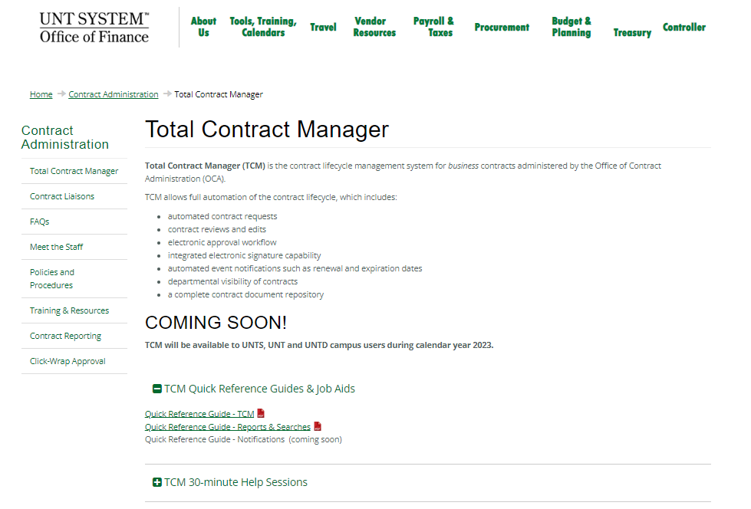
TCM Guides and Job Aids
Use the HSC TCM. DO NOT Submit Contract Requests here.

Slide 13
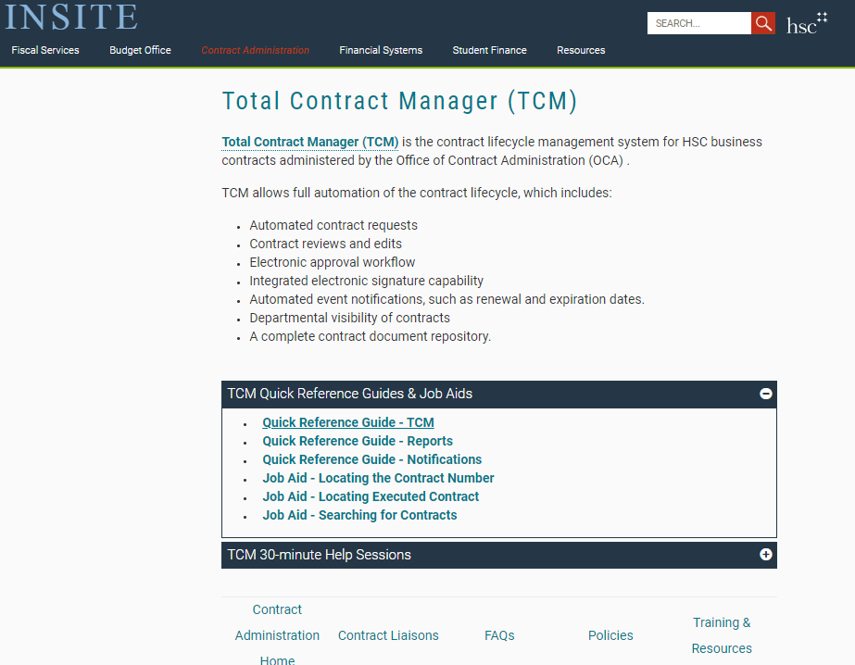
TCM Guides and Job Aids

