Slide 1
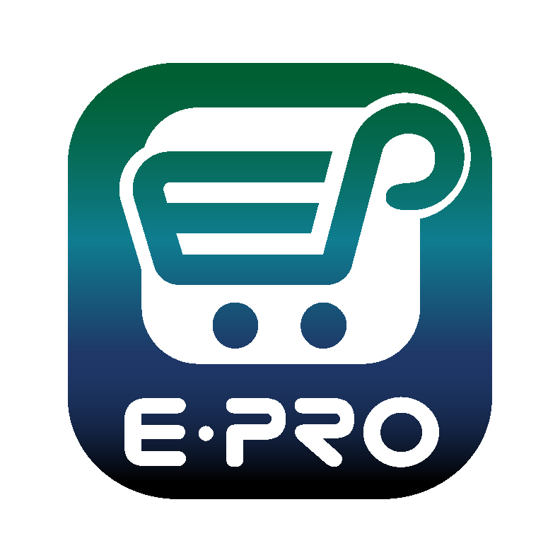
Shopping is Easy in ePro!
Non-Catalog Shopping Quick Guide​

Slide 2
Creating a Cart with a Non-Catalog Supplier
ePro Shoppers and Requestors:
Both Shoppers and Requestors can shop for items and add them to carts.
Requestors have additional permissions:
Requestors can submit carts that have been assigned to them by Shoppers.
Requestors are users who have knowledge of ePro accounting codes and Chartfields. The requestor may need to update the requisition with these codes before placing an order.
Responsibilities of a Requestor include following Procurement Guidelines, bid thresholds, validating accuracy of Accounting Chartfields, Ship To information, and Business Purpose.

Slide 3
Creating a Cart with a Non-Catalog Supplier
Your Home page contains links to make shopping easier.
If you need to purchase goods from a supplier who does not have a catalog in ePro, you can utilize the Non-Catalog Item link in the top navigation bar.

Slide 4
Creating a Cart with a Non-Catalog Supplier
Begin by selecting a Supplier using the Search feature (the magnifying glass). A pop-up list will display for you to find your supplier.
When you begin typing the name of your supplier on the pop-up, Search will auto-populate a list of options for you. Click the “+” sign to select your supplier.

Slide 5
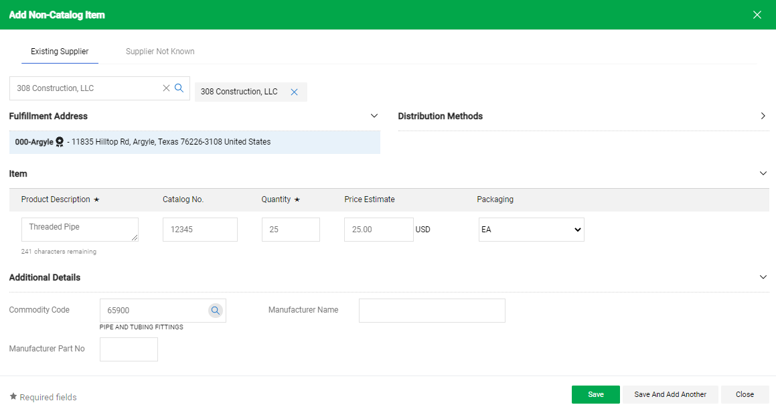
Creating a Cart with a Non-Catalog Supplier
You will need to complete information about the item:
Product Description
Catalog Number
Quantity
Price Estimate
Packaging
Click the arrow to expand Additional Details and add a Commodity Code.
Save to add the item to your cart or Save And Add Another to continue shopping for items.

Slide 6
Creating a Cart with a Non-Catalog Supplier
When you click the Cart icon or the link displaying the amount of your cart, a popup displaying items in your cart will appear. ​
​
You have the option to View My Cart or Checkout. When you choose to checkout, a requisition will be created.​
If you choose the option to View My Cart, you can review items in the cart, update the Cart Name, choose a Delivery Location, and make other adjustments as needed.​
​

Slide 7
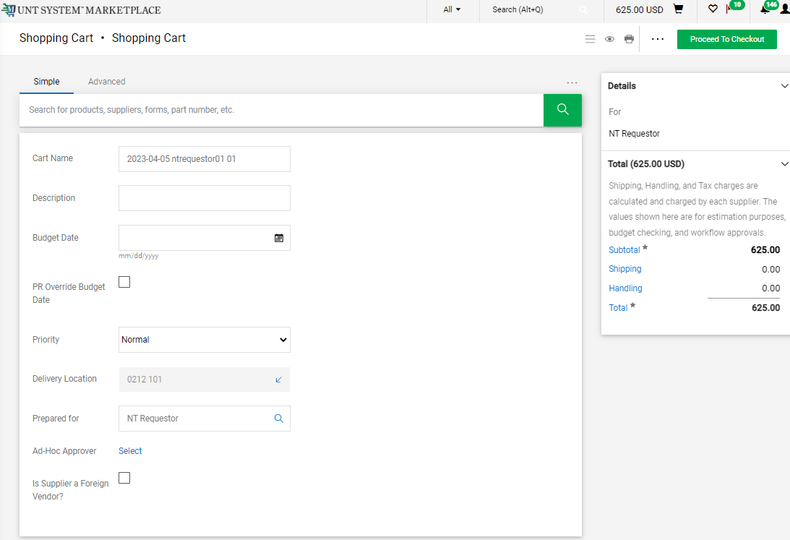
Creating a Cart with a Non-Catalog Supplier
​If you choose the option to View My Cart (shown on the previous slide), you can add or remove items, but you should not attempt to add items from multiple suppliers to one cart.
When you are ready to check out and create your Requisition in Marketplace, click the Proceed to Checkout button.​

Slide 8
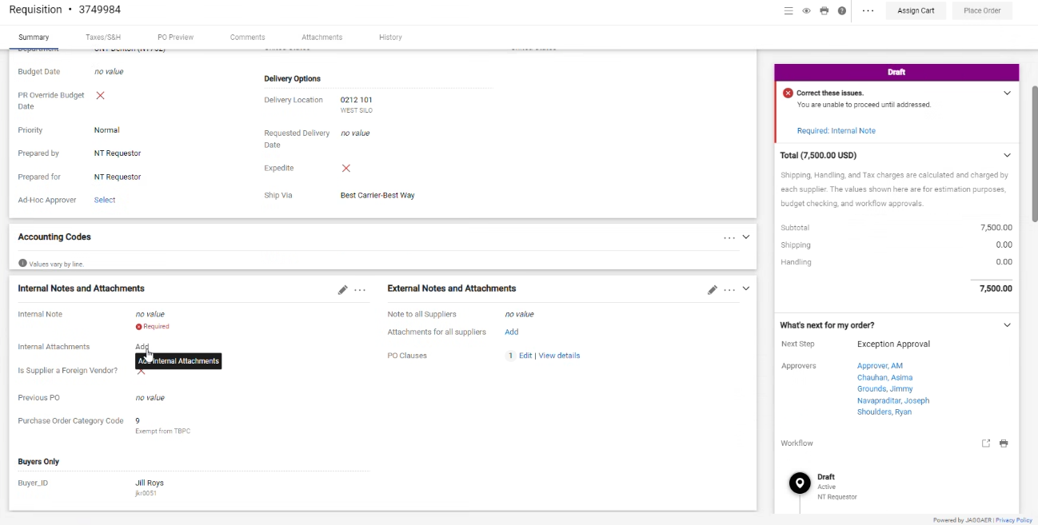
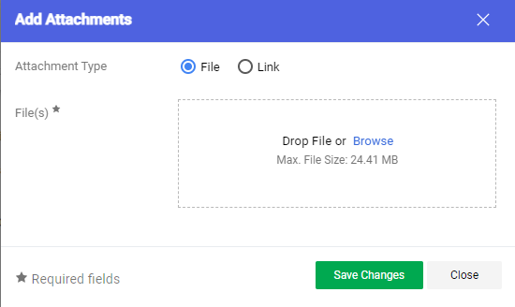
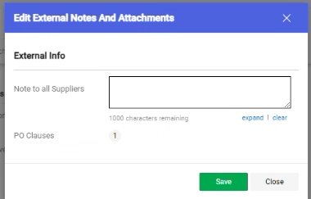
Creating a Cart with a Non-Catalog Supplier
​
Internal and External attachments can be added by clicking the Add links in the Internal Notes and Attachments section and External Notes and Attachment section.
Please note that external attachments are visible to suppliers.

Slide 9
Creating a Cart with a Non-Catalog Supplier
​
For SHOPPERS, the next step is to Assign Cart to a designated requestor to place the order. See page 10 for additional details.
For REQUESTORS, the next step is to proceed directly to Place Order.​
To continue creating your requisition or to submit requisitions assigned to you by Shoppers, please follow the instructions on page 11 and in the Requisition from the Shopping Cart document.​​ ​​

Slide 10
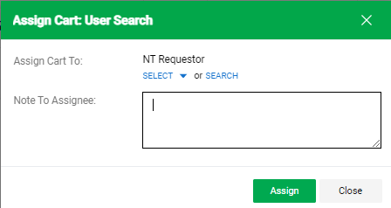
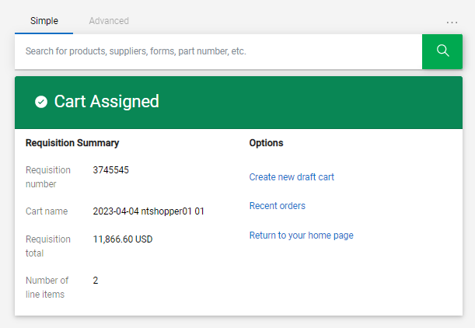
Creating a Cart with a Non-Catalog Supplier
If you are a Shopper, you will be prompted to select a Requestor to review and submit your cart after you click the Assign Cart button. Once your assigned Requestor places the order, the requisition will begin the ePro approval process.

Slide 11
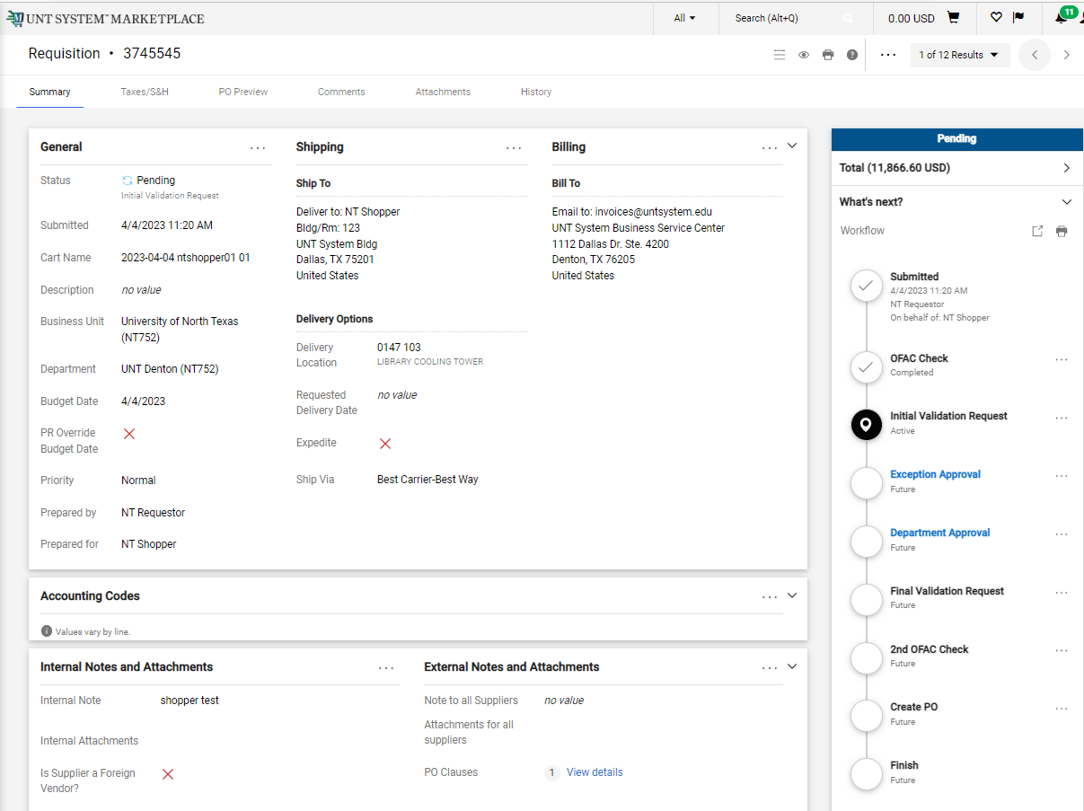
Creating a Cart with a Non-Catalog Supplier
When the Requestor places the order, the workflow status can be viewed in the What’s Next section of the requisition. Once it moves all the way through the workflow, a Purchase Order will be issued.

