Slide 1
Shopping is Easy in ePro!
Navigation​

Slide 2
Home icon brings you back to the main shopping page
The Shop icon provides you access to the shopping options and carts
The Orders icon allows you to search for documents
The Contract icon allows you to view University Contracts.
Navigating around ePro
The Accounts Payable icon allows you to view invoice information
The Suppliers icon allows you to search for current suppliers
The Sourcing icon allows you to view sourcing event
The Reporting icon allows you access to reports based on role
Administer only available to Jaggaer Administrators
Setup only available to Jaggaer Administrators

Slide 3
Basic Search
You can use the search box at the top of your homepage to search for relevant things throughout the system.
Quick links to mostly frequented pages are setup.
You can also browse by different options.

Slide 4
Global Search
You can use the Search (Alt+Q) at the top of your homepage for a robust search across ePro for anything.
You can also filter the search down by selecting from the dropdown

Slide 5
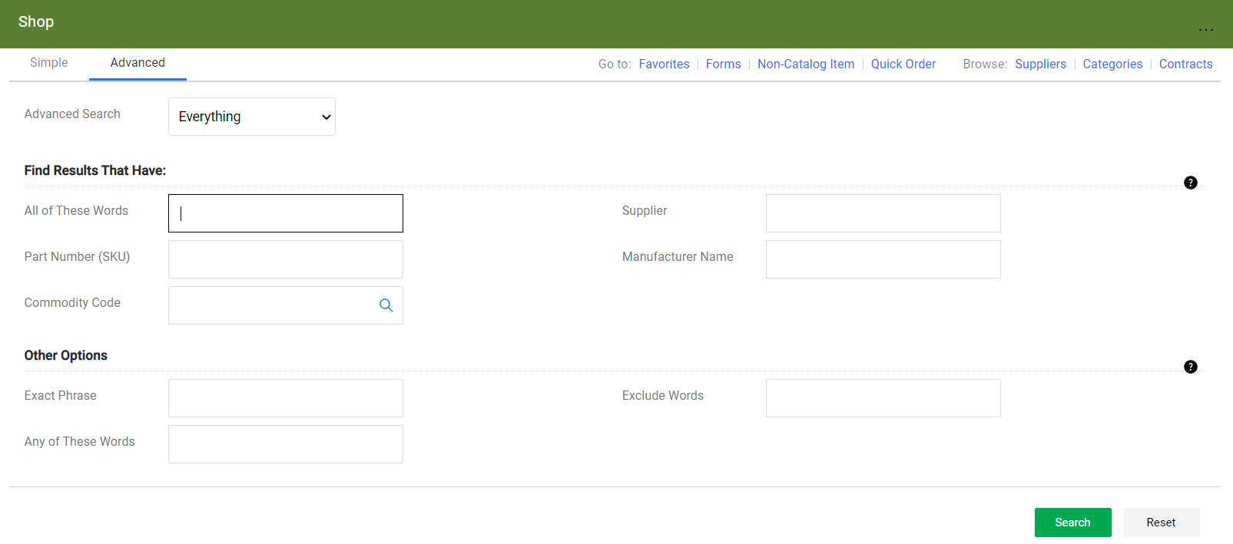
Advanced Search
You should use the Advanced Search to focus and limit the results using filters and sort options

Slide 6
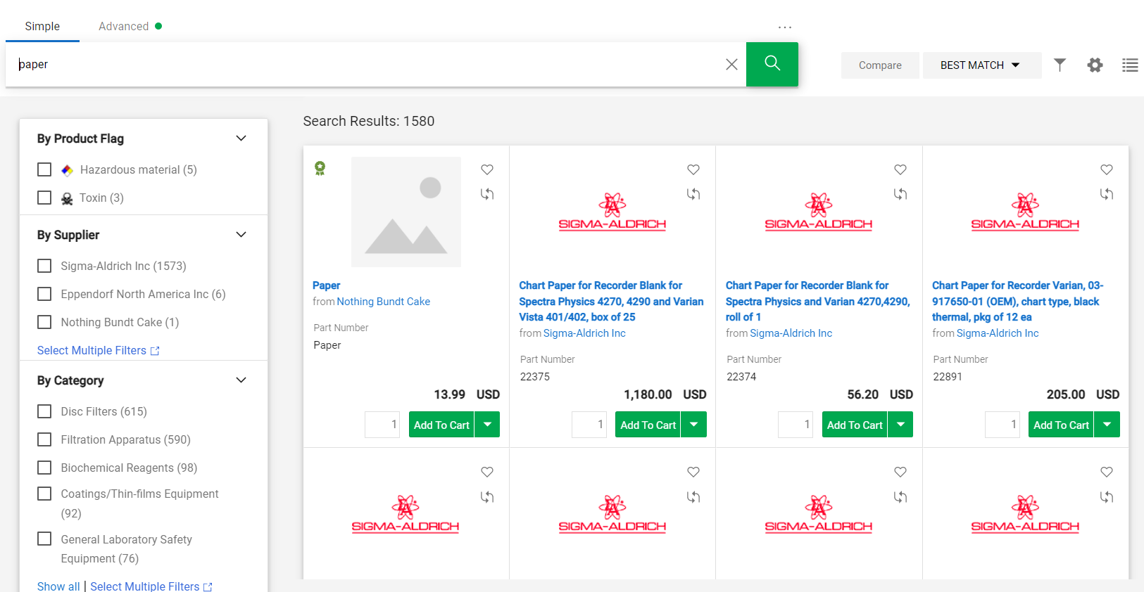
New Shopping Screen
Expand to view more options
Add Favorites
Sort Options
Filters
You can find more details on Navigation in the internal documentation.

