Slide 1
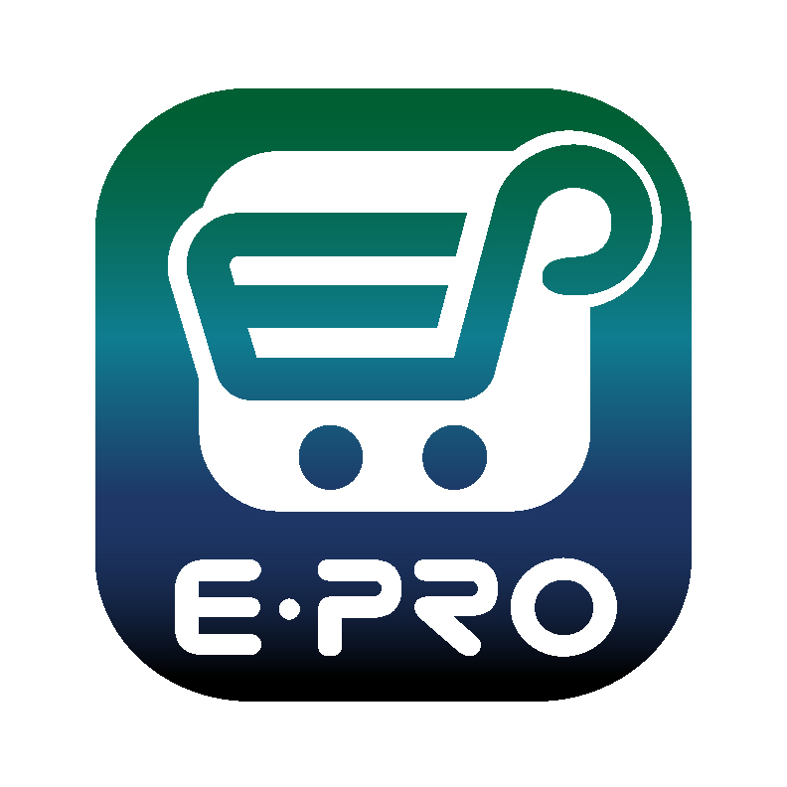
Shopping is Easy in ePro!
Creating a Change Request
for a Non-Catalog Item
Quick Guide​

Slide 2
Creating a Change Request for Non-Catalog Items Quick Guide
ePro Requestors:
Requestors have permissions for creating change requests:
Requestors can submit change requests. On non-catalog change requests, Requestors can update price, quantity, accounting Chartfields, commodity codes, shipping information, notes and attachments.
The Requestor can submit change requests on behalf of Shoppers, who do not have permission to submit change requests.
Requestors are users who have knowledge of ePro accounting codes and Chartfields. The requestor may need to update the Change Request with these codes before placing an order.
Responsibilities of a Requestor include following Procurement Guidelines, bid thresholds, validating accuracy of Accounting Chartfields, Ship To information, and Business Purpose.

Slide 3
Creating a Change Request Quick Guide
From the search bar on the top of ePro screen, search for the PO Number needing a change request. ePro search will allow you to search using a portion of the PO number. As you can see in the example, the system provides multiple ways to search.
Click the link to the PO Number when it is displayed.

Slide 4
Creating a Change Request Quick Guide
From the Purchase Order, click on the three dots in the top right of the screen, and click the link to Create Change Request.

Slide 5
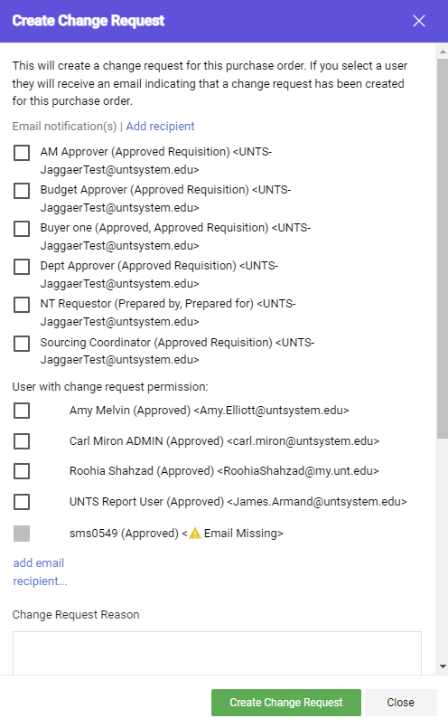
Creating a Change Request Quick Guide
Optional for this form:
You can send an email notification by clicking the checkbox to the recipient(s) you wish to include.
You can also attach files to the change request.
Required for this form:
In the Create Change Request window, enter a Change Request Reason (for instance: give details for a price change).
Click the Create Change Request button.

Slide 6
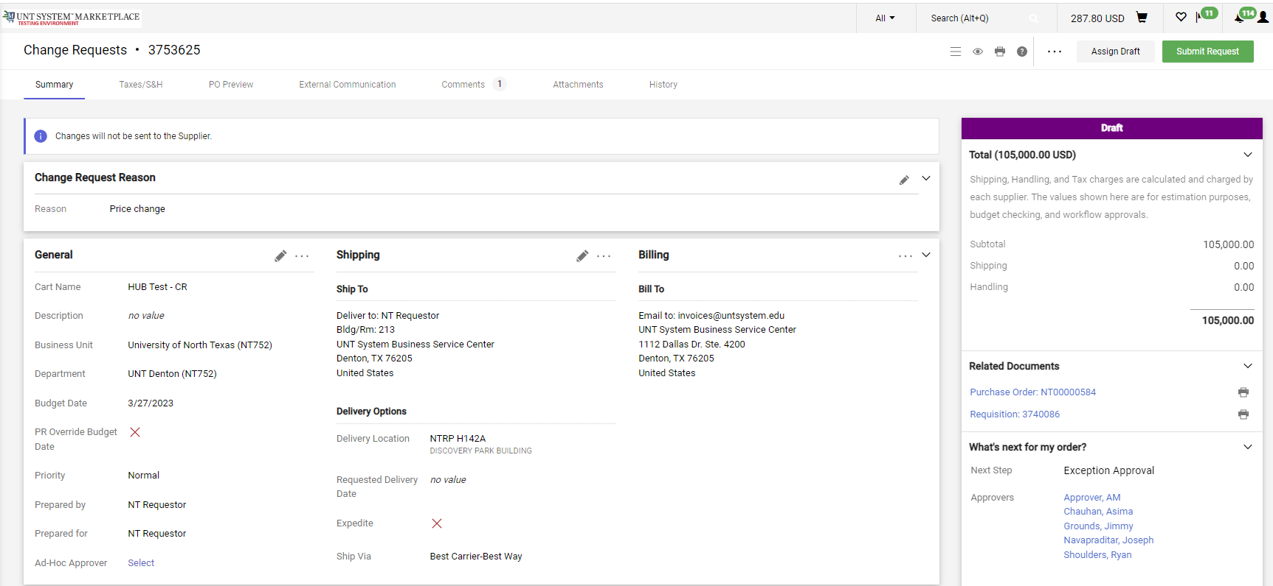
Creating a Change Request Quick Guide
The Change Request is created and ready for additional updates by you.

Slide 7
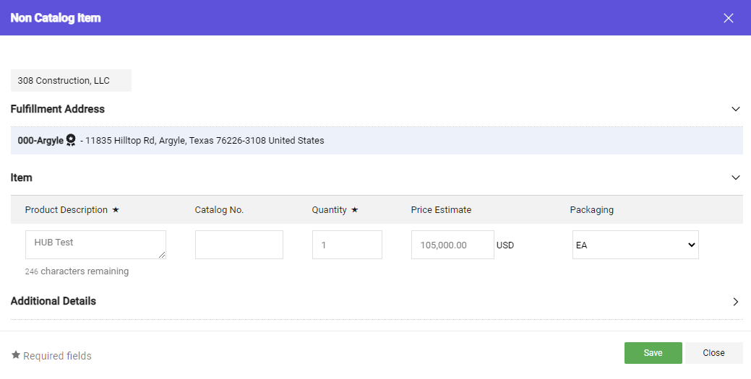
Creating a Change Request Quick Guide
Click the link for the Item description in the Item section. On the Non-Catalog Item window, make your changes and click the Save button.

Slide 8
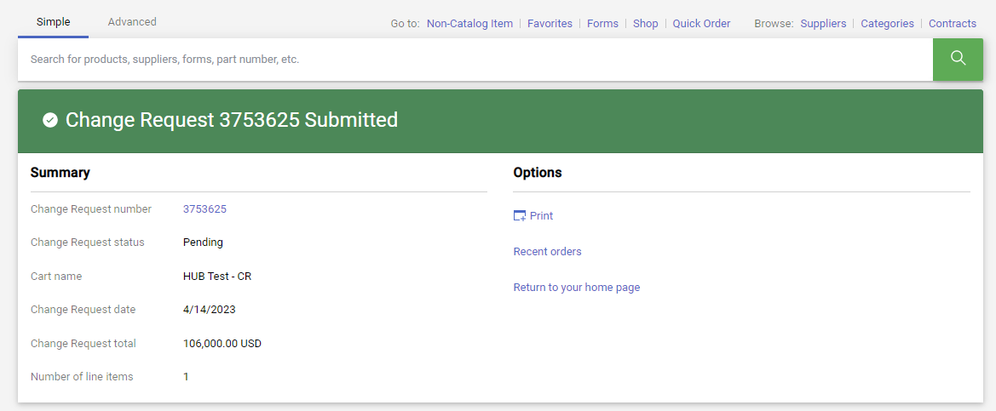
Creating a Change Request Quick Guide
After you review your changes, click the Submit Request button in the top right section of the change request. A confirmation will display to confirm the request is successfully submitted.

Slide 9
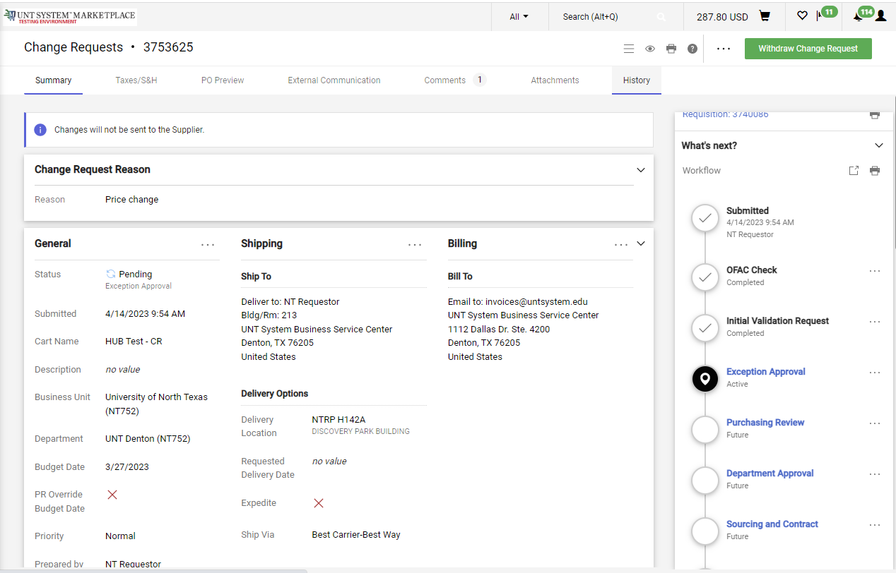
Creating a Change Request Quick Guide
You can view the status of your change request by watching the Location icon in the workflow.

