Slide 1
ePro & EIS
Approving Budget Overrides​

Slide 2
ePro Budget Exceptions
When a Requisition, Change Request or a Service Form Request is returned to a Requestor due to a budget exception for “available funds exceeded”, best practice is to “Move the money” and resubmit.
An alternative method is to work with your budget office to get an override. This is done on a case-by-case basis and should not be the normal manner of doing business.

Slide 3
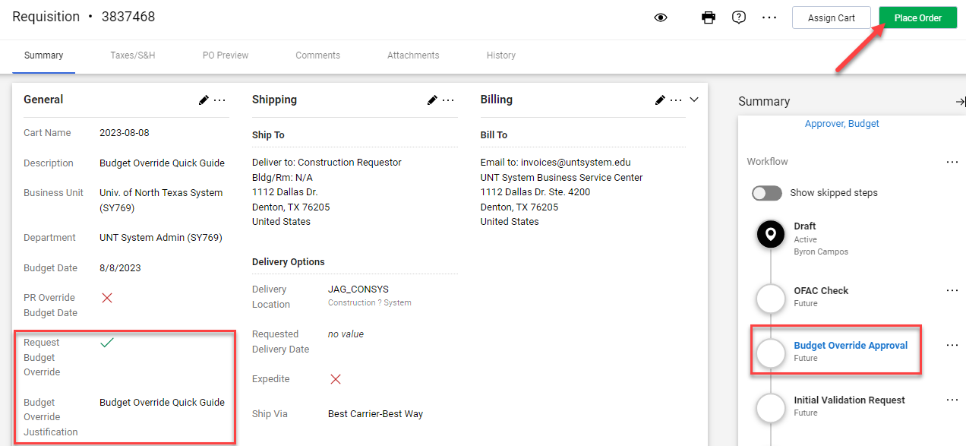
ePro Budget Exceptions
Budget Override Request completed by Requestor:
Once a requestor completes the budget override information, they will see the below and if they have completed all the information needed for the requisition, they will submit by clicking the Place Order button.

Slide 4
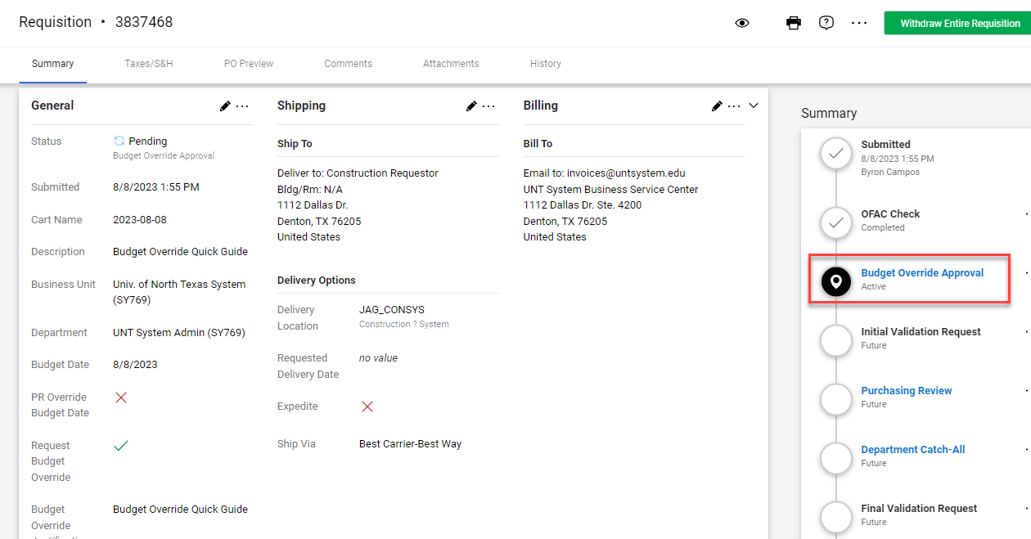
ePro Budget Exceptions
Budget Override Request completed by Requestor:
After the Place Order button is clicked, the requisition will begin going through the approval process.
The requisition shows that is currently at the Budget Override Approval step – status equal Active. Once the step is triggered, the approvers listed in the step will receive a notification and an email.

Slide 5
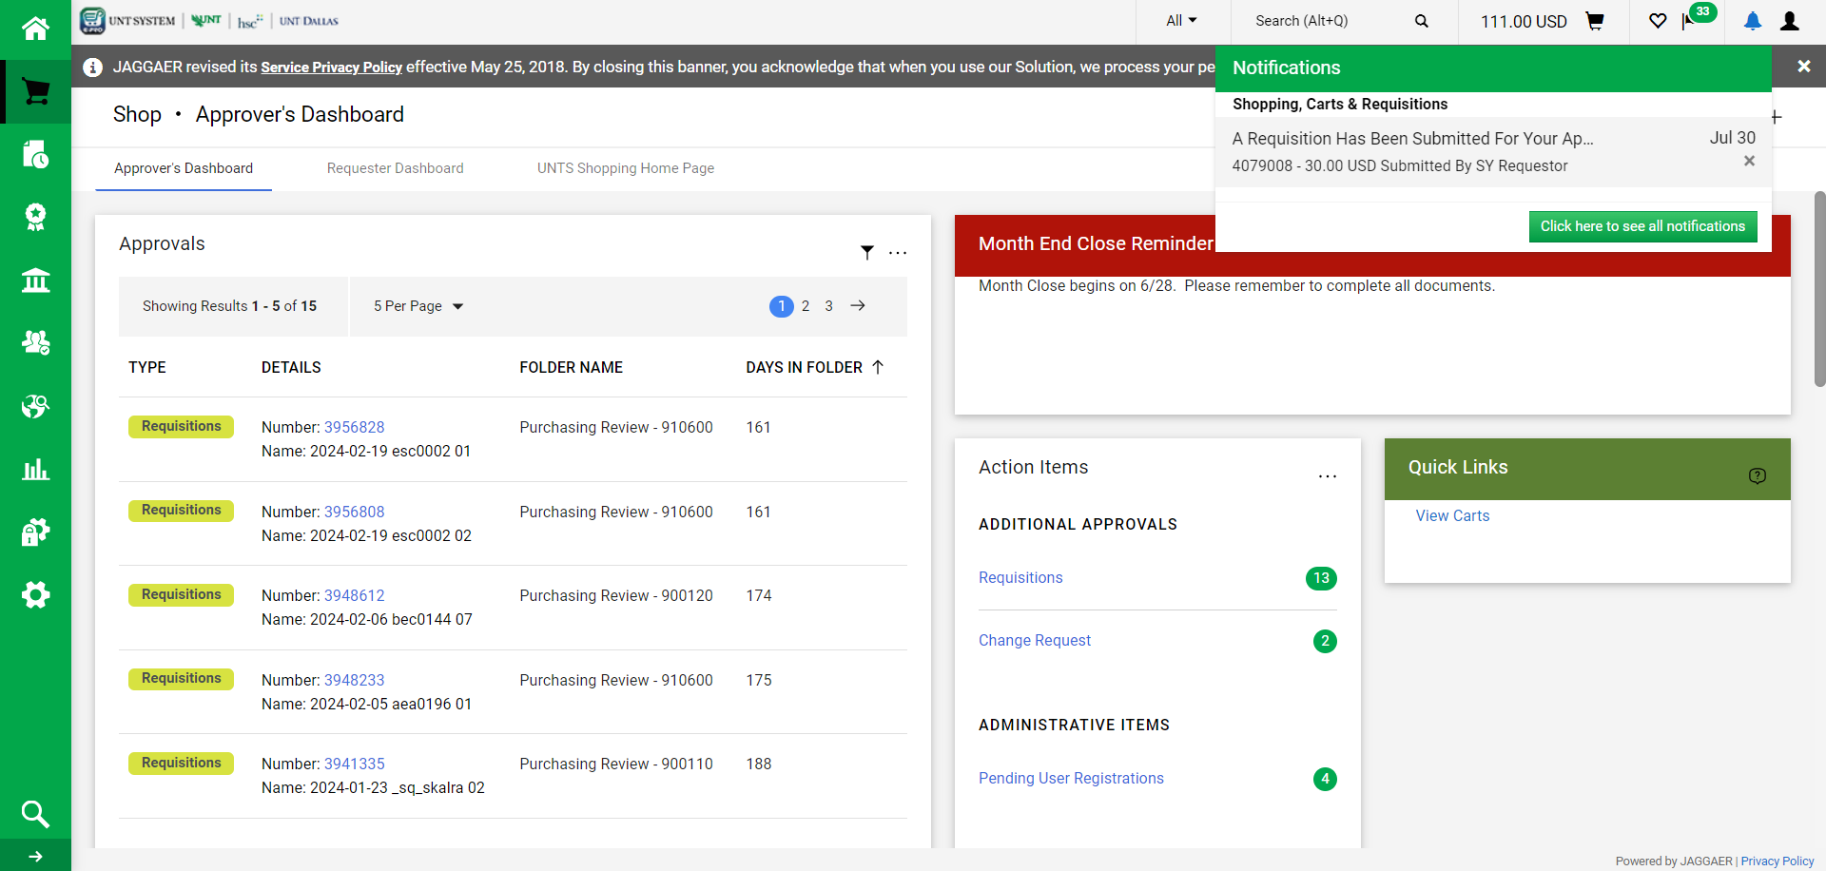
ePro Budget Exceptions
Approving a Budget Override Request in ePro
Once you’re on your Home page, you have different options for retrieving requisitions you need to approve.
Click on Notifications and you will get a list of items that need your attention.
Click on one of the Hyperlinks:
Requisition hyperlink showing a Folder Name of your Business Unit characters plus Budget Override Approval (i.e., SY Budget Override Approval)

Slide 6
ePro Budget Exceptions
Approving a Budget Override Request in ePro
Click Requisitions to Approve hyperlink. The hyperlink will take you to the Approvals page. On the Approvals page, you will see a folder of your Business Unit characters plus Budget Override Approval (i.e., SY Budget Override Approval). Expand the folder to see Budget Override Requests that need approval.

Slide 7
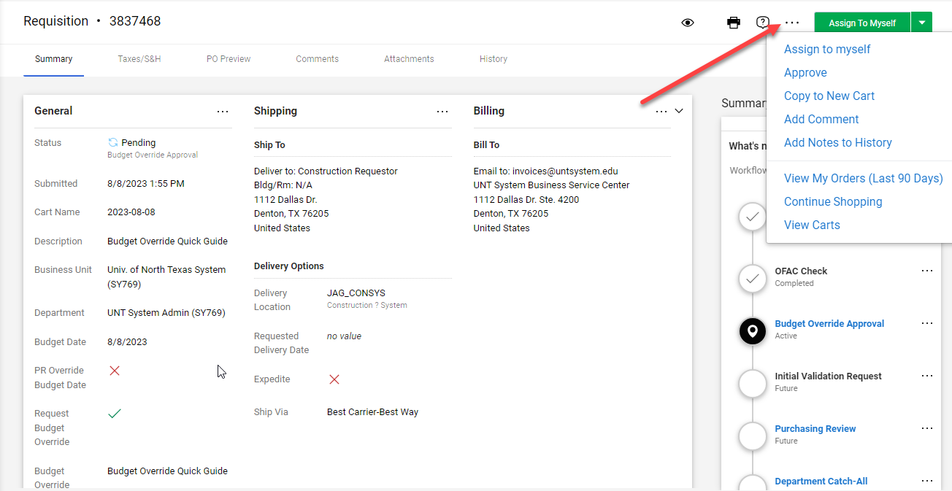
ePro Budget Exceptions
Approving a Budget Override Request in ePro
Once you retrieve a requisition you need to approve, click on the three dots “…” at the top of the page to perform one of the actions from the dropdown menu.
To approve the Budget Override Request, click on Approve and that’s all you need to do.

Slide 8
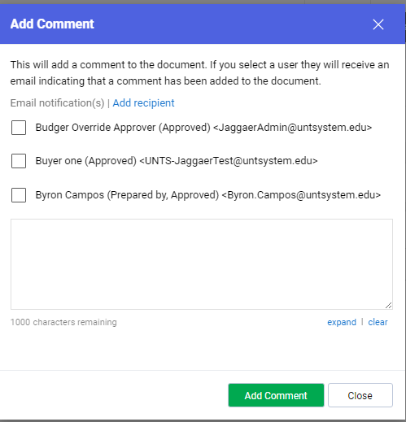
ePro Budget Exceptions
Approving a Budget Override Request in ePro
You can also add a comment here prior to approving by clicking on Add Comment.

Slide 9
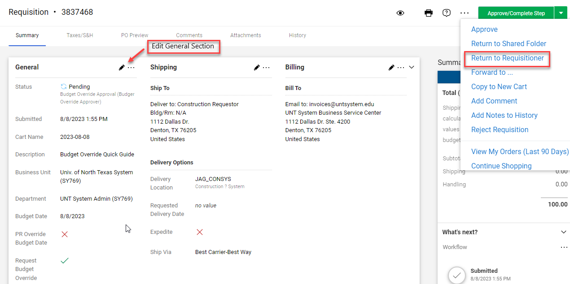
ePro Budget Exceptions
Approving a Budget Override Request in ePro
If you click on Assign to Myself, you will get another set of options which include not approving the Budget Override Request by selecting Return to Requisitioner.
Also, when Assign to Myself, you’re able to make updates to the requisition by clicking on one of the pen icons.

Slide 10
ePro Budget Exceptions
Approving a Budget Override Request in ePro
It’s not recommended for approvers to make any updates to a requisition that has been routed to them for approval. If you see something that needs updating, return the requisition to the requestor by clicking on Return to Requisitioner.
A comment can also be added when Assign to Myself to include additional information regarding the budget override or for any other information after clicking on Add Comment.

Slide 11
ePro Budget Exceptions
Approving a Budget Override Request in ePro
Note 1: PO’s that are created from a requisition that was approved for a budget override will need to be override in EIS
Note 2: Budget Override Requests for invoices follow the same approval process as Requisitions
PO Invoice (Created Electronic or AP)
Invoices created from a PO in ePro are not budget checked since an encumbrance exists for the PO. Therefore, no Override is needed in ePro or EIS
Non-PO Invoice (Created by AP)
Override needed in ePro and EIS if budget deficit. AP completes the Budget Override Request and submits for approval.
Payment Request
Departments complete the Payment Request and AP approves the request to create a non-PO invoice. Departments can complete the Budget Override Request on the Payment Request. Only AP can update the invoices created from a Payment Request.
Override needed in ePro and EIS if budget deficit. AP completes Budget Override Request and submits for approval if not originally completed on the Payment Request.

