Slide 1
PaymentWorks: Initiator Role
Procurement Office
March 2023

Slide 2
Vendor Onboarding Process
Initiator
Monitors Invite Status
Vendor
Completes Registration
PaymentWorks
Verification of TINS
Verification of Banking Information
Checks for Financial Sanctions
Supplier Management
Review and Approval Vendor Registration
Sets Up User Account
Updates Company Information
Grants Access to Company Users
Invites Vendor

Slide 3

Initiator Role
ePro Coordinators will have access to PaymentWorks. Once users log in, the role defaults to the Initiator Role.
Initiator Responsibilities
A valid vendor email address is required

Slide 4
How to Navigate PaymentWorks
Initiator Role Navigation:
Log into link on UNTS Procurement website (https://www.paymentworks.com/login/saml/?idp=unt)
  You will be prompted to log in via SSO (Single Sign-On) using your EUID and password
Once logged in, you can:
  Search
  Set up or update vendor information

Slide 5
How to Search
for Suppliers

Slide 6
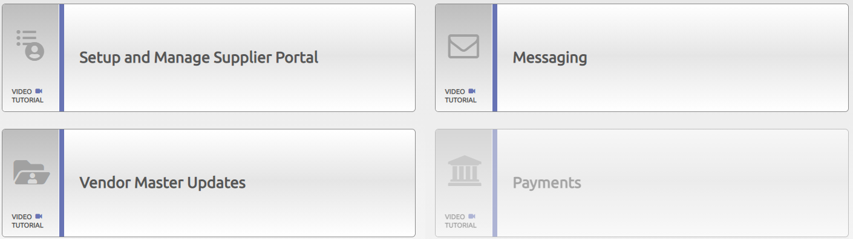
Search for Suppliers
Option 1
Once logged in to PaymentWorks, click on Setup and Manage Supplier Portal to send an e-invitation to vendor.
Click on the Suppliers tab.

Slide 7
Search for Suppliers
Option 1 cont.
The Supplier list is displayed.
Note: A vendor can be approved but not connected. Connected means the vendors in PaymentWorks have successfully interfaced into PeopleSoft.

Slide 8
Search for Suppliers
Option 1 cont.
To display Connected Suppliers ONLY, click on the Connected search field and select option Connected Only. Verify supplier address to ensure correct vendor is used.

Slide 9
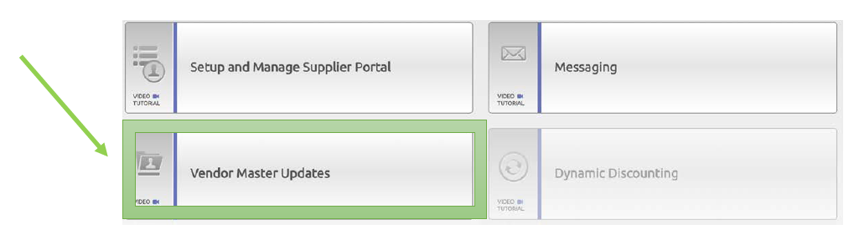
Search for Suppliers
Option 2
Go back to Home and click on Vendor Master Updates
Click on the New Vendors tab

Slide 10
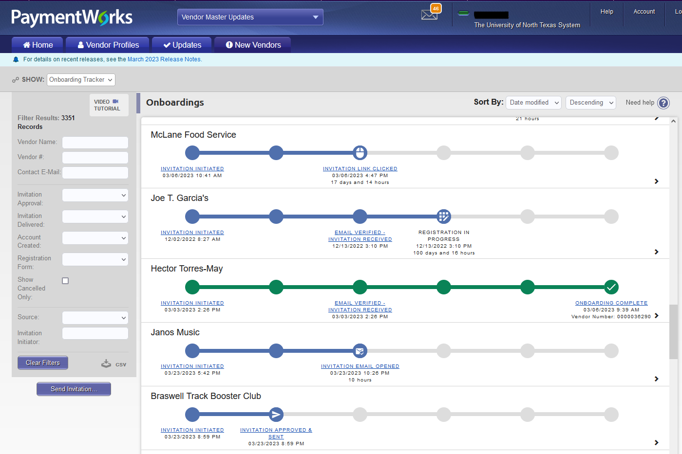

Search for Suppliers
Option 2 cont.
The new supplier list is displayed
  Show "Onboarding Tracker" on the left
  Scroll through the supplier list
*The supplier registration invitation has been sent by the department. Observe the different statuses of an invite.

Slide 11
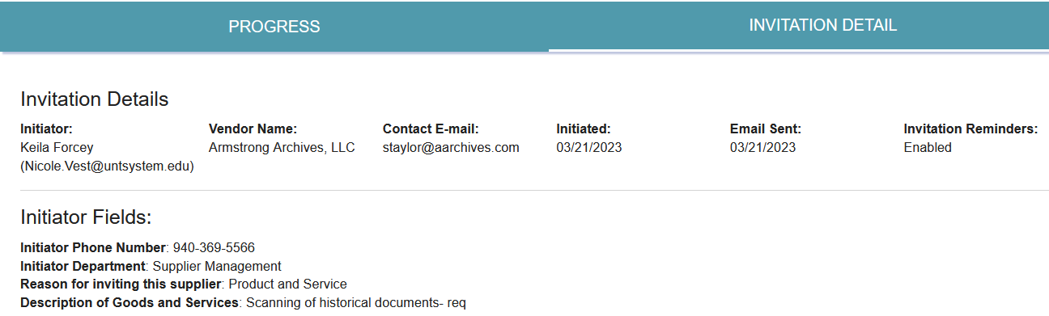
Search for Suppliers
Option 2 cont.
The general supplier invitation is displayed.
Important: Verify email address before selecting supplier.

Slide 12
Search for Suppliers
Not Listed
If a supplier name is not found using Option 1 or Option 2, click on the New Vendors tab.

Slide 13
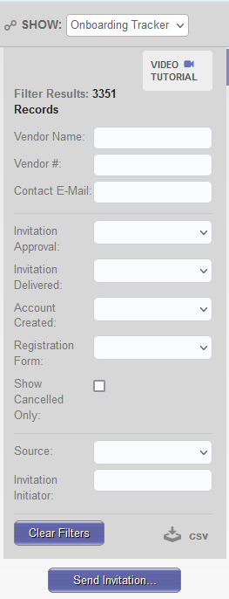
Search for Suppliers
Not Listed cont.
In the Filter Results screen, search by Vendor Name, Vendor ID or Contact E-mail.
If the supplier is found:
  The supplier has been invited and is in some stage of the registration process; however, still not connected and not available for use
If the supplier is not found:
  Then a PaymentWorks invite should be initiated

Slide 14
How to Invite
a Supplier

Slide 15
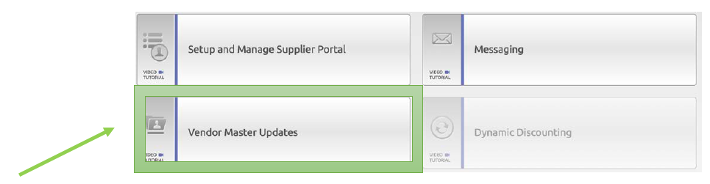
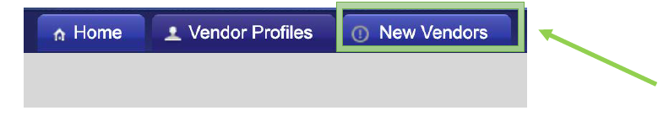
How to Invite a Supplier
Click on Vendor Master Updates
Click on the New Vendors tab

Slide 16
How to Invite a Supplier cont.
A Video Tutorial is available to help you navigate screens.
Click on the Send Invitation button

Slide 17
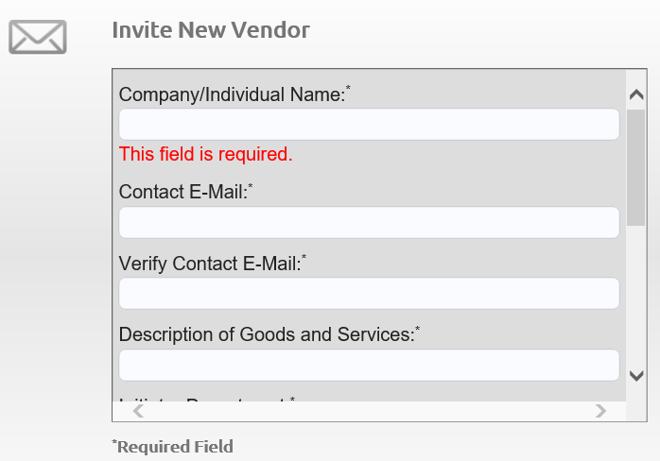
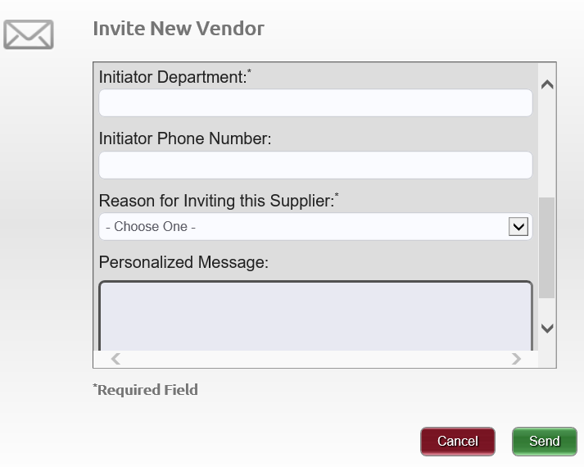
How to Invite a Supplier cont.
The Invite New Vendor screen will appear. Complete the fields and click the Send button.
Include a reference for your vendor, such as an invoice or quote number, and either a requisition number or "Concur request" for Supplier Management's reference.

Slide 18
Naming Standards
The following are best-practice naming standards for creating suppliers in vendor files. These standards will provide consistency and accuracy when loading and maintaining suppliers in the vendor files.

Slide 19
Naming Standards
Improper or lax standards can cause significant degradation of the accuracy of information generated from the system, fines and improper tax reporting, and loss of control
The naming conventions make it easier for development and maintenance teams to carry out their work
The Company/Individual Name is the vendor’s full name. This may or may not be the legal name shown on the vendor’s W-9

Slide 20
Naming Standards cont.
All names should be in upper case (SMITH, JOHN)
Enter last, first name (SMITH, JOAN)
Do not use punctuation, such as periods or commas, in business names
Do not use abbreviations except when the last word in the company is CO, CORP, INC, LP or LLC
Do not use the word “The” in front of the name of an organization: for example, The University of North Texas

Slide 21
Naming Standards cont.
Do not use abbreviations for vendors where it may cause confusion, such as:
  APA (American Payroll Association or American Psychology Association) or AARP (American Association of Retired Persons or American Association of Research Pathologists)
For vendors commonly known by their initials or an acronym, the initials or acronyms may be used rather than the full name
  No spaces or acronym may be used rather than the full name. No spaces or periods are entered between the initials of a vendor

Slide 22
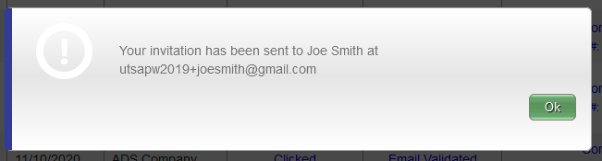
How to Invite a Supplier cont.
Initiator receives a confirmation once the invitation is sent.

Slide 23
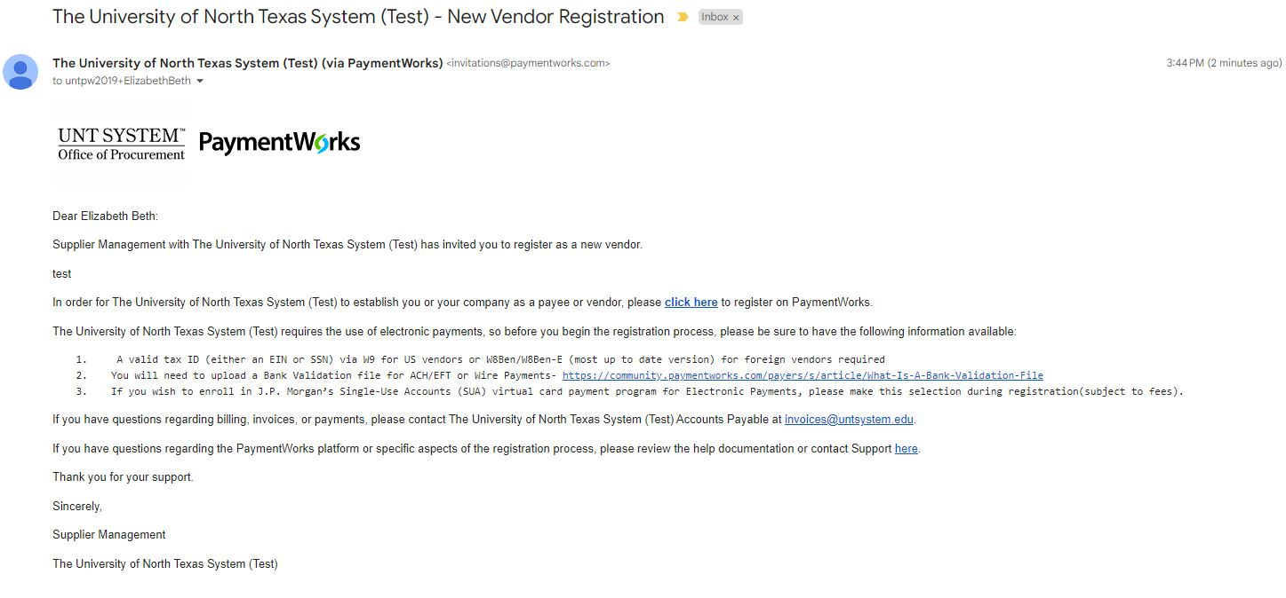
Sample of Supplier Invitation

Slide 24
Supplier Registration Process
Suppliers are prompted to join and set up a user account in PaymentWorks
After user account is set up, suppliers are asked to confirm an email address before completing the next step of the registration process (e.g., vendor name, address, SS# or TINS#, banking information, etc.)
Once the registration process has been successfully completed and registration form submitted, suppliers will receive and e-confirmation

Slide 25
Existing Vendors
Existing suppliers must receive an invite from UNTS to:
  Set up a new user account in PaymentWorks
  Update current vendor information in PeopleSoft
Once an invitation has been sent by a user, PaymentWorks does not allow other users to send additional invitations using the same email address

Slide 26
How to View Status
of an Onboarding
Vendor Registration

Slide 27
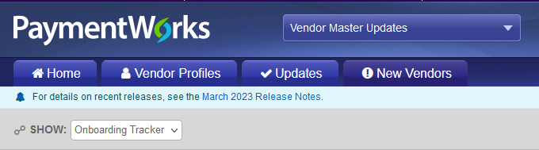
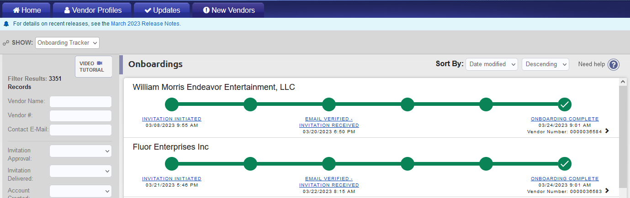
View Invitation Status
Navigate to the Vendor Master Updates page
Click on the New Vendors tab
The supplier’s record indicates the status of the registration

Slide 28
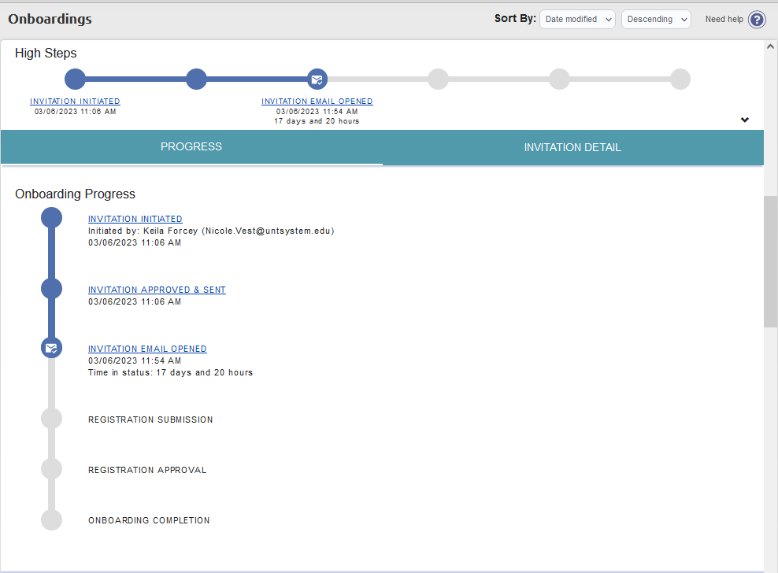
View Vendor Onboarding Status
On the New Vendors tab, you can track the status of the supplier’s registration invitation, vendor account and new vendor registration status by clicking on one of the blue links on the record:
A Video Tutorial is available to help you navigate screens.

Slide 29
How to View General Information of Onboarding Vendor Status
Click on one of the hyperlinks in the vendor record to view general status information of onboarding vendor. You can cancel reminders or resend invitation from this screen.

Slide 30
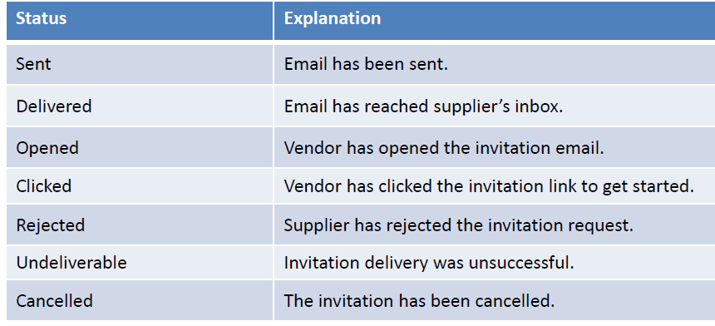
Invitation Status

Slide 31
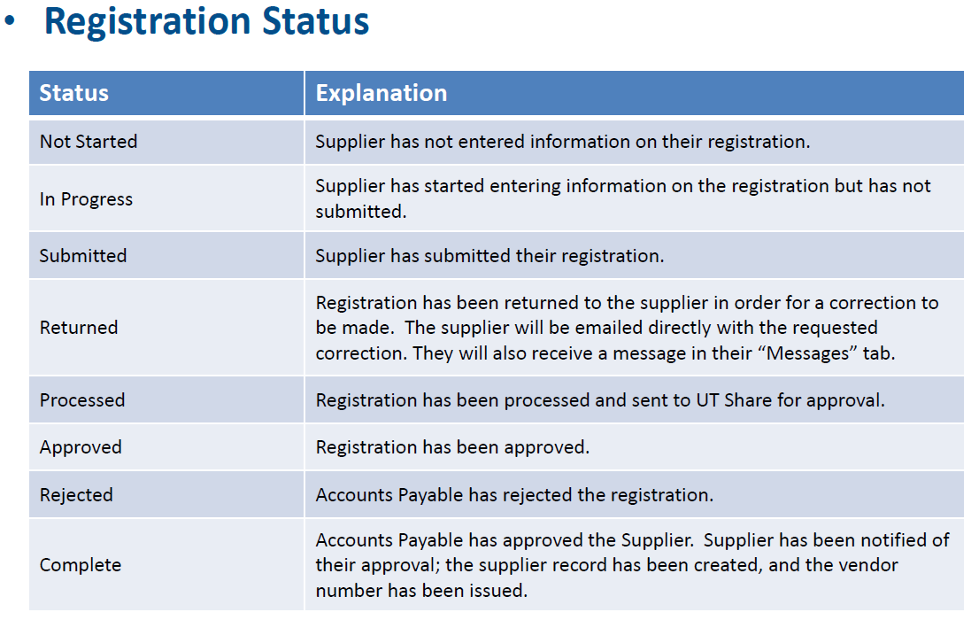
Vendor Onboarding Registration Status
UNT for registration approval.

Slide 32
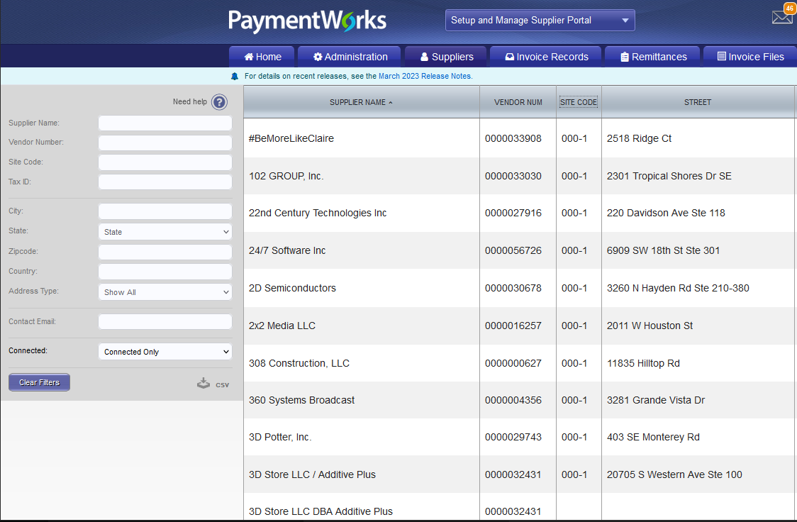
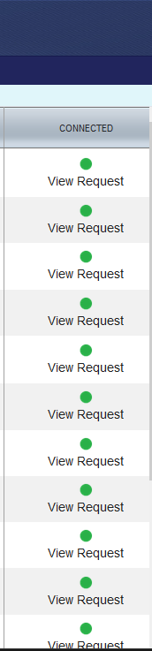
Suppliers with Connected Status
Suppliers with a connected status have successfully interfaced with PeopleSoft. Connected vendors will display a green dot in the connected column.

Slide 33
Viewing Invoices in PaymentWorks
While invoices can be viewed in PaymentWorks, we do not recommend using this function at this time. Please continue to use PeopleSoft or UNT System Marketplace to check invoices and payments.

Slide 34
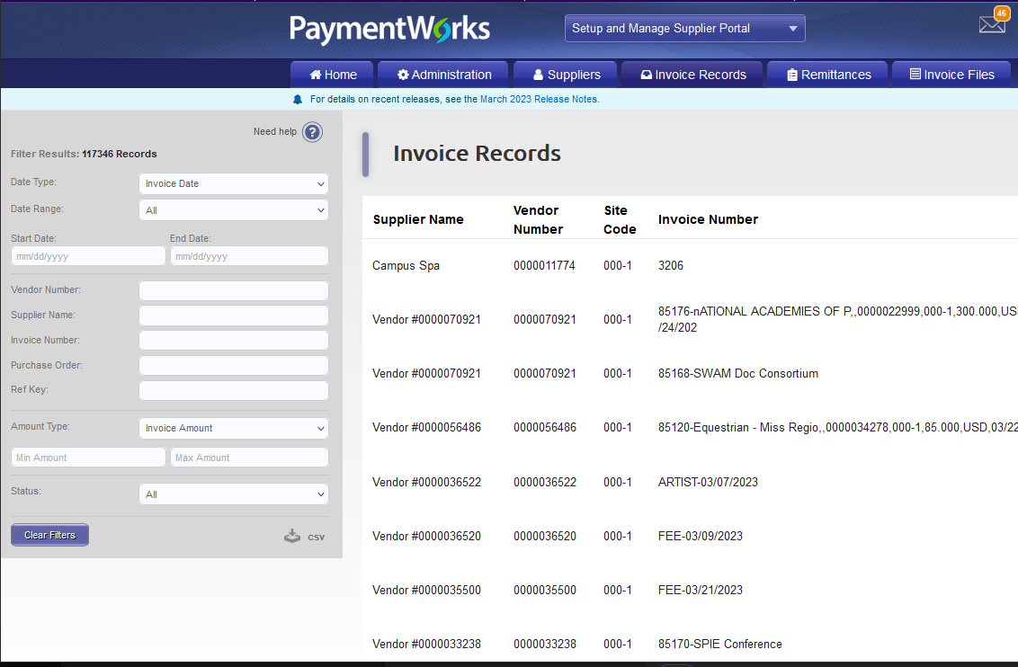
Viewing of Invoices
Initiators and vendors have access to view vendor payments (invoices).
  Additional detail payment information for all vendor locations remains housed in PeopleSoft
Select the Invoice Records tab to view invoice payments.

Slide 35
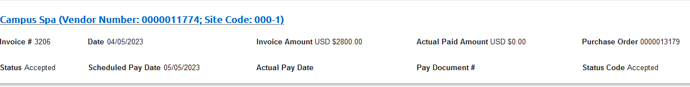
Viewing of Invoices
Window will expand when clicking on the invoice line
Site Code (Mapped to location and sequence address in PeopleSoft)
Note: Payment updates are immediate but may encounter a small delay due to server data exchange.

Slide 36

Supplier Reminders
Onboarding vendors receive emails until the registration is complete or reminders are cancelled
From the date the invite is submitted, reminder email notifications automatically generate as follows:
    1st Reminder – 3 days
    2nd Reminder – 7 days
    3rd Reminder – 14 days
    4th Reminder – 21 days
    5th Reminder – 28 days

Slide 37

Setting Up Your Campus as a Vendor
Please contact your campus’ Controllers Office for more information.

Slide 38


Slide 39
Tips & Tricks
Do not re-send an invitation unless the supplier notifies you that the initial email was not received.
  Remember to check the vendor onboarding status before resending an invite
If a supplier will no longer be used, you can cancel the invite by cancelling the reminders.
You can correct an email address on an invite by clicking on the Resend Invite button and entering the correct email address.

Slide 40
Tips & Tricks cont.
You can resend an invite only if the Invitation column status is on Sent, Delivered, Opened, or Clicked.
You cannot delete an invite, but you can cancel it.
Cancel reminders for the first invite when correcting a supplier email address; otherwise you will continue to generate reminders.
Suppliers in an approved status and properly interfacing with PeopleSoft will display a connected status with a vendor number.
  Suppliers in connected status have set up user accounts

Slide 41
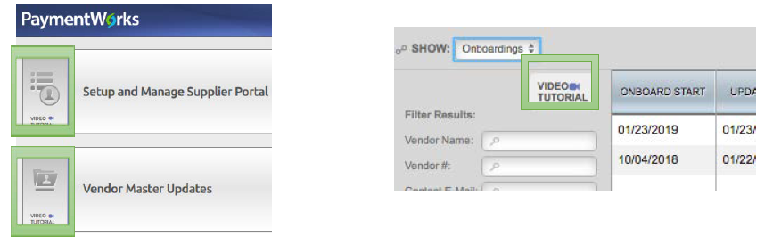
Online Help
Located at the top right corner, Help is available to assist you with navigating and moving between screens
A tile For Initiators within the Help feature also displays on the page.
For initiators
PaymentWorks homepage and onboarding pages contain video tutorials to assist with navigating through the online platform. Click each button to view them.

Slide 42
Contact Information
For supplier questions
  PaymentWorks help
    Online resources: https://community.paymentworks.com/payers/s/
    Email: support@paymentworks.com
  Supplier Setup in PeopleSoft and General Supplier Management Questions
    Email: Supplier.Management@untsystem.edu
Reimbursement & Travel Services
    Email: Travel@untsystem.edu
Send Invoices to
    Email: Invoices@untsystem.edu
General Payment Questions
    Email: AccountsPayable@untsystem.edu
General Requisition/PO Questions
    Email: Buyers@untsystem.edu

