Slide 1
PCard Holder Overview
&
Concur PCard Training
1

Slide 2
Learning Objectives
Be familiar with the Roles & Responsibilities of the UNT PCard Holder
Understand when to use Pcard vs creating a Requisition
Understand the Rules & Policies regarding the use of UNT Pcard
Know where to find additional Information and Resources
2

Slide 3
PCard Holders are part of the
Purchasing Team!
PCard Holders, by receiving a UNTS PCard, are accepting the terms and conditions
that are required for its use.
PCard Holders are a select group of individuals who exercise buying power on behalf
of UNT for their Department.
The PCard allows the Holder to make discretionary purchases as needed without prior approval which would be required when making purchases using the Requisition process. For this reason, PCard Holders must take their Purchasing responsibilities seriously
and just like any member of the Purchasing Team, PCard users must be familiar with
UNT’s Purchasing Policies and all State, System/Institutional, or Departmental Guidelines.
3

Slide 4
PCard Payment or Requisition?
Always create a requisition if:
The vendor requires an agreement or contract
If using HEAF Funds (Higher Education Assistance Funds)
UNTS PCard purchase will require an Exemption Form if:
Purchasing a restricted item
Purchasing from a restricted vendor
Purchase exceeds the Pcard purchasing limit
Note: Food cannot be purchased using Appropriated Funds (State Funds)
4

Slide 5
PCard Program Roles
Cardholder – Responsible for making purchases following Purchasing Guidelines and ensuring timely monthly reconciliations of transactions in Concur Module.
Approver – Responsible for reviewing allocations of purchases made by the Cardholder in Concur Pcard Module system to ensure transactions are coded properly and Dept ID/Proj ID information is correct.
COA Approver – Responsible for authorizing the use of PCards in their department(s). Ensures all Purchasing guidelines are followed when using the Pcard.
Ensures sufficient funds are available for all purchases.
Approvers have budget authority on Dept Ids/Proj Ids for which approval is made.
PCard Program Coordinator - Administers the PCard Program for all institutions within the UNT System.
Conducts periodic reviews of Pcard transactions and maintains documentation for the PCard activities within the UNT System in Concur Module.
5

Slide 6
PCard Holder Responsibilities
Follow all Purchasing Guidelines, including Bid Requirements
Chart strings can be entered as soon the transaction posts
PCard Holders must review their transactions to safeguard against fraud
PCard Holders must submit reconciled transactions including receipts for Approval
PCard Holders should always compare pricing among several vendors, including HUB vendors to obtain the best value for their
Department and the University.
6

Slide 7
PCard Reconciler/Approver Responsibilities
Participate in initial PCard training
Participate in PCard refresher training each year
Ensure all PCard transactions are allocated to the appropriate chart string by verifying Dept ID/Proj ID information
Ensure the appropriate description of items purchased have been assigned (no blanks or “unknown” descriptions)
Approve PCard Holder transactions in the Concur PCcard Module
Report any possible fraudulent activity to the Office of Internal Audit and the PCard Program Coordinator
7

Slide 8
PCard Limitations
Beyond the convenience of using a PCard, PCard Holders should know that there are limitations and restrictions to using a PCard. The Purchasing Card Guide lists the limitations and restrictions in detail in appendices A, B & C.
Important points to note:
All cards have a single transaction dollar limit.
Monthly transactional dollar limits also apply – know your PCard limits.
The PCard may be used in-store, via mail, via telephone, via fax or over the internet using secured sites.
The PCard may never be used for personal purchases. In the event of an error, contact the PCard team immediately. Multiple errors could result in PCard sanctions and/or institutional/departmental disciplinary action.
Restrictions refer to prohibited purchases by either the State, System, or Institution. The transaction may not decline; however, that does not mean that the transaction is sanctioned. An exception form MUST be completed and approved before making any restricted purchase.
8

Slide 9
Bid Requirements Overview
All Funds (Total Amount) | Procurement Method | Bid Requirements | Estimated Processing Time for Purchase Order
$0 to $5,000.00 | One (1) verbal or written bid/quote | Department selects the best value. Price comparisons are encouraged. *** Any Purchase Over $500 Requires Doing a Vendor Hold Search *** | 3-5 business days
$5,000.01 to $25,000.00 | Three (3) informal written bids/quotes | Department solicits at least 3 written informal bids/quotes, including at least 2 Historically Underutilized Business (HUB) vendors. These should be entered on the bid tab. All bids/quotes must be attached to the ePro requisition. Documentation must be included when HUB vendors are not available or “No bid” quotes are received. Dept. must complete bid tab. | 3-5 business days
$25,000.01 and over | Formal bid | Procurement Services completes formal bidding process. A completed Formal Solicitation form must be attached to the requisition. | Varies, up to 60 days, based on type of purchase.
$100,000.01 and over | All methods | In addition to the formal bid process, Historically Underutilized Business (HUB) Subcontracting Plans are required. | Add 7 business days to estimated processing time listed above.
9

Slide 10
Exceptions to Bid Requirements
Sole Source: Supplier is the only source of good/service due to patent, licensing restrictions, contract restrictions, or lack of competitor(s).
Proprietary: Supplier has exclusive rights to trade information OR consistent, continued use of supplier’s goods/services is required to maintain integrity of UNT System research, etc.
Co-operative Contract: Supplier is quoting from one of the co-operatives of which UNT System is a member. Quote must list the name of the co-operative and contract number.
State or UNT System Contract:
Supplier is quoting from an existing state contract, or there is a UNT System-negotiated contract already in place.
10

Slide 11
Informal Bid Assistance
Purchases between $5K and $25K require informal bids/quotes
  Attempts to gather bids from HUB vendors must meet the State’s Good Faith Effort guidelines.
  Seek bids BEFORE selecting a vendor and submitting requisition
  Bids to include vendors who actually do the service/sell the product
  Bids to include vendors from the local area
  Allow sufficient/equitable time to respond
  Purchases over $25K - should utilize a co-op
12

Slide 12
Informal Bid Assistance - continued
HUB Team
Will solicit bids/quotes on the Department’s behalf using appropriate, local vendors from the State’s CMBL and utilize UNT’s network of interested HUB vendors.
Ensure Bid Solicitation process satisfies State GFE requirements.
Gather quotes (send specifications)
Provide the Department with a list of appropriate HUB vendors
  Contact us at HUB@UNTSystem.edu
13

Slide 13
HUB Program – State of Texas
What is a HUB - Historically Underutilized Businesses?
  Business owned by a minority, woman, or a service-disabled veteran
  Business owner is a Texan who actively controls the business
  Business is State certified/registered
HUB Program establishes procurement “goals” not quotas
Each member institution Leader (University President/CFO or Chancellor) must justify if there is a failure to meet HUB utilization goals.
11

Slide 14
Protect yourself and the Purchasing Card!
Take care to protect against accidental use of the card.
Helpful Hints:
    Use Card Sleeve provided
    Place the card in your wallet or purse in a location different from any personal credit or debit cards.
    Create separate online account for the PCard use.
      Ensure the Purchasing Card is used appropriately and with intent, each and every time.
Accident usage of the Purchasing Card for a personal purchase is a violation of the program guidelines and may result in permanent revocation.
Pcard Administration Team should be notified as soon as a violation is realized, and restitution should be made immediately.
14

Slide 15
Declined Transaction(s)
If a Transaction is Declined - The PCard Holder should call Citibank directly (number listed on the back of the Pcard) and inquire the reason for the decline.
Then contact the PCard Team with Citibank’s decline information and the PCard Team will aide in assisting resolution of the purchase transaction.
If Citibank closes the users PCard account due to unauthorized charges, and reissues a new
Purchasing card, the Cardholder should notify the PCard Team immediately to ensure
appropriate user set up in Concur.
15

Slide 16
When the PCard Holder departs or transfers out of the Department
Contact the Pcard Administrator in order for the PCard Account to be closed immediately.
Exit review to conducted by the PCard Team for the last accounting period
  If the PCard Holder has already exited, the department will be required to reconcile and submit outstanding PCard expenditures in Concur.
  Complete a new PCard Assignment Form to replace any Approvers and email to pcard@untsystem.edu.
Ensure all records in the Concur Pcard Module have been updated.
Ensure all records are retained electronically for the current fiscal year plus five additional years for auditing purposes.
17

Slide 17
Purchasing Card Fraud
Purchasing Card Fraud is a deception deliberately practiced in order to secure unfair or unlawful personal gain. It is a premeditated, calculated act intended to defraud the institution. Fraud can occur from a moment of bad judgment.
What does fraud look like?
Services are paid for, but not received by the University (usually two individuals are involved)
Personal purchases made and removed from the University and/or shipped to another location
Personal purchases made in combination with
authorized goods and services
Approvers are the University’s first line of defense against Purchasing Card fraud.
Cardholders are less likely to take the risk if they know transactions are carefully reviewed and approved in Concur by the Reconciler.
18

Slide 18
Purchasing Card Negligence
Purchasing Card Negligence occurs as a result of sloppy recordkeeping or inattention to detail. PCard users will be sanctioned whenever negligence occurs.
Examples of Negligence:
Unsecured Purchasing Card
Missing Receipts
Lack of transaction documentation
Blank or Unknown Expenditure Descriptions
Approver neglecting to approve purchases in Concur
Expenditure reconciliation not completed in Concur by deadline
Inappropriate use of HEAF Funds
Use of the PCard for a personal purchases
Purchase of food using Appropriated Funds
19

Slide 19
Sanctions
LEVEL ONE SANCTION — NOTIFICATION
An email notification outlining infraction(s) will be sent to the Cardholder, Reconciler, Approver, and Internal Audit, as appropriate. The cardholder will be required to make any appropriate changes to become compliant and a follow-up review will be completed by the PCard Team within 90 days.
Examples of a level one sanctions (first time occurrences) include, but are not limited to:
Purchase of logo/branding/spirit mark items
Restaurant dine-in meals
Purchasing items with terms/conditions not pre-approved
‘Splitting’ of purchases
Entertainment expenditures
Insurance purchases
Purchase of cylinder gases
Telecommunication equipment
Missing receipts
Advertisements/job postings
Purchasing food on appropriated funds
20

Slide 20
Sanctions - continued
LEVEL TWO SANCTION — SUSPENSION
Cardholder privileges will be suspended for at least thirty (30) days from the date that the sanction was issued and additional PCard training must be completed successfully before suspension will be lifted. A follow-up review will be completed within 90 days. Future infractions of the same nature within a fiscal year or in consecutive reviews/audits will result in a higher level sanction being issued.
Examples of a level two sanction (first time occurrences) include, but are not limited to:
Purchase of alcoholic beverages, ammunition, weapons, controlled substances/prescription drugs, gift cards, gift certificates, restricted chemicals, and radioactive materials
Purchasing items for personal use
Losing the Purchasing Card two times
Second occurrence of a level one sanction within a fiscal year or in consecutive reviews/audits
21

Slide 21
Sanctions - continued
LEVEL THREE SANCTION — ACCOUNT CLOSURE
Purchasing Card Accounts will be closed, which may include the Cardholder no longer being eligible to obtain a Purchasing Card through the University.
Level three sanctions are typically a result of multiple instances of lower level sanctions found in consecutive reviews/audits or within the same fiscal year.
Note: These are PCard use sanctions only. They do not represent the possibility of institutional or departmental disciplinary action.
22

Slide 22
Chart of Accounts (COA) Questions
Budget Office Contact Phone Numbers
UNT Dallas UNT Health Science Center
Contact: 972.338.1095 Contact: 817.735.2630
UNT Denton UNT System
Contact: 940.565.3231 Contact: 940.369.5559
Questions about the Chart of Accounts?
CoA@untsystem.edu
23

Slide 23
Concur Pcard Module
Expenditure Reconciliation
24

Slide 24
Learning Objectives
Sign into Concur Pcard Module
Add a delegate to user profile
Allocate and split transactions
Itemize transactions
Add attachment to transaction: receipts, vendor status report approved PCard exception form and other documents.
Warnings Icons that stay with your transaction.
Automated Approval Work Flow
Contacts Pcard
25

Slide 25
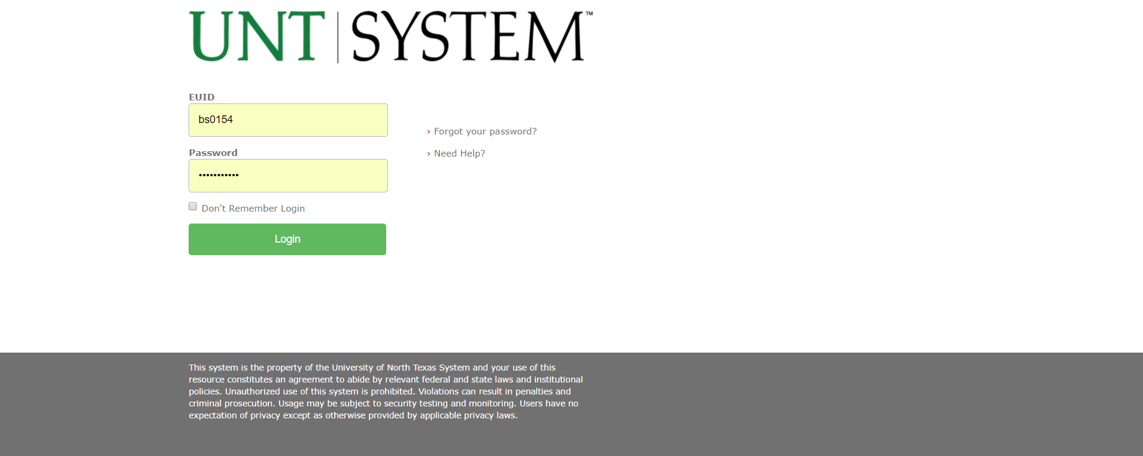
Single Sign On my.unt.edu
26

Slide 26
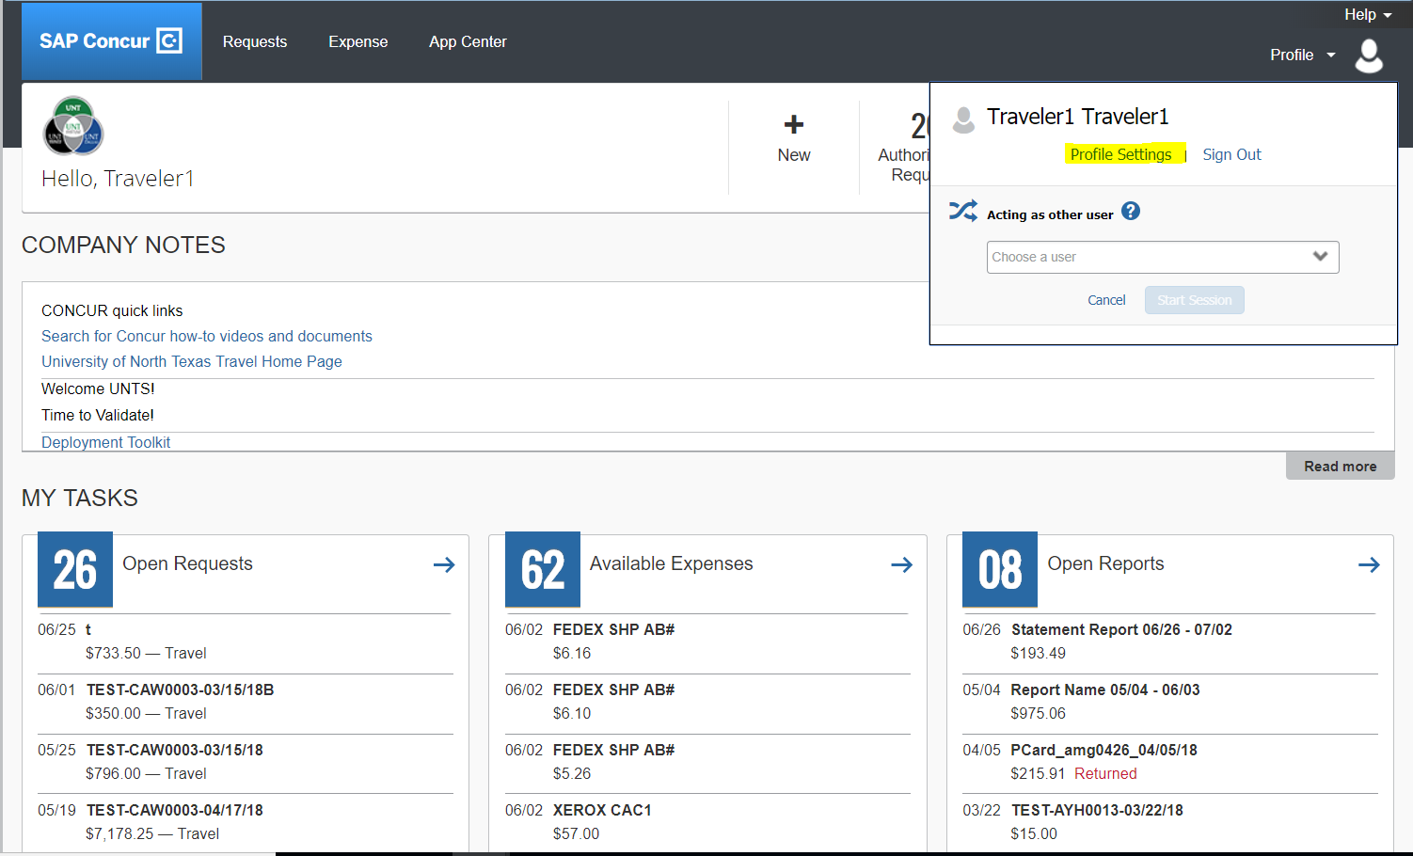
Adding a Delegate
Select Profile Settings
27

Slide 27
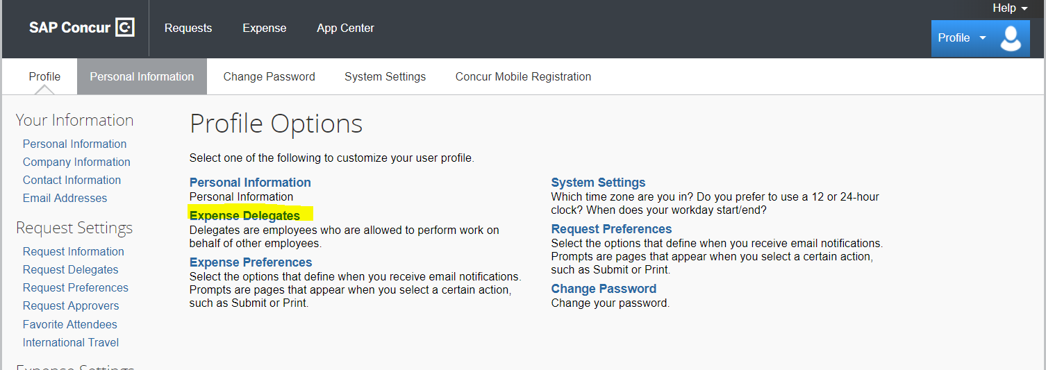
Adding a Delegate
Select Expense Delegates
28

Slide 28
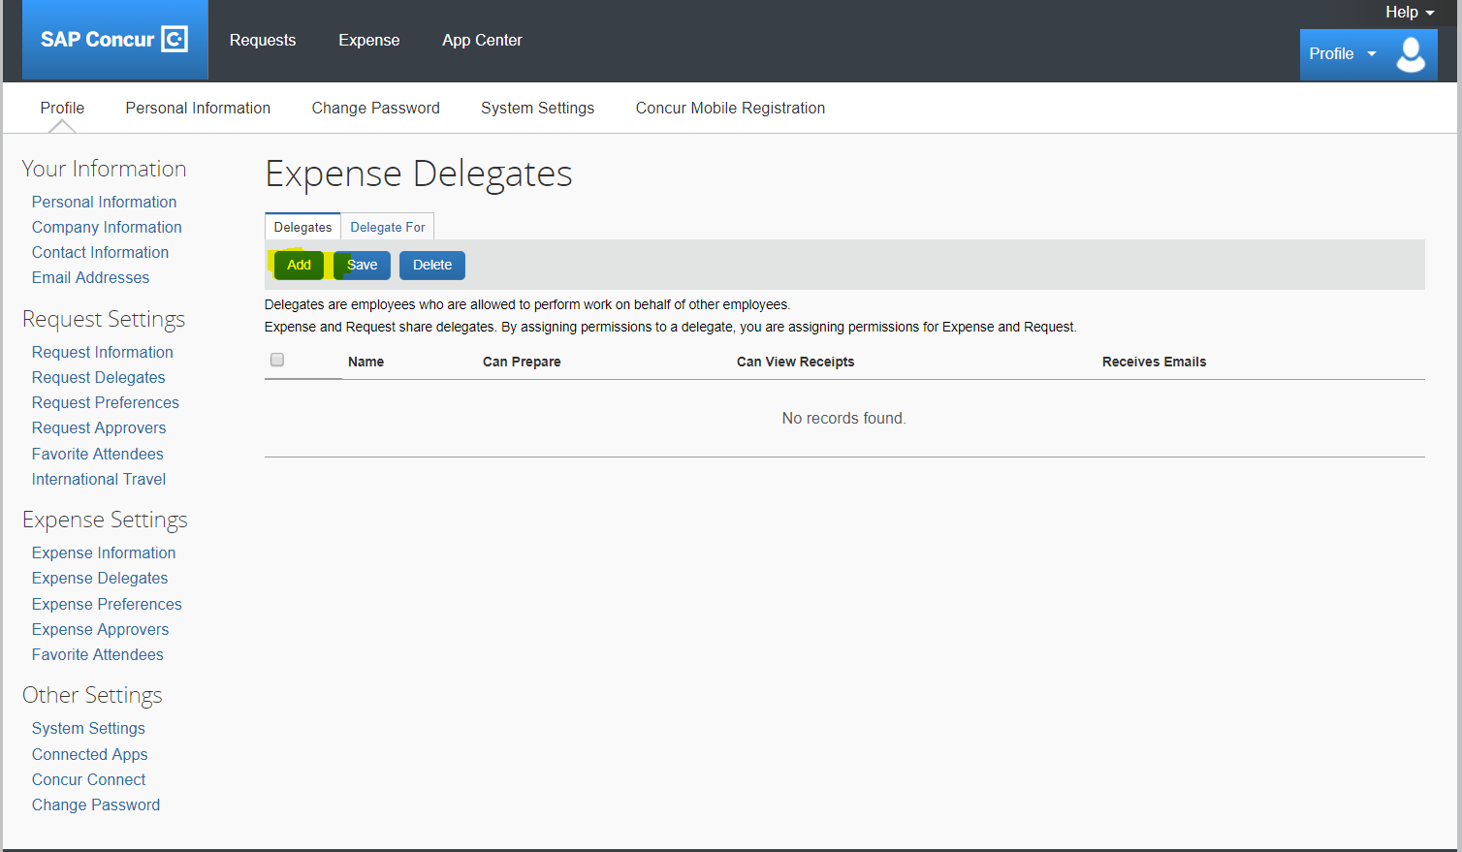
Adding a Delegate
Select Add
29

Slide 29
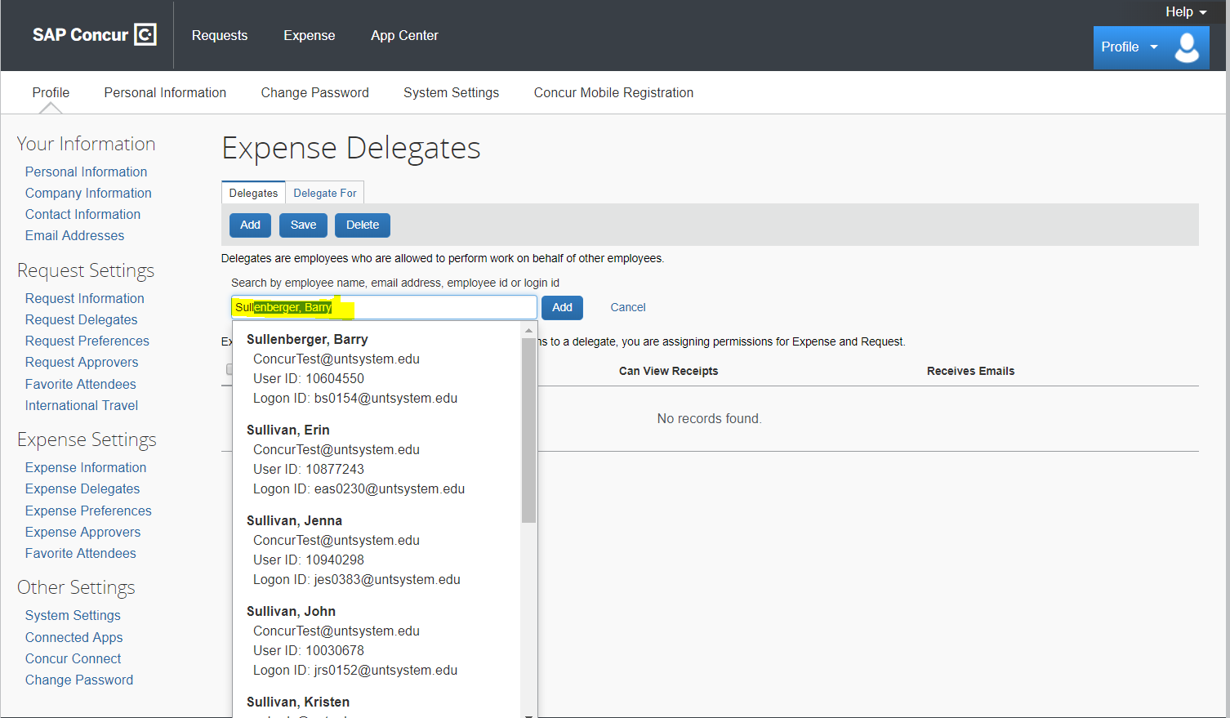
Adding a Delegate
Type in last name of delegate and select Add.
30

Slide 30
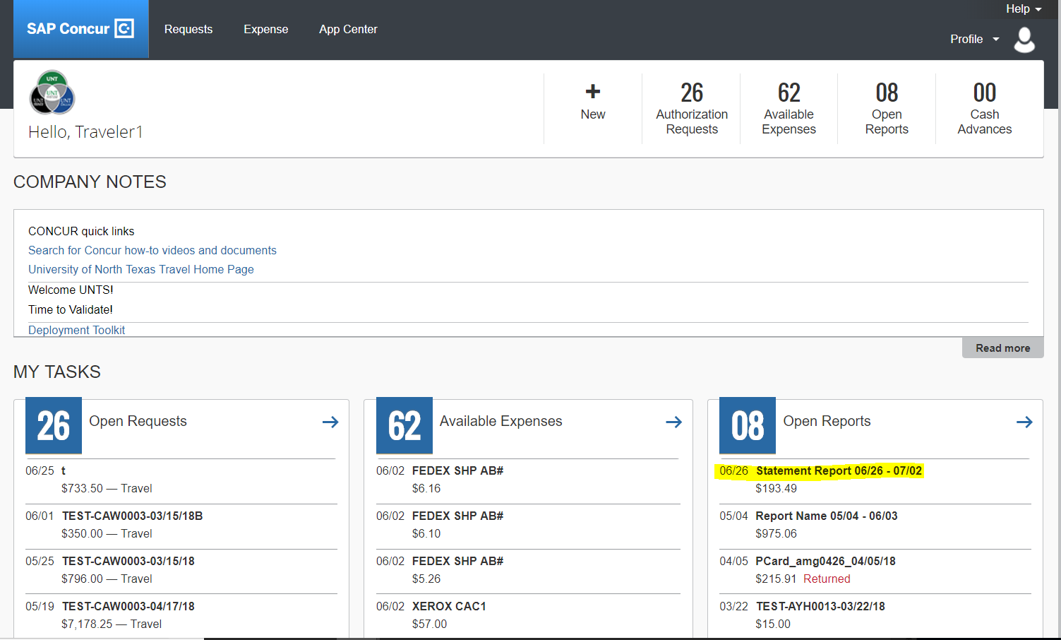
Allocation of Transactions
Select SAP Concur Logo to go to Home Page
Under Open Reports, select the Statement Report period to be reconciled.
31

Slide 31
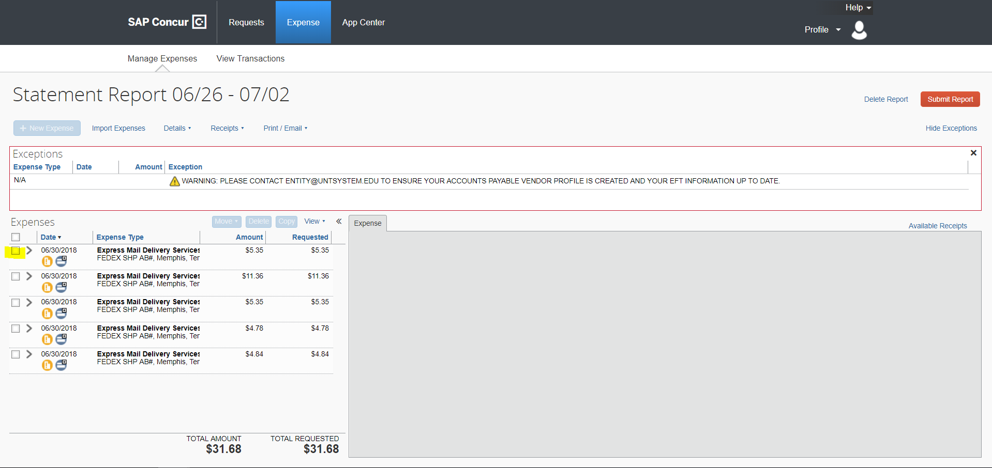
Allocation of Transactions
Select the expense for allocation.
32

Slide 32
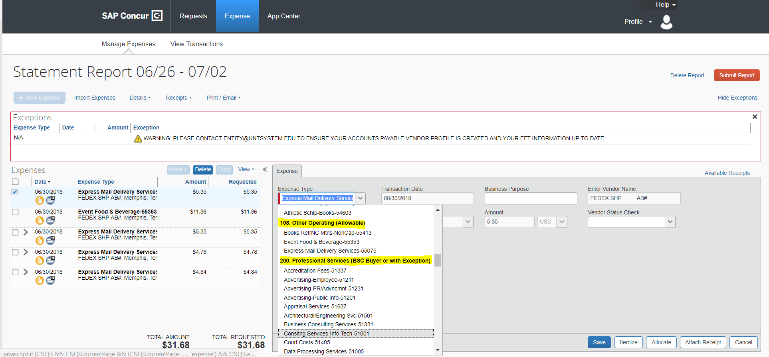
Allocation of Transactions
The Expense Type field is based on the Merchant Code provided by Citibank, but can be edited.
Warning: Expense Types listed under
a heading starting with a “0” or “1”
are allowable Pcard expense. If you select
an Expense Type starting with a “2” you
will be prompted to attach your an approved Pcard Exception Request Form.
33

Slide 33
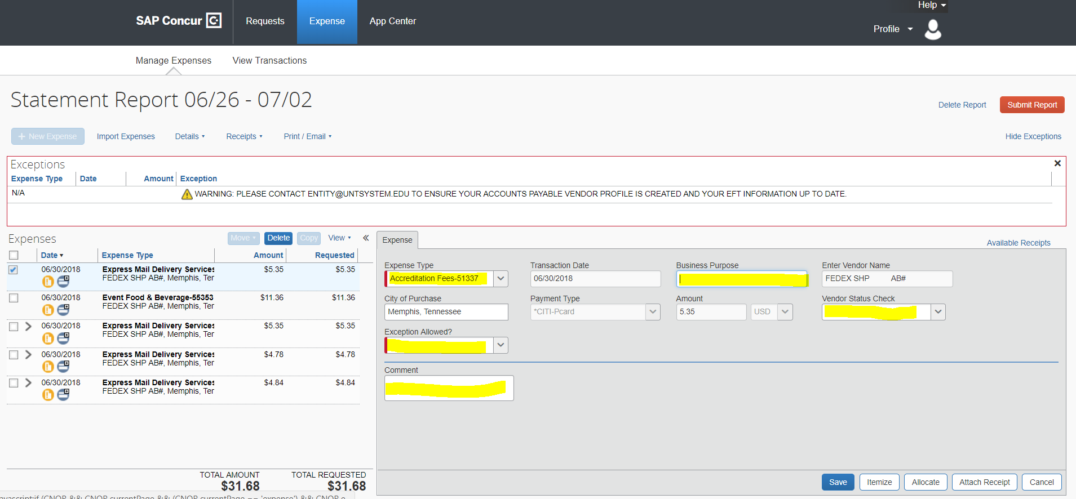
Allocation of Transactions
Populate highlighted fields then select Allocate.
All fields require data
34

Slide 34
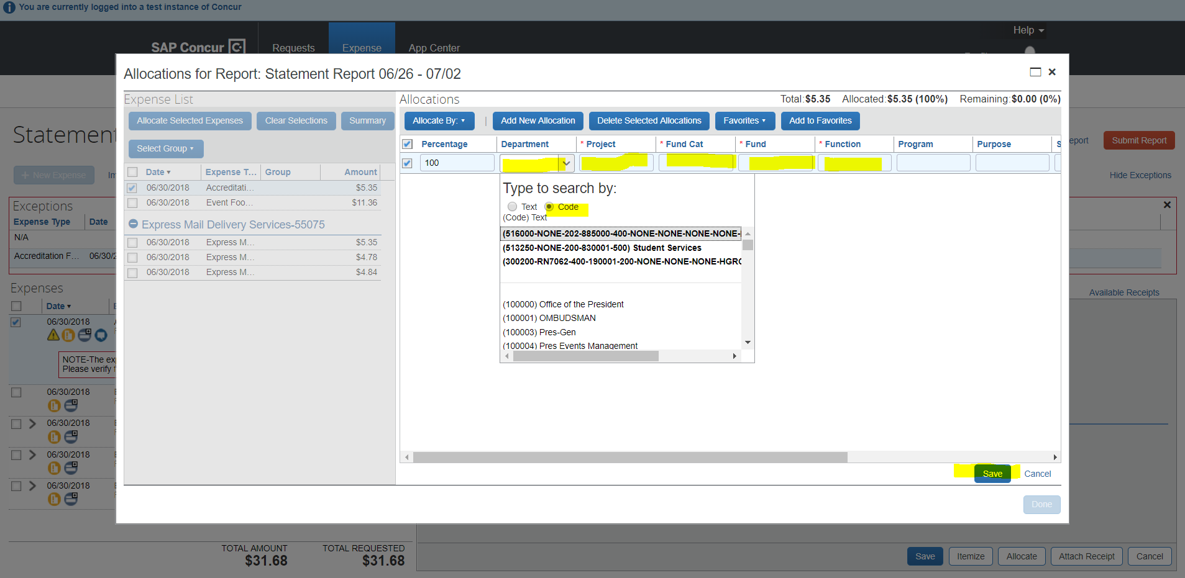
Allocation of Transactions
Select Department by searching by Code or typing in Dept Number.
A selection is required in the first five fields. If not Using a Project select “NONE”.
Then select Save.
35

Slide 35
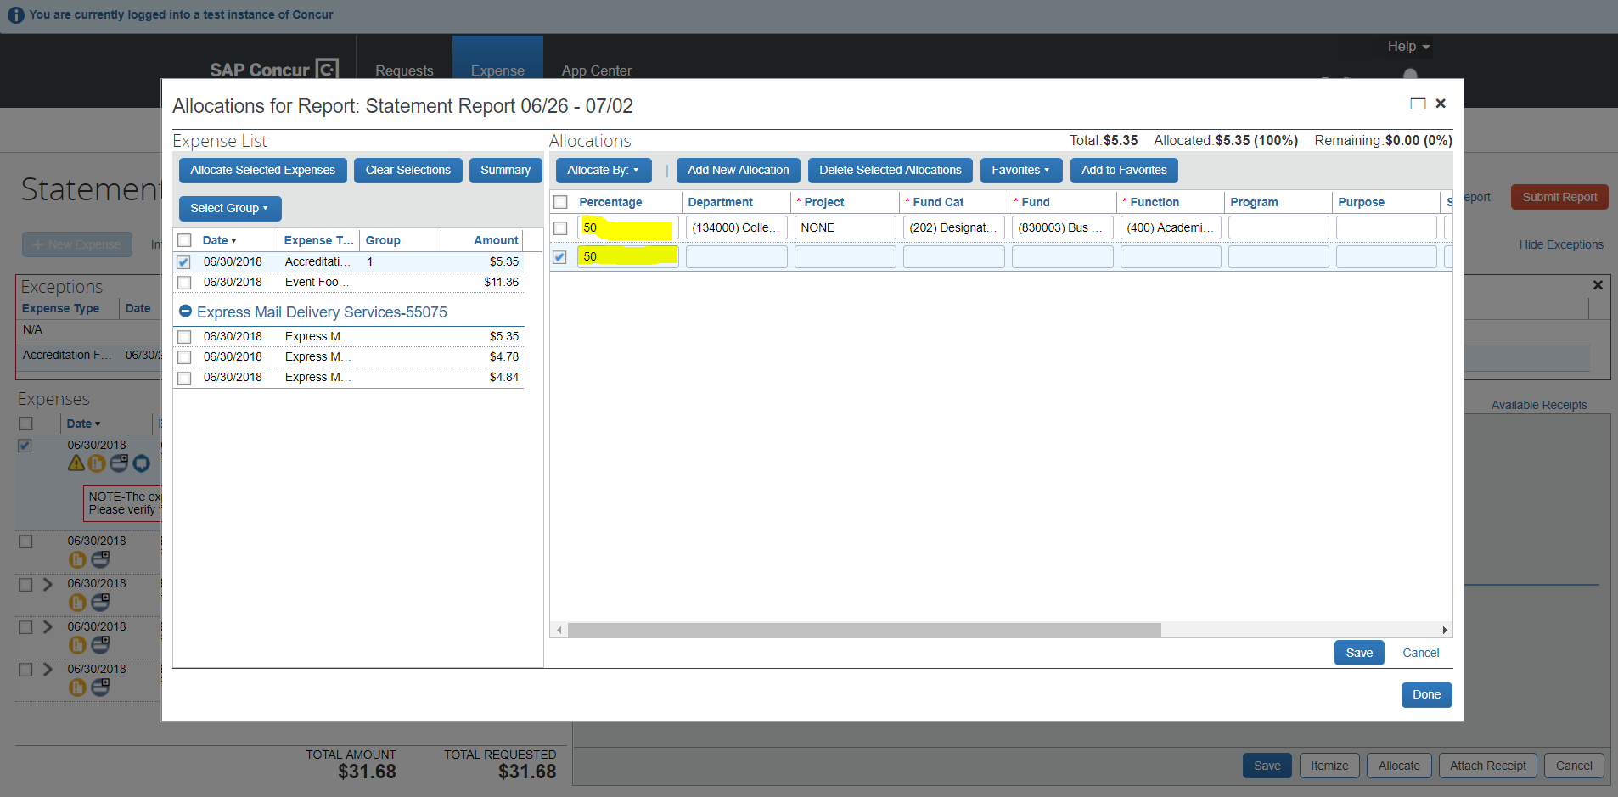
Allocation of Transactions
By changing the Percentage the transaction can be split
adding a second or third chart string.
Then select save.
36

Slide 36
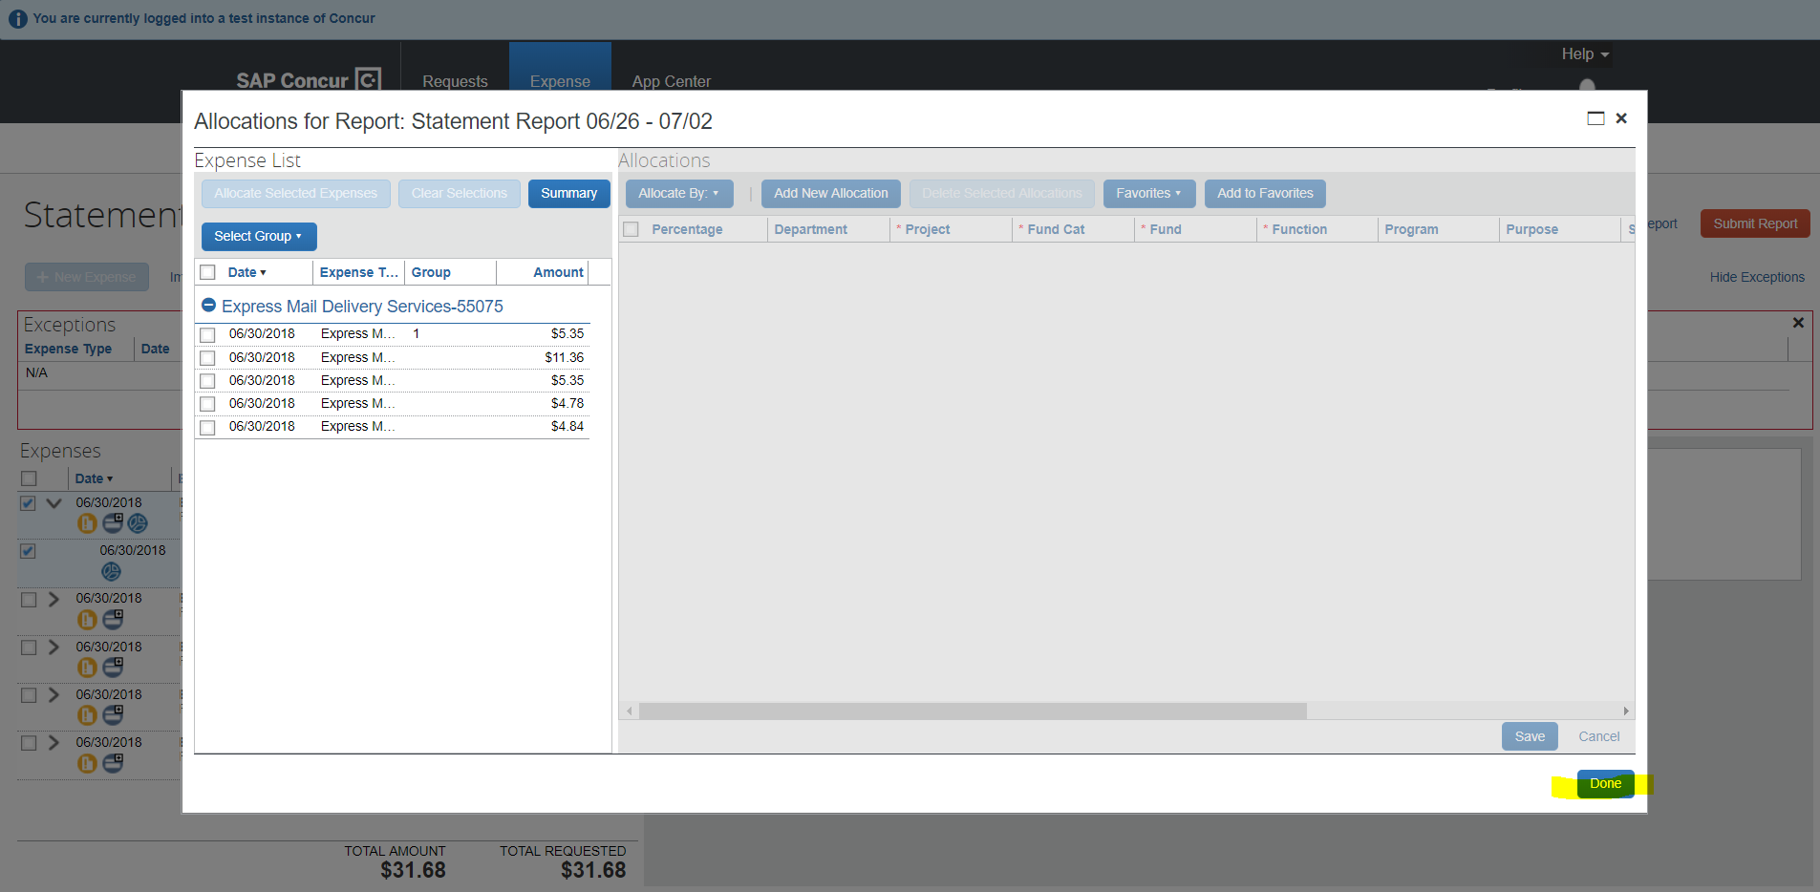
Allocation of Transactions
Review Allocations, then Select Done.
37

Slide 37
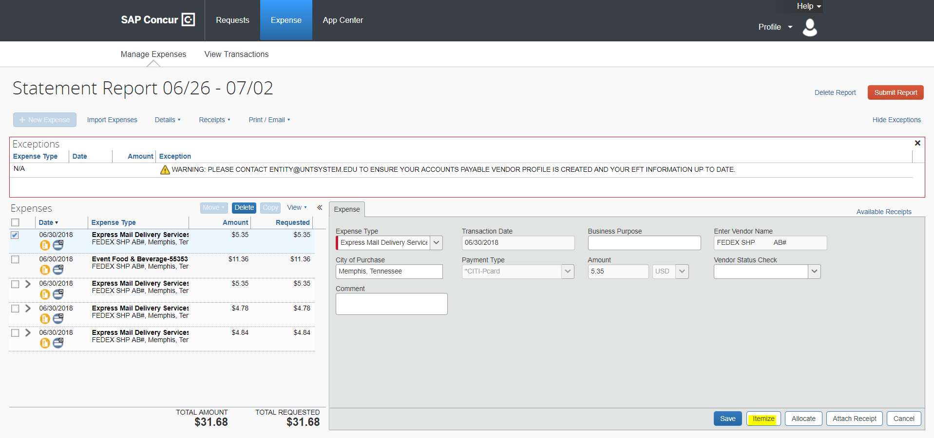
Itemize a Transaction
Select Itemize if the transaction requires splitting by Expense Types.
38

Slide 38
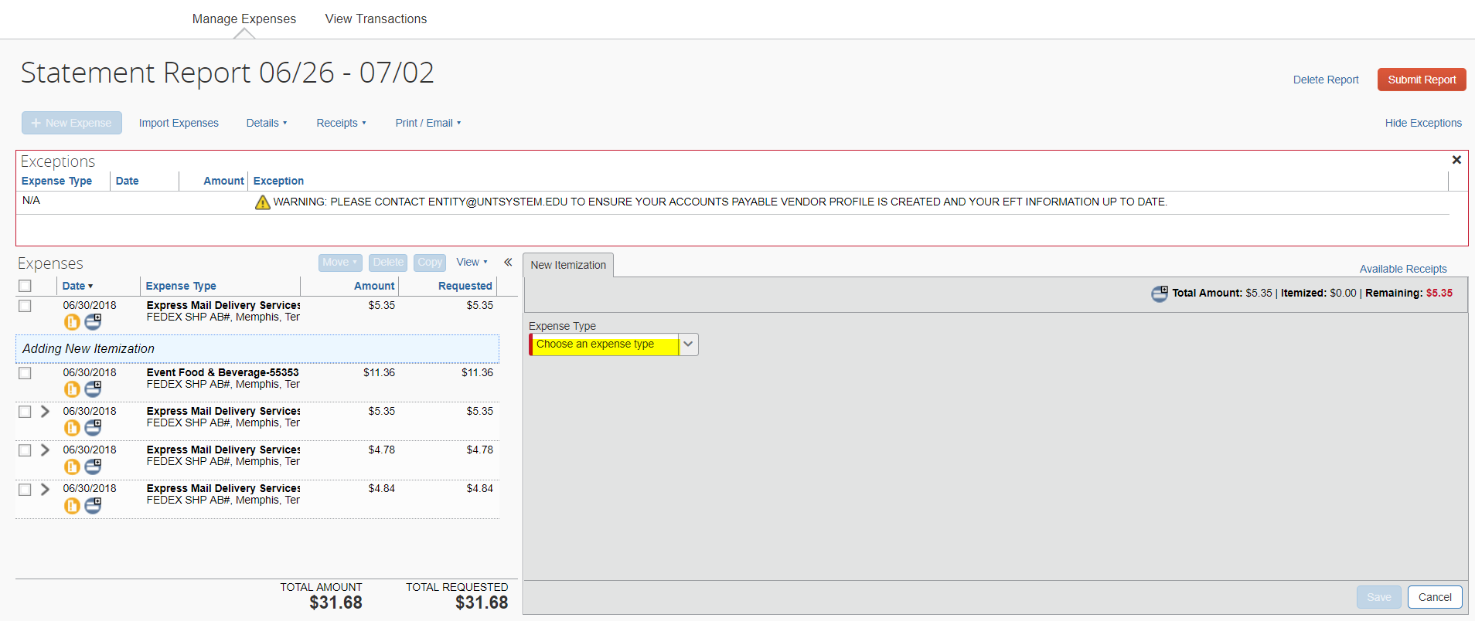
Itemize a Transaction
To itemized based on Expense Type, first select the an Expense Type to be used.
39

Slide 39
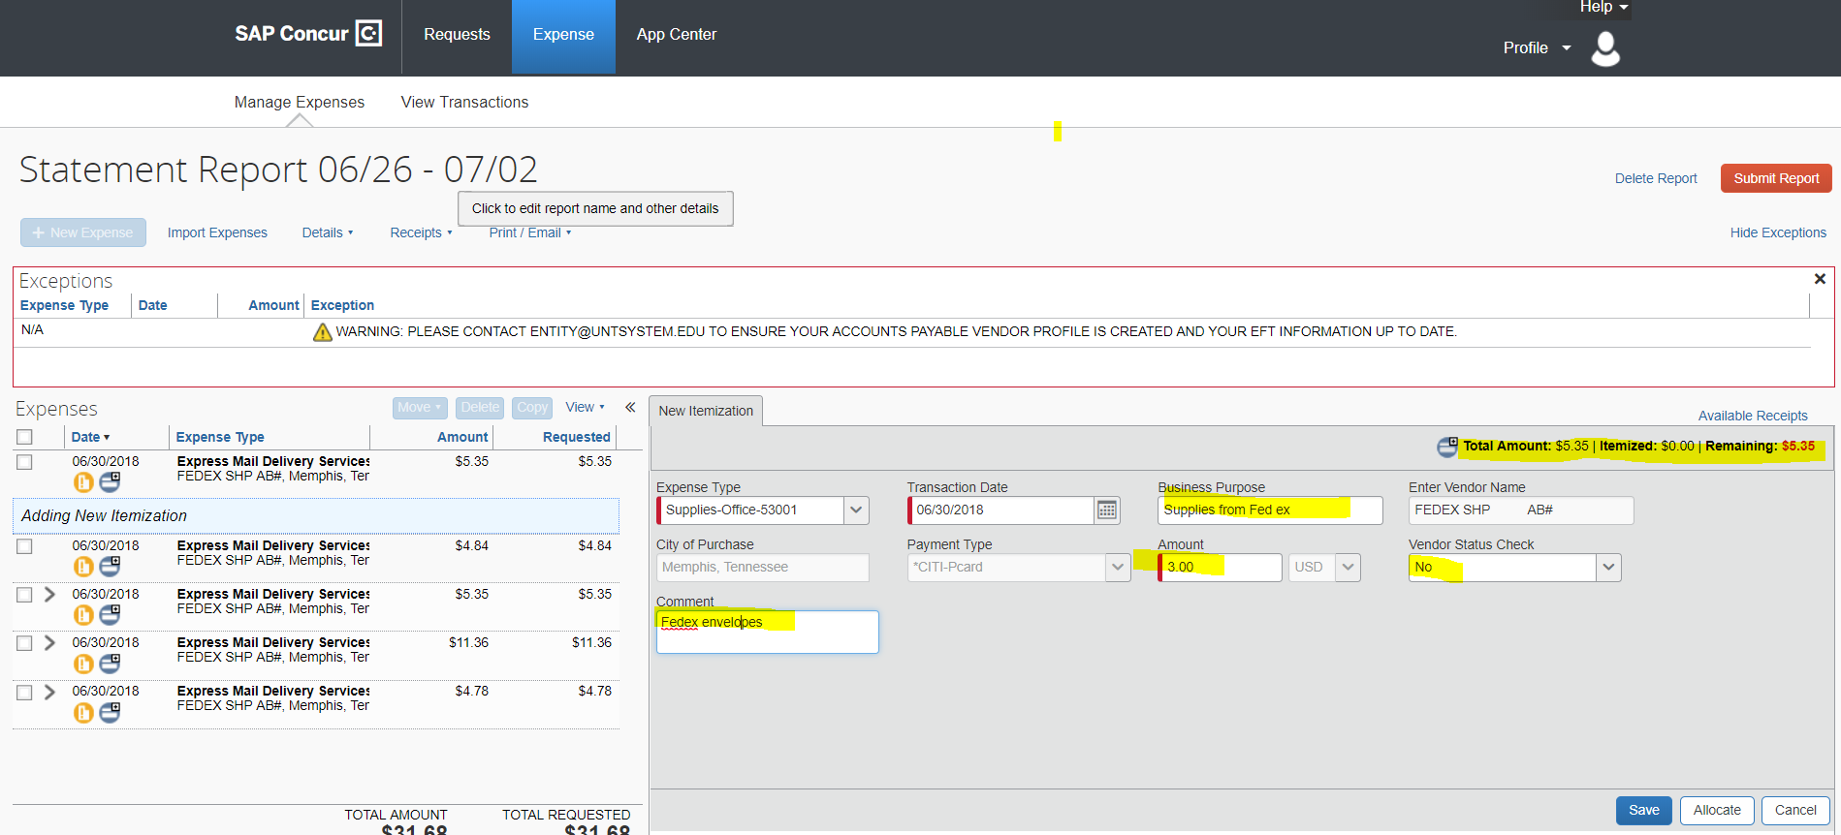
Itemize a Transaction
Note: Track the “Total Amount” of your Itemization
Populate fields: Amount should be the portion of the total that needs to be charged to the selected expense type. Then select Save.
40

Slide 40
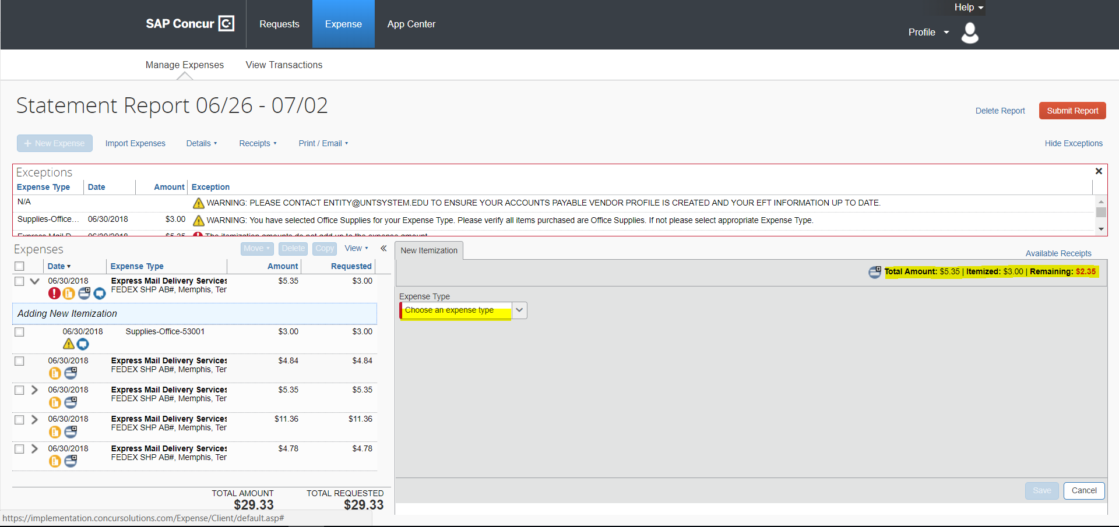
Itemize a Transaction
Note: Track the “Total Amount” of your transaction
Select the second Expense type to be used.
41

Slide 41
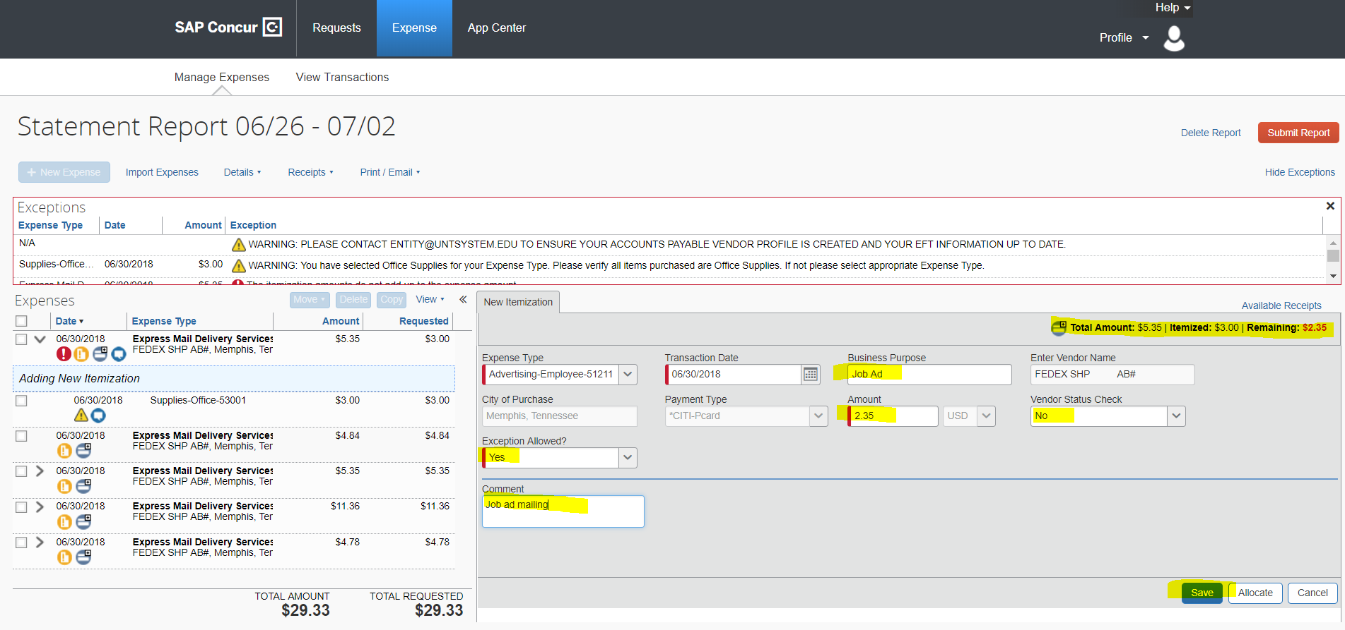
Itemize an Transaction
Note: Track the “total Amount of your transaction
Populate fields: Amount should
be the remaining portion of total.
Select Save.
42

Slide 42
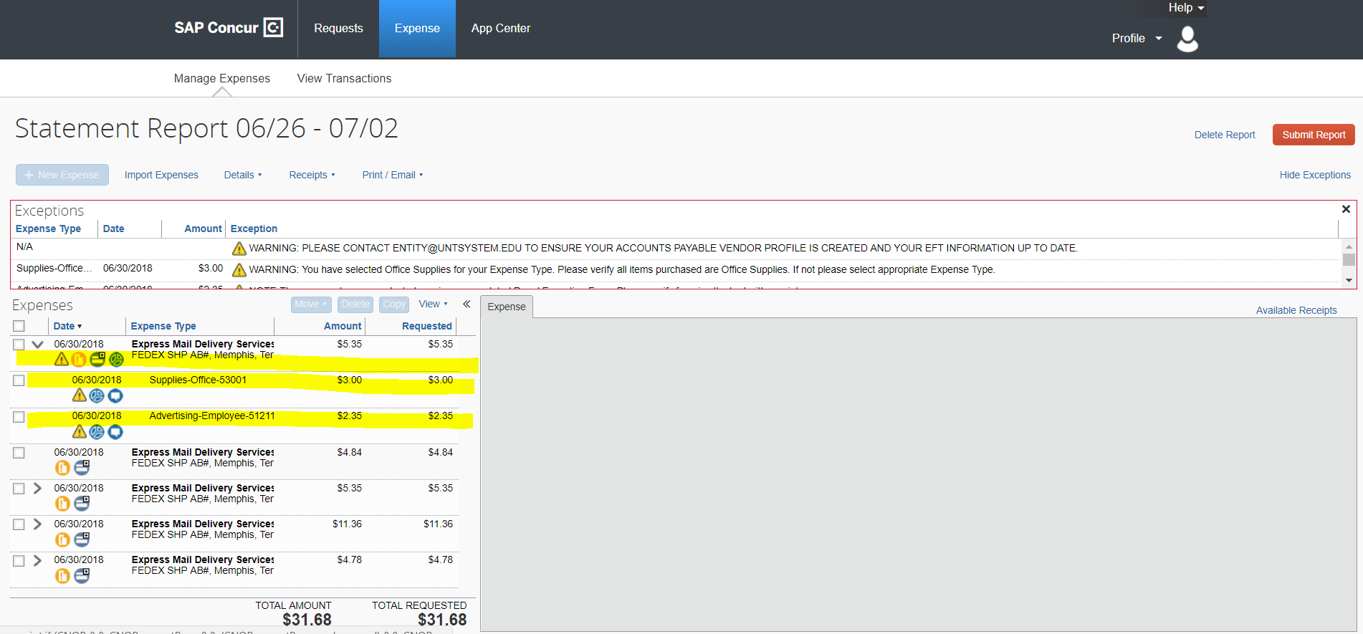
Itemize a Transaction
Itemization is now visible for review and validation.
43

Slide 43
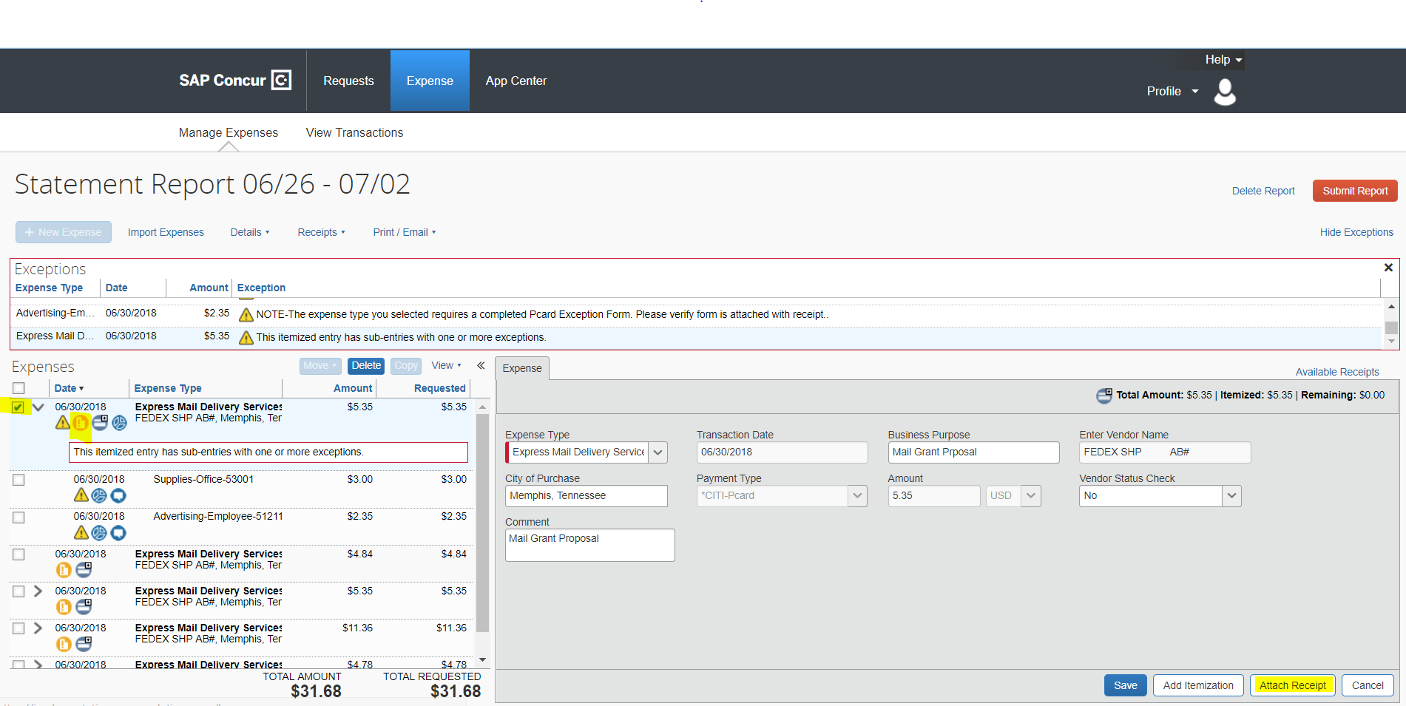
Attachments to Transactions
Select Attach Receipt.
Including: Receipts, Vendor Status Report and Approved Pcard Exception Request Form.
44

Slide 44
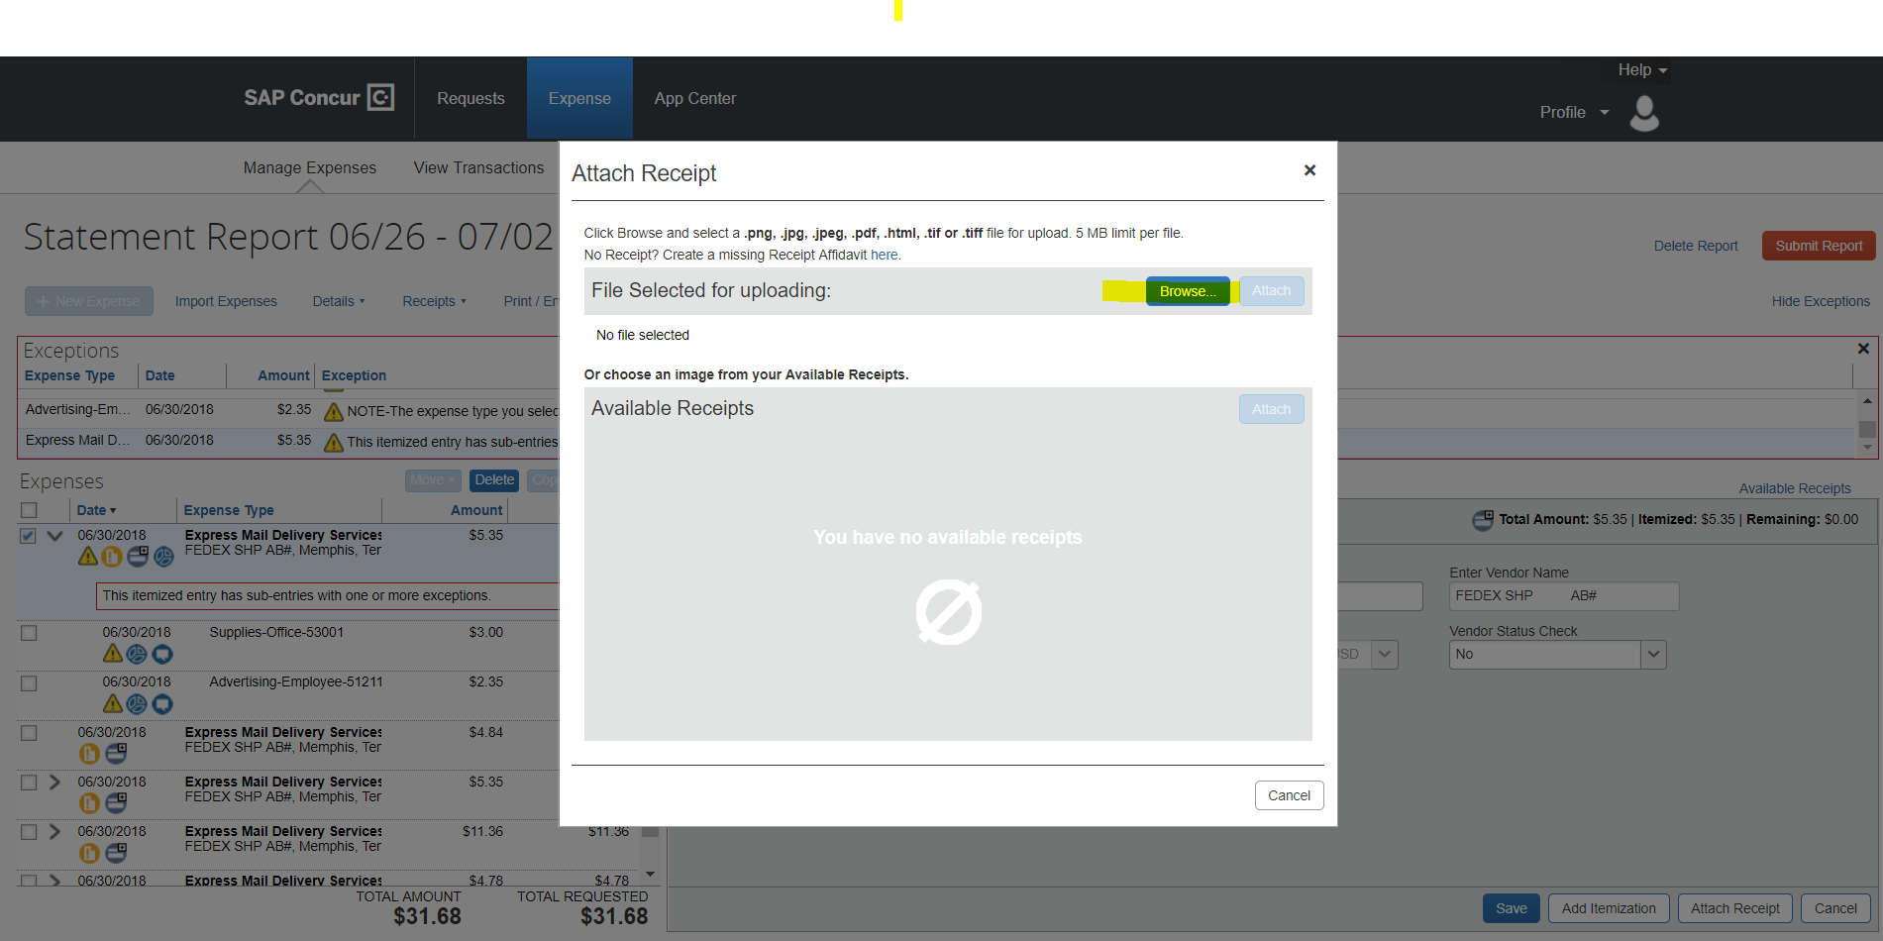
Attachments to Transactions
Select Browse.
45

Slide 45
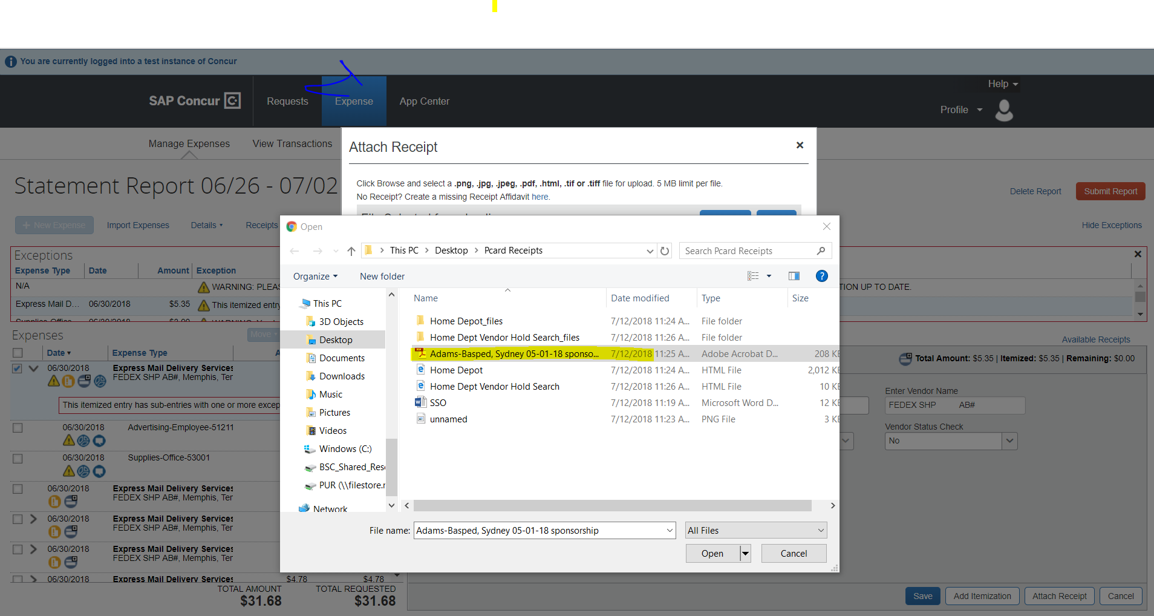
Attachments to Transactions
Select attachment from computer.
46

Slide 46
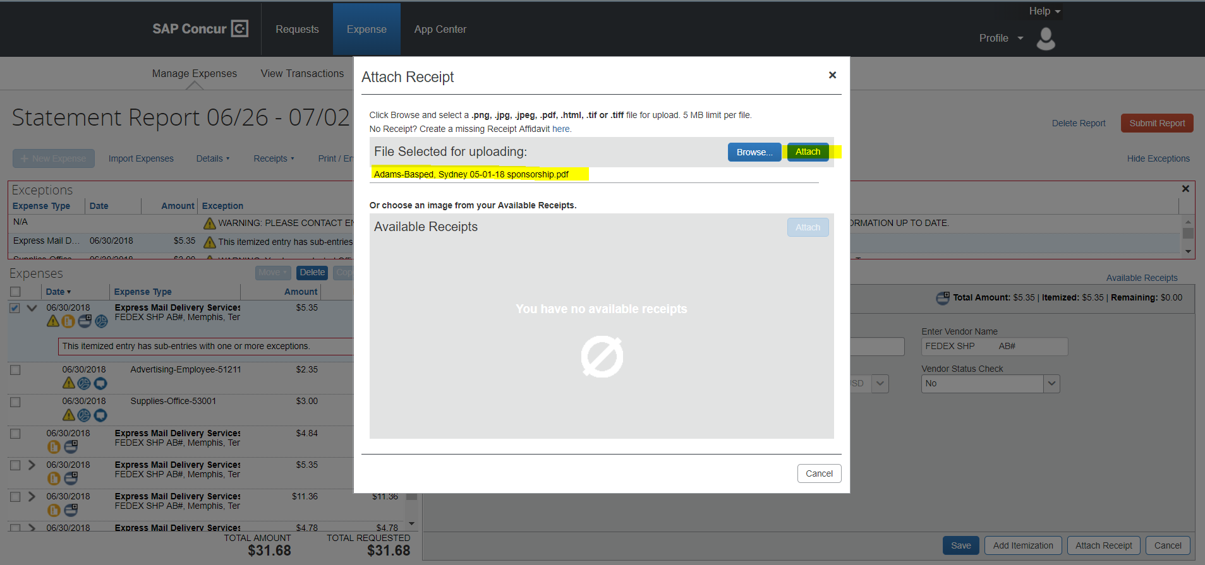
Attachments to Transactions
Document Name selected will be visible. Select Attach.
47

Slide 47
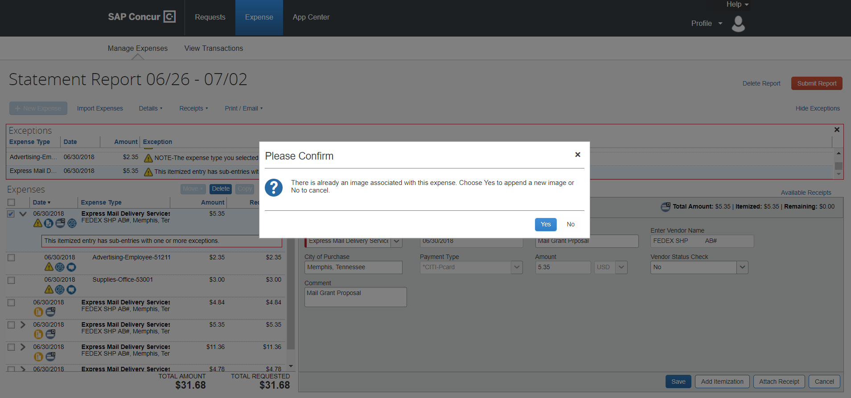
Attachments to Transactions
Add a second document by repeating the process.
Note: Confirmation Message will appear after attaching each document.
48

Slide 48
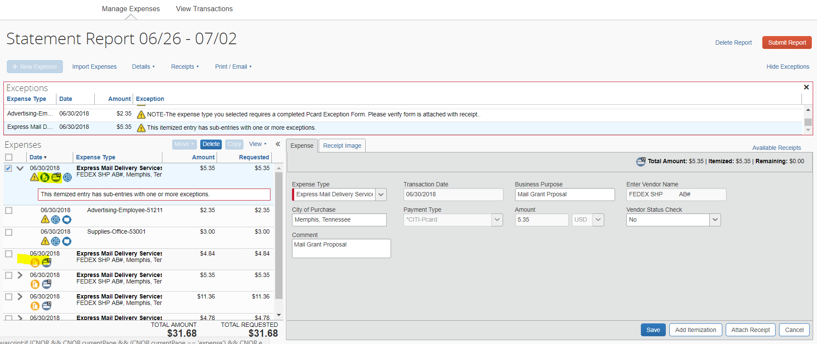
Attachments to Transactions
Note: Blue Icon with check mark shows that document has been attached. Roll over with curser to see document.
Note: Yellow icon means document has not been attached to that transaction.
49

Slide 49
Icons and Warnings on Transactions
50

Slide 50
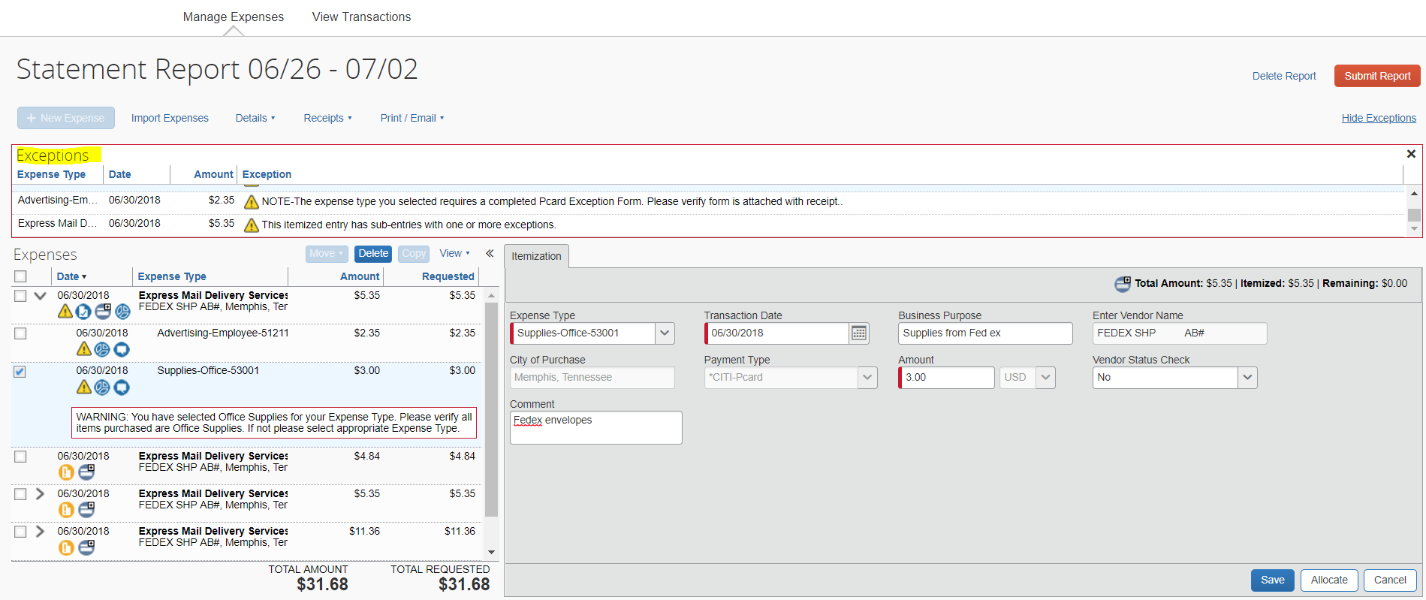
Transactional Icons and Warnings
See list of exception and warning messages at the top of the page.
These correspond with the Warnings in the transaction detail.
53

Slide 51
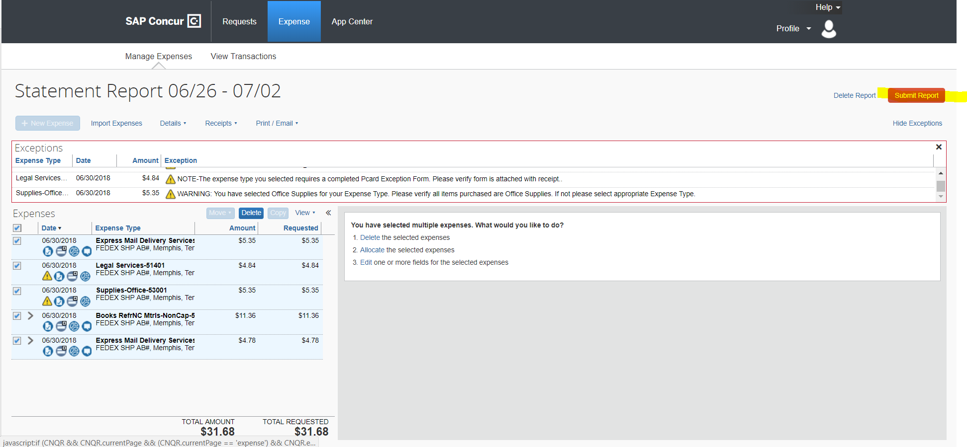
Approval Workflow
Select Submit Report when Expenditures are ready for Approval – Expense Allocations are completed and documents have been attached.
54

Slide 52
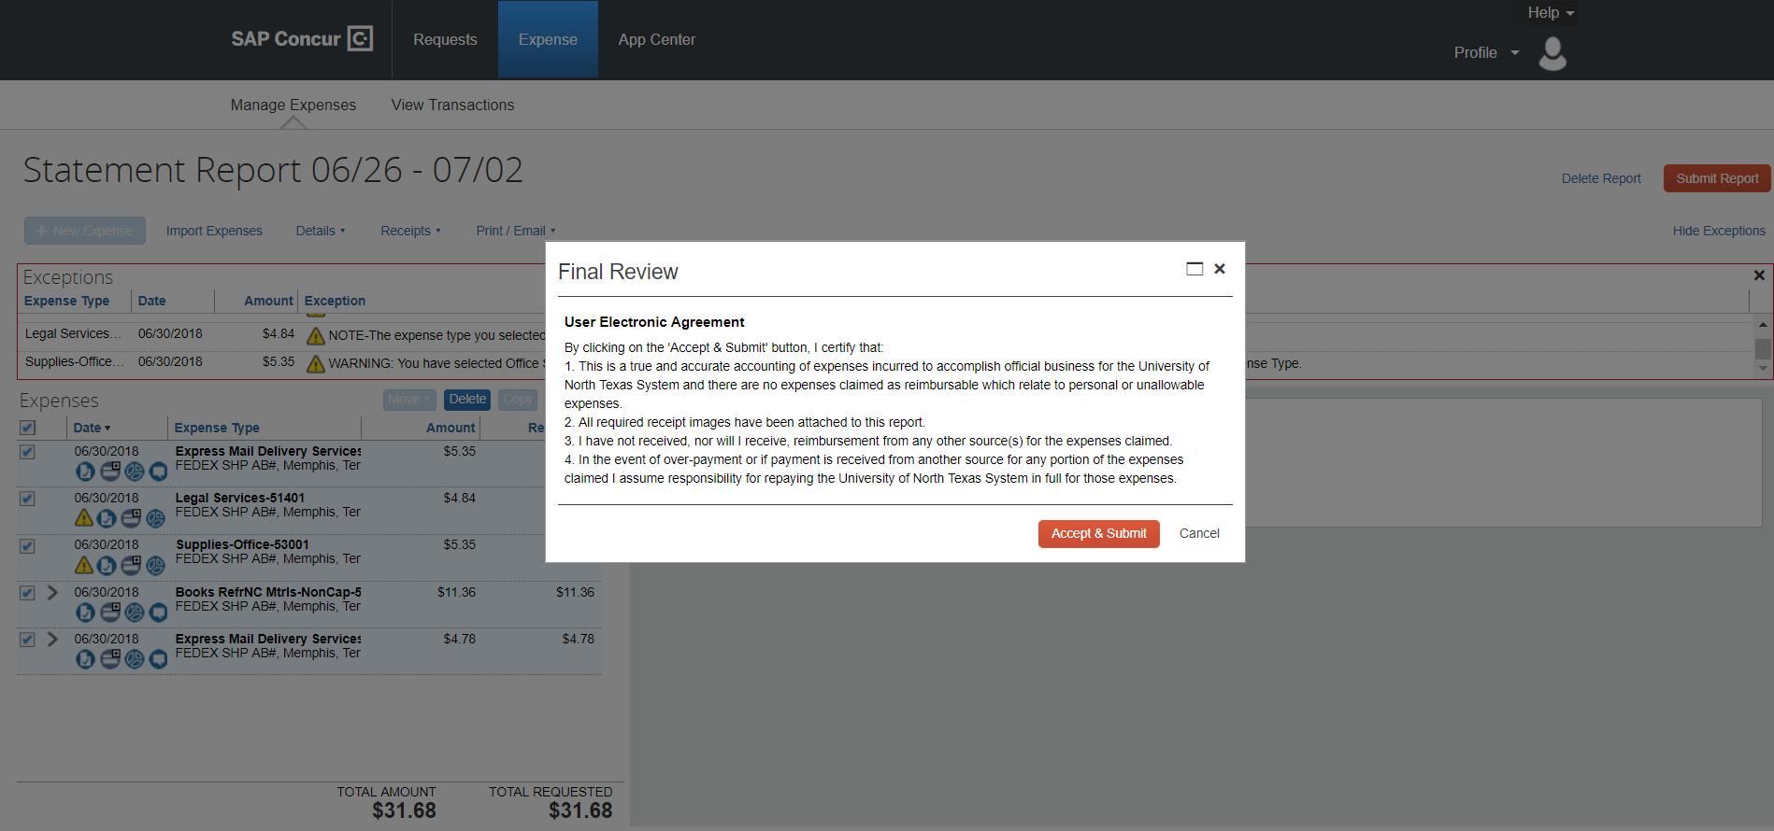
Approval Workflow
Request for Final Review and confirmation of accuracy.
Select Accept & Submit – Expense report will enter Automated Approval workflow.
55

Slide 53
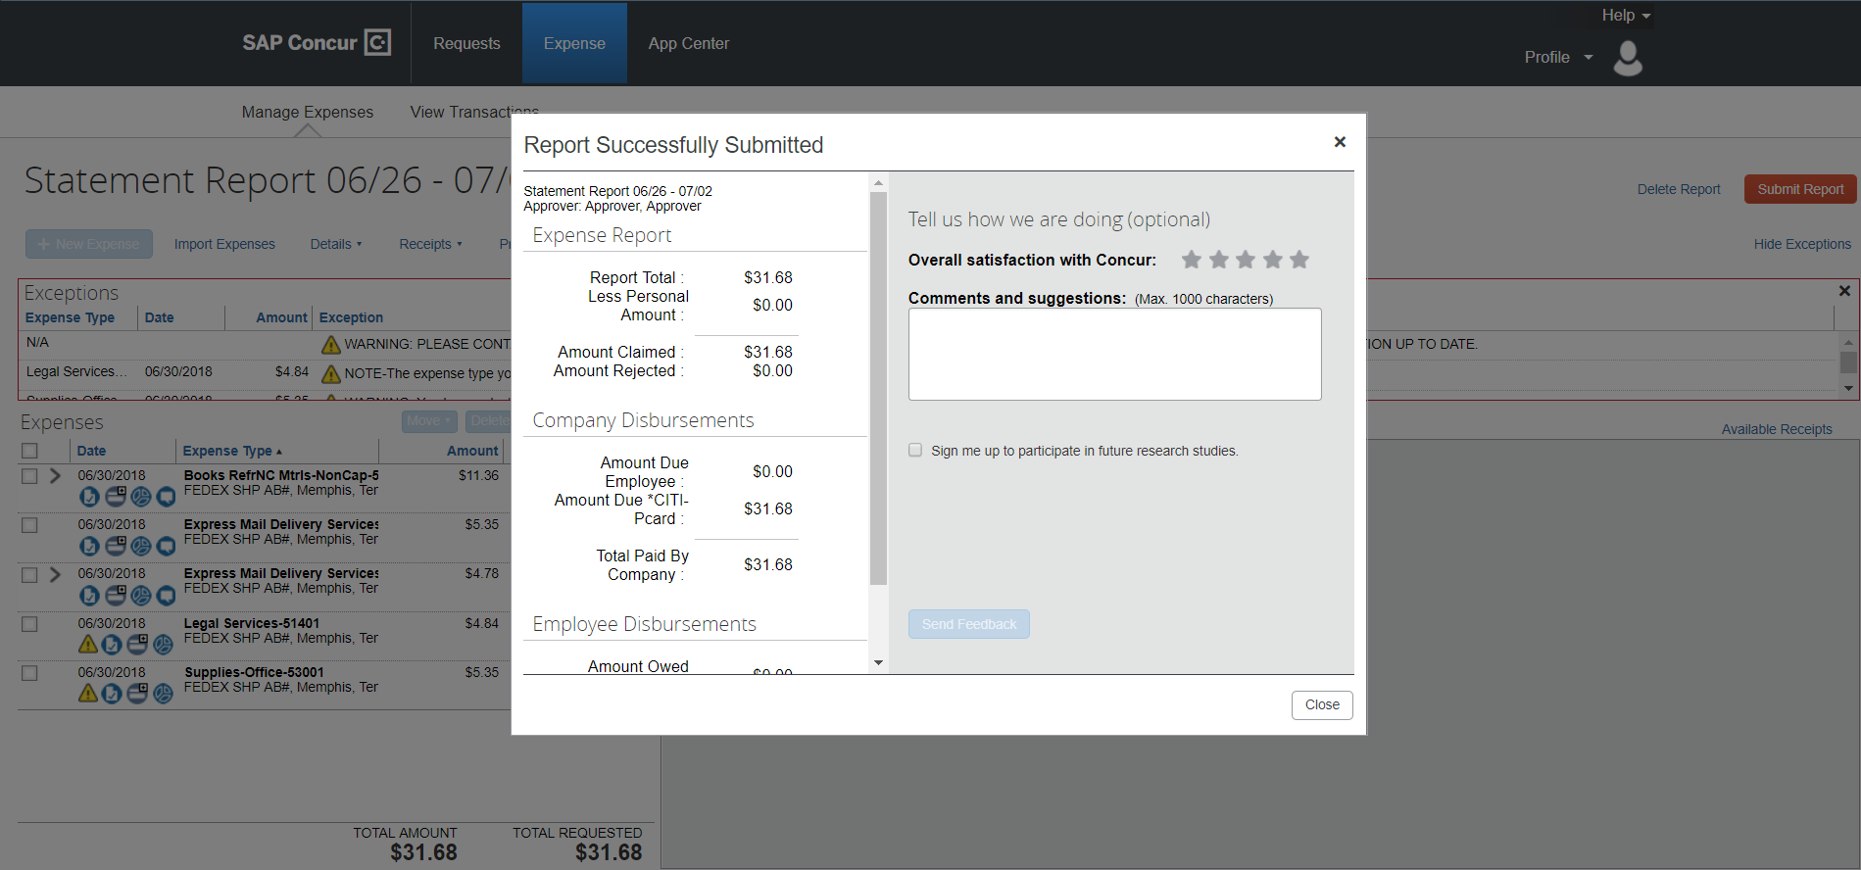
Approval Workflow
Success!!!
56

Slide 54
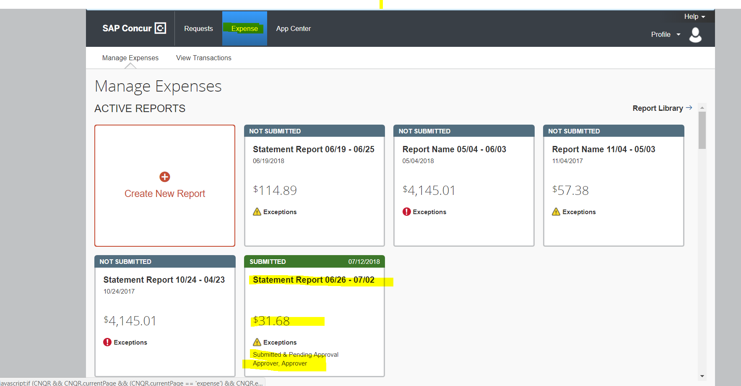
Approval Workflow
To track the Expense report through the Approval workflow – Select Expense.
To make Edits to a Report - Select the Report to Recall.
57

Slide 55
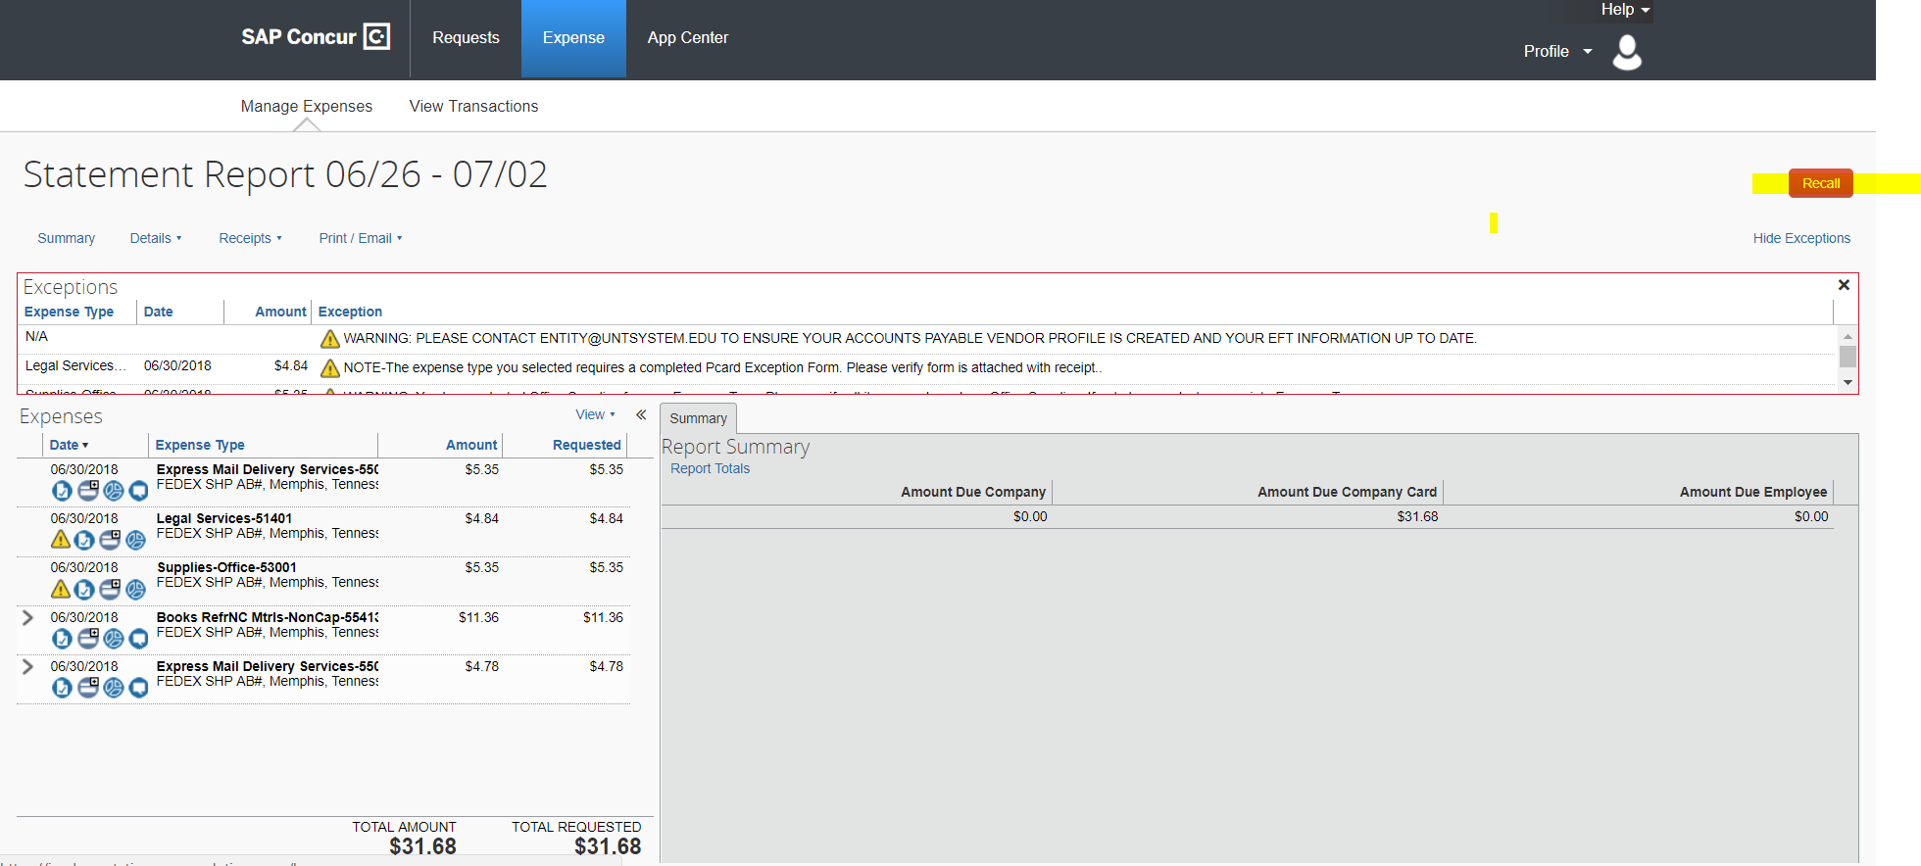
Approval Workflow
Select Recall to edit report and make appropriate changes.
58

Slide 56
PCard Approval Workflow
PCard
Holder
Approver
(Reconciler)
Dept. ID Holder
or
Project Holder
Grants
or
CRO
PCard Team
Processor
59

Slide 57
Concur - Important Dates
Cardholder Training – September 18 to October 4, 2018
Concur go-live and available for Expenditure Reconciliation - October 4, 2018
Complete Reconciling Transaction for October Statement by October 10, 2018
  Transactional Dates: September 4 to October 3, 2018
Citibank GCMS Access will be available until October 30, 2018
60

Slide 58
Concur PCard Contacts
Concur User Support Desk (Questions regarding Concur System)
  Phone
PCard Administrative Team
  Phone 940.369.5500 X 5
  Email pcard@untsystem.edu
61

