Slide 1
FIRST FRIDAY’S 11/02/2018 CONCUR PCARD FAQ’S
1

Slide 2
CONCUR PCARD FAQ’S
Concur Pcard Statement Report Name
Do not modify or change the name of the Statement Report assigned by Concur system.
2. Delegate vs Approver Role Responsibilities
Delegates are individuals acting on behalf of a named list of specific users.
Approvers are individuals responsible for chart of accounts (COA) validation.

Slide 3
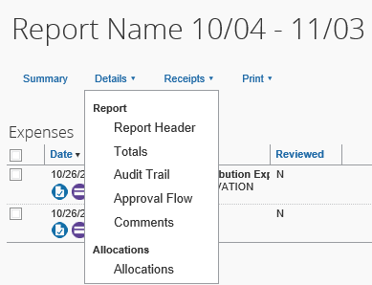
CONCUR PCARD FAQ’S CONTINUED
3. How to view Audit Trail
Report Name Header / Details / Audit Trail
4. How to view Approval Workflow
Report Name Header / Details / Approval Flow
5. How to view Expense Allocations
Report Name Header / Details / Allocations

Slide 4
CONCUR PCARD FAQ’S CONTINUED
6. Vendor Level 3 data imported from vendor into Concur PCard
Statement.
Some vendors will send in level 3 data (itemization) and Concur tries to itemize the transaction for you.
Please review expenses to ensure itemization is correct.
If incorrect, the itemization can be deleted and a corrected one entered.
*Be careful not to delete the Expense line itself off the Statement Report.

Slide 5
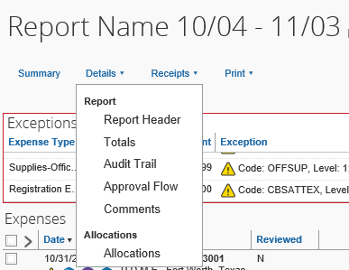
CONCUR PCARD FAQ’S CONTINUED
Statement Report Comments
Report Name Header / Details / Comment
All Comments associated with Statement
can be viewed
on the
“Clipboard”

Slide 6
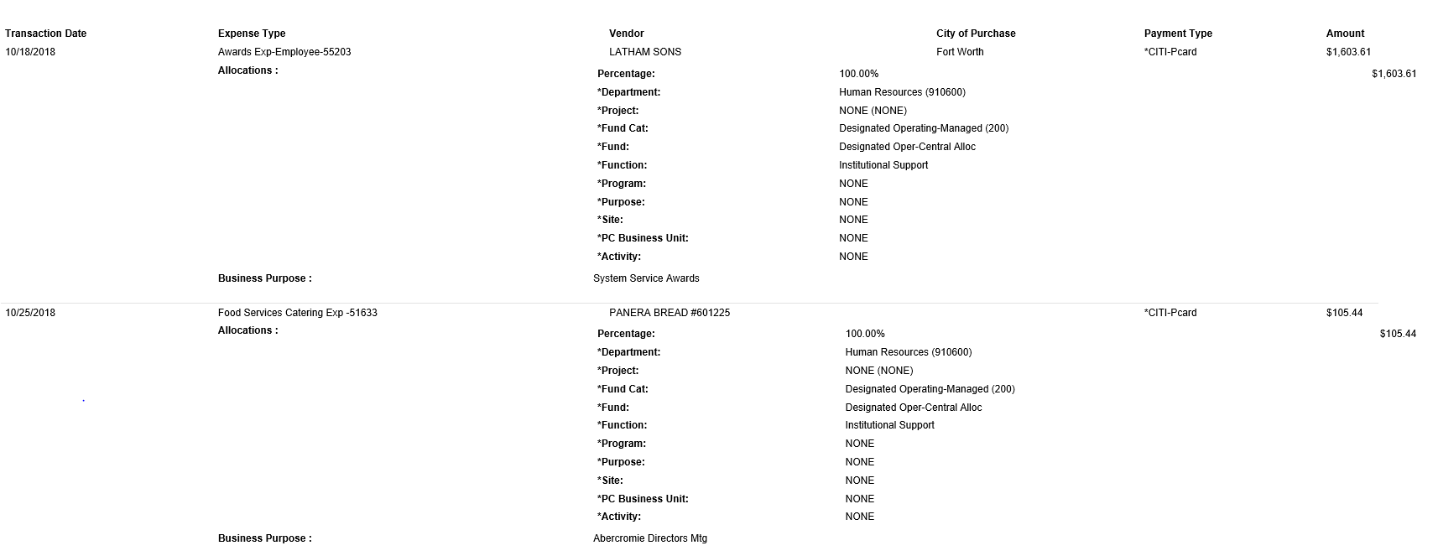
CONCUR PCARD FAQ’S CONTINUED
View Detail Pcard Statement Report by Expense Line
Report Name Header / Print / UNTS-Report-Allocation

Slide 7
CONCUR PCARD FAQ’S CONTINUED
Email Notifications
Concur Email Notifications are system generated and are triggered when action is taken against the Pcard Statement Report.
Approval Workflow
Concur receives data from our HR System nightly which contains the same Approval workflow currently in EIS. The workflow for Departmental Approvers, Project and Grant Approvers (with the exception of the “Reconciler” Role has been automated for the users.

Slide 8
Concur PCard Contacts
Concur User Support Desk (Questions regarding Concur System)
1-866-793-4040
PCard Administrative Team
Phone 940.369.5500 X 5
Email pcard@untsystem.edu
61

